Slide 1
CompTIA IT Fundamentals
Study Guide (FC0-U61)
Chapter 9:
Security Concepts and Threats

Slide 2
Chapter 9: Security Concepts and Threats
Explain the value of data and information
  Data and information as assets
  Importance of investing in security
  Relationship of data to creating information
  Intellectual property
    Trademarks
    Copyright
    Patents
  Digital products
  Data-driven business decisions
    Data capture and collection
    Data correlation
    Meaningful reporting
Summarize confidentiality, integrity, and availability concerns
  Confidentiality concerns
    Snooping
    Eavesdropping
    Wiretapping
    Social engineering
    Dumpster diving
  Integrity concerns
    Man-in-the-middle
    Replay attack
    Impersonation
    Unauthorized information alteration
  Availability concerns
    Denial of service
    Power outage
    Hardware failure
    Destruction
    Service outage

Slide 3
Chapter 9: Security Concepts and Threats (con’t.)
Compare and contrast authentication, authorization, accounting, and non-repudiation concepts
  Authentication
    Single factor
    Multifactor
    Examples of factors
      Password
      PIN
      One-time password
      Software token
      Hardware token
      Biometrics
      Specific location
      Security questions
    Single sign-on
  Authorization
    Permissions
    Least privilege model
    Role-based user access
      User account types
    Rule-based user access
    Mandatory access controls
    Discretionary access controls
  Accounting
    Logs
    Tracking
    Web browser history
  Non-repudiation
    Video
    Biometrics
    Signature
    Receipt

Slide 4
Understanding Hackers and Motives
Stealing passwords or personal information
Gaining remote access to a server or an operating system
Logging in locally and stealing data
Changing a website’s content
Gaining access to the contents of a database (perhaps one that contains passwords or credit card information)
Surreptitiously analyzing network traffic
Installing software designed to cause harm or steal data
Creating a condition in which a computer or network no longer works well
Modifying existing software so that it no longer performs as it should or so that it secretly does harmful things in addition to its usual activity

Slide 5
The Value of Data
Data as a driver of business decisions
Intellectual property
  Trademarks
  Copyright
  Patents
Digital products

Slide 6
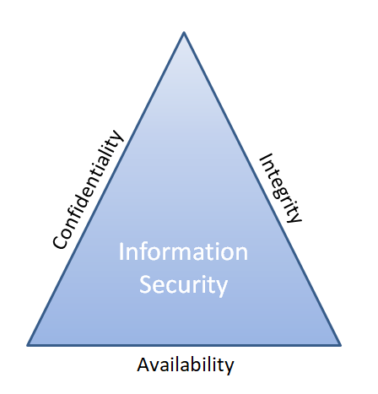
Understanding Security Threats
CIA triad

Slide 7
Confidentiality Concerns
Snooping
Eavesdropping
Wiretapping
Social Engineering
  Phishing
  Shoulder surfing
Dumpster diving

Slide 8
Integrity Concerns
Man-in-the-middle attack
Replay attack
Impersonation
Unauthorized information alteration

Slide 9
Availability Concerns
Denying service
Hardware concerns
  Hardware damage
  Hardware theft

Slide 10
Software-Based Security Threats
OS and Application Exploits
Viruses
Worms
Trojan horses
Adware
Spyware
Ransomware
Rootkits
Backdoors
Spam
Password cracking

Slide 11
Understanding Access Control
Triple A:
  Authentication
  Authorization
  Accounting
  (and non-repudiation)

Slide 12
Authentication
Validates identity
Types of authentication
  Single-factor
  Multifactor
  One-time password
  Smart card or security token
  Location-specific
  Biometrics
Single sign-on (SSO)

Slide 13
Authorization
Determines what users can do
Mandatory access control
Discretionary access control
Role-based access control
Rule-based access control

Slide 14
Accounting
Records who does what
OS and application logs
Web browser history

