Slide 1
CompTIA Network+ Certification
5.3 Installing Wireless Networks

Slide 2
Distinguish between different IEEE 802.11 Wi-Fi standards and topologies
Perform a site survey and understand issues impacting on site design
Troubleshoot wireless connectivity, configuration, and security issues
Notes:
The number in the bottom right corner of the slides refers back to the page where this topic starts in the course book.

Slide 3
Wireless Standards (IEEE 802.11)
IEEE 801.11 “Wi-Fi”
Radio carrier signals
Modulation schemes
Carrier schemes

Slide 4
CSMA/CA
Wi-Fi is like shared Ethernet but with collision avoidance media access
Acknowledgement of frames
Virtual Carrier Sense
Request-to-Send (RTS)/Clear-to-Send (CTS)

Slide 5
Frequency Bands
2.4 GHz
  Better propagation and indoor range
  Limited number of channels
  Used by many technologies so more interference
5 GHz
  Lacks penetrating power and range
  Supports more channels
  Less interference and congestion

Slide 6
IEEE 802.11a
Ratified 1999
5 GHz frequency band
23 non-overlapping 20 MHz wide channels available
Orthogonal Frequency Division Multiplexing (OFDM) carrier scheme
Up to 54 Mbps
“Goodput” often much lower

Slide 7
IEEE 802.11b/g
802.11b also ratified 1999
  2.4 GHz frequency band
  Up to 11 Mbps
  11 channels in North America (but only 3 non-overlapping available)
  Direct Sequence Spread Spectrum (DSSS) carrier scheme (same as original 802.11 standard) plus Complementary Code Keying (CCK) modulation
802.11g offered 54 Mbps upgrade path for 2.4 GHz with backwards compatibility for 802.11b

Slide 8
IEEE 802.11n
Ratified 2009
Can use both 2.4 GHz and 5 GHz frequency bands
Multiple-Input-Multiple-Output (MIMO)
  AxB:C (A=transmit; B=receive, C=simultaneous streams)
Can use bonded (40 MHz) channels
Up to 150 Mbps per stream over 40 MHz channel
Longer range (almost double previous standards)
Compatibility modes
  High Throughput (HT or “greenfield”)
  HT mixed mode (802.11a-ht, 802.11b-ht, 802.11g-ht)
  Non-HT

Slide 9
IEEE 802.11ac
5 GHz frequency band only
Data rates similar to Gigabit Ethernet
  4x4:4 with 80 MHz channels means 1.7 Gbps nominal data rate
Wider (80 or 160 MHz) channels
Up to 8 spatial streams (in theory)
  4x4:8 with 160 MHz channels would give about 6.93 Gbps (nominal)

Slide 10
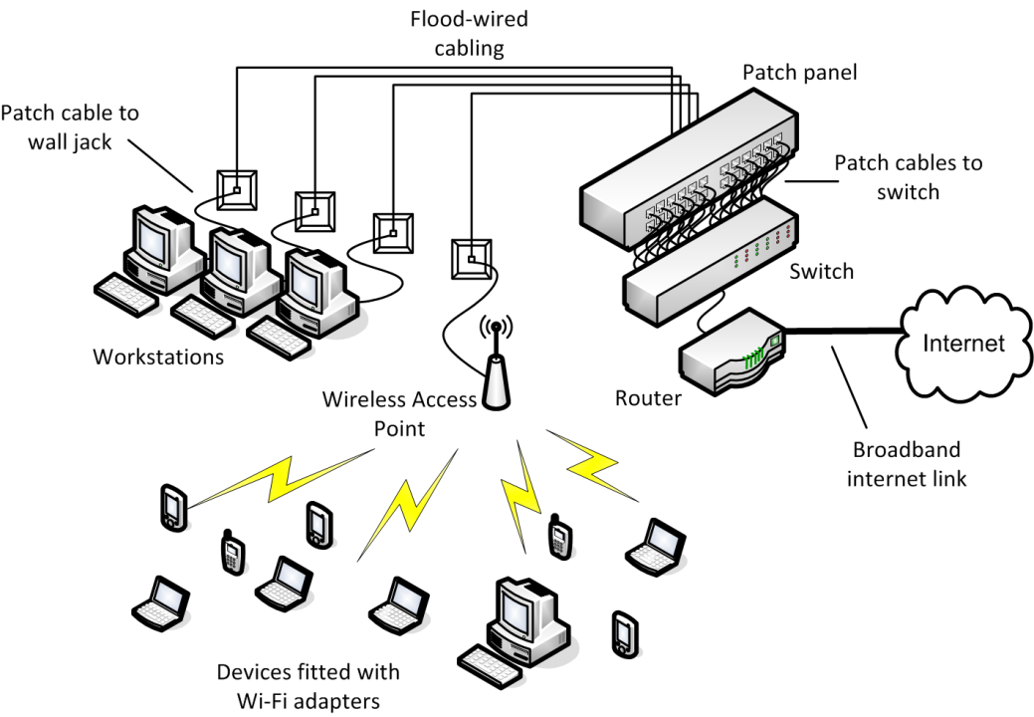
Wireless Network Topologies
Ad hoc - “Peer-to-Peer” or “Independent Basic Service Set”
Infrastructure
  Stations connect via base stations (access points [AP])
  An AP plus attached stations is a Basic Service Set (BSS)
  The MAC address of the AP is the BSSID
  Each WLAN has a Service Set Identifier (SSID) or network name
  Multiple BSSs with the same SSID form an Extended Service Set (ESS)
Mesh - self-forming network with path discovery and routing

Slide 11
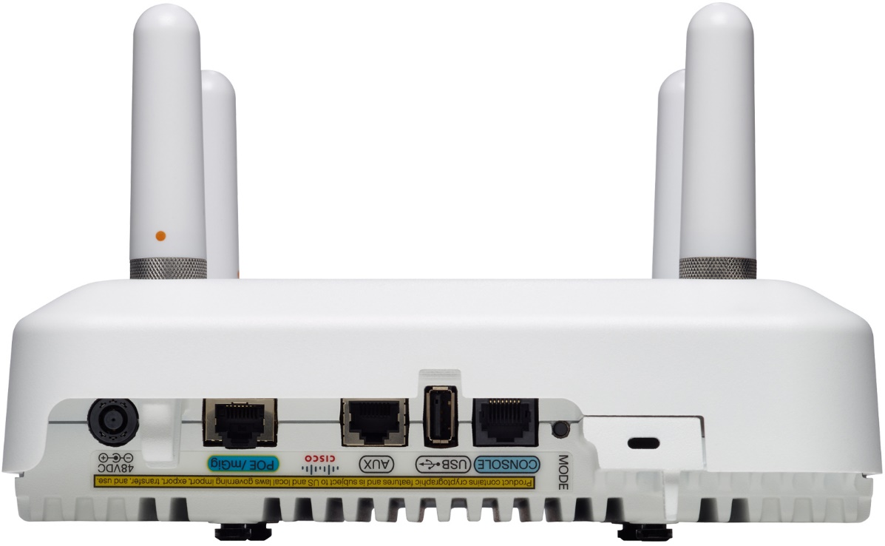
Wireless Site Design
SSID broadcast
Beacon frame
Speed and distance requirements
  Dynamic Rate Shifting reduces data rate to maintain connection with weak signal
  Interference factors
Image © and Courtesy of Cisco Systems, Inc. Unauthorized use not permitted

Slide 12
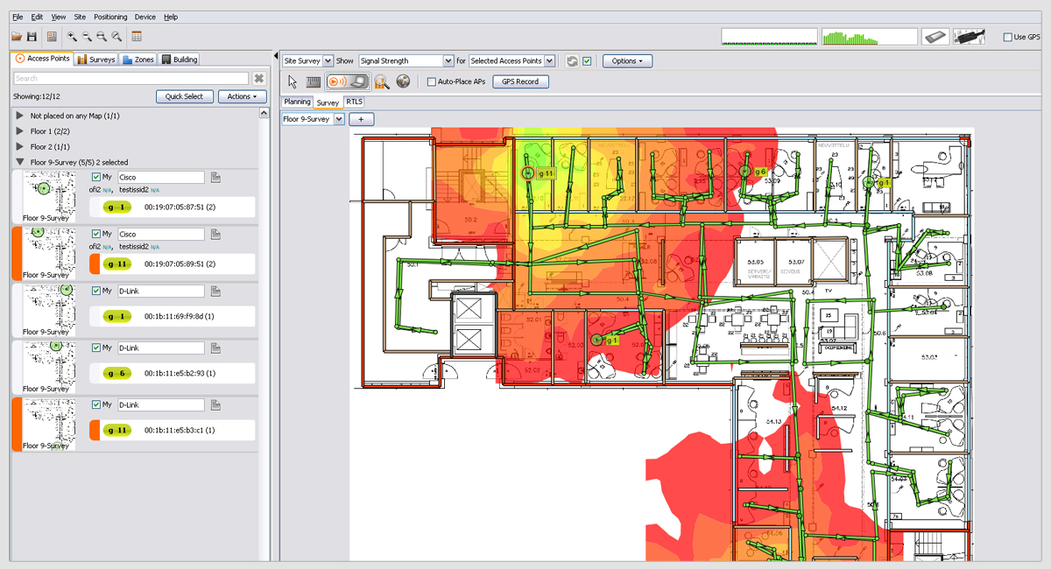
Site Surveys and Heat Maps
Inspect floorplan and rooms to identify obstructions
Plan cells to provide good coverage of the area
  Device density
  Bandwidth per device (uplink/downlink)
Use wireless survey tools to identify signal strength (heat map)
Roaming (Distribution System)
Image © Ekahau Inc. (ekahau.com)

Slide 13
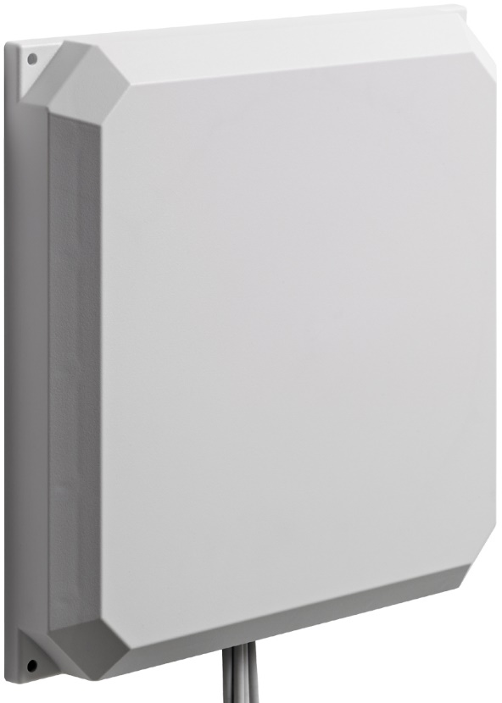
Antenna Types
Omnidirectional (same signal in all directions)
Unidirectional - signal can be focused in one direction (gain)
  High gain omnidirectional
  Yagi
  Parabolic
MU-MIMO (Multiuser-MIMO)
  Beamforming
  Send a signal more strongly on a particular axis
  Primitive sort of switching
Wireless range extenders
Image © and Courtesy of Cisco Systems, Inc. Unauthorized use not permitted

Slide 14
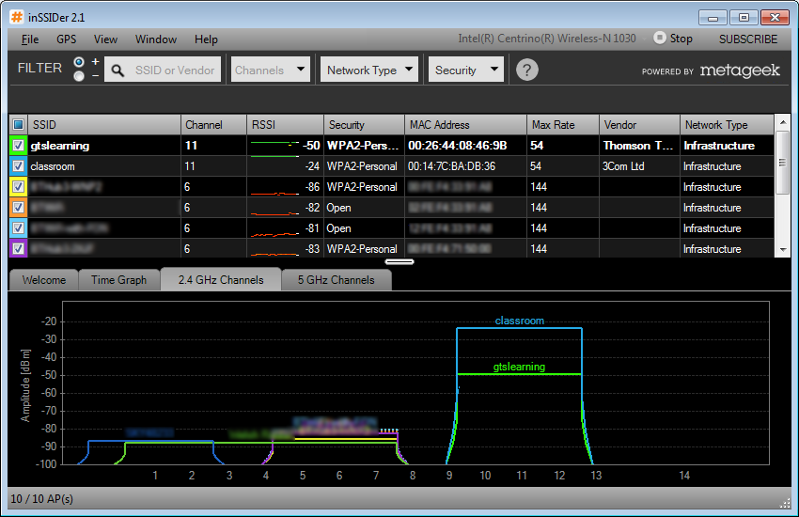
Troubleshooting Wireless Links
Attenuation
  Received Signal Strength Indicator (RSSI) – index value
  Measured signal strength (dbM)
  Signal-to-Noise Ratio (SNR)
Wi-Fi Analyzers

Slide 15
Troubleshooting Channel Overlap
Co-Channel Interference (CCI)
Channel layout
  On legacy networks, use non-overlapping channels (e.g. 1, 6, 11) to avoid co-channel interference
  With modern access points, use frequency bands to support legacy clients (e.g. 2.4 GHz for 802.11b/g/n and 5 GHz for 802.11ac)
Setting power levels

Slide 16
Troubleshooting Interference
Reflection/bounce
Refraction
Absorption/environmental factors
ElectroMagnetic Interference (EMI)
Latency and jitter

Slide 17
Antenna Placement and Overcapacity
Using wrong antenna type (unidirectional or omnidirectional)
Optimize placement to avoid interference (e.g. ceiling-mounted)s
Device/bandwidth/channel saturation
SOHO wireless routers versus enterprise WLANs

Slide 18
Troubleshooting Frequency Mismatch
Frequency bands and compatibility (2.4 GHz versus 5 GHz)
Throughput and compatibility mode issues
Channel usage and support

Slide 19
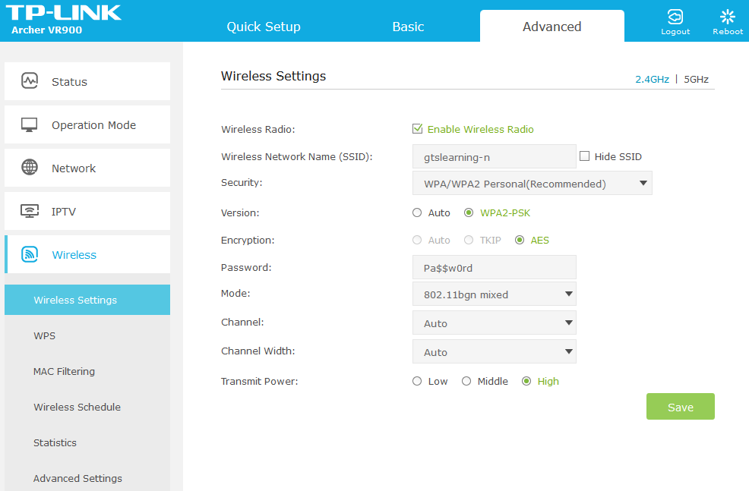
Wireless Security
War driving
Wired Equivalent Privacy (WEP)
  Not secure enough to use anymore
Wi-Fi Protected Access (WPA)
  WPA1: RC4 with Temporal Key Integrity Protocol (TKIP)
  WPA2: AES (Advanced Encryption Standard) with Counter Mode with Cipher Block Chaining Message Authentication Code Protocol (CCMP)

Slide 20
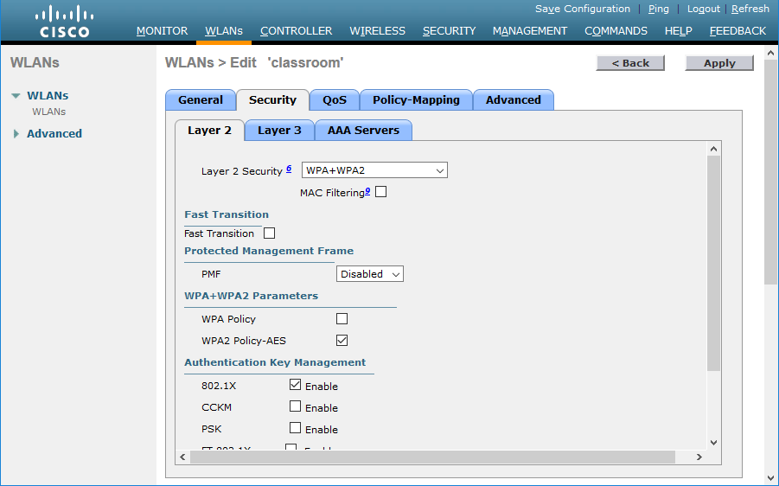
Wi-Fi Authentication
Pre-shared key (group authentication)
  WEP/WPA-Personal
802.1X/WPA Enterprise
  Strong authentication (multifactor)
  Network directory authorization
Open authentication

Slide 21
MAC Filtering and Geofencing
MAC filtering
  Keep an ACL (Access Control List) of MAC addresses permitted to join WLAN
  Allow access point to learn valid MAC addresses
Geofencing
  Use location services to define ACLs and access policies

Slide 22
Extensible Authentication Protocol (EAP)
Designed to provide for interoperable security devices and software
Supplicant – client device requesting authentication
Authenticator – device receiving authentication request
Authentication Server – performs authentication

Slide 23
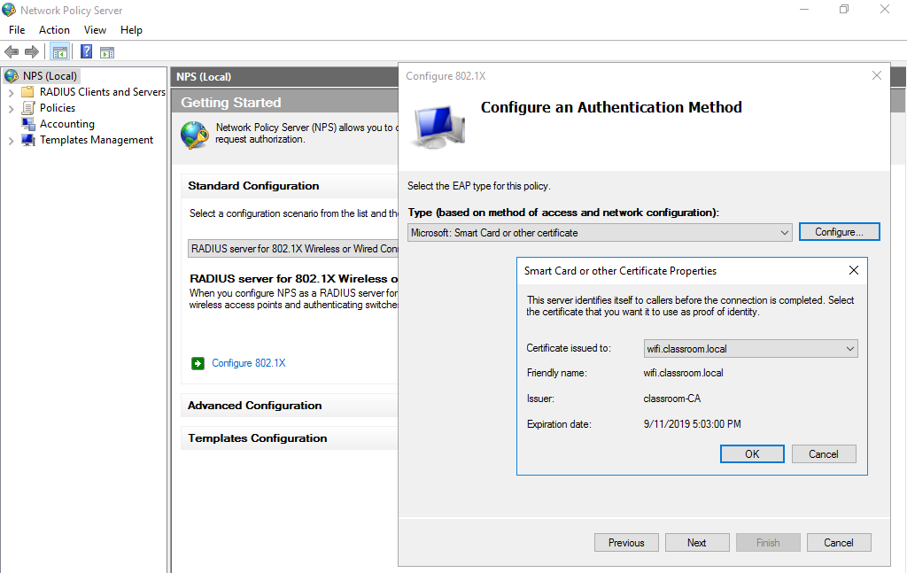
EAP Types
EAP-TLS (Transport Layer Security)
Protected EAP (PEAP)
EAP-TTLS (Tunneled Transport Layer Security)
Lightweight EAP (LEAP)
Flexible Authentication via Secure Tunneling (EAP-FAST)
Used with permission from Microsoft

Slide 24
Troubleshooting Wireless Security (1)
Wrong SSID
  Authentication issues
  Open networks
Security type mismatch/wireless standard issues
  Verify client support for settings configured on AP

Slide 25
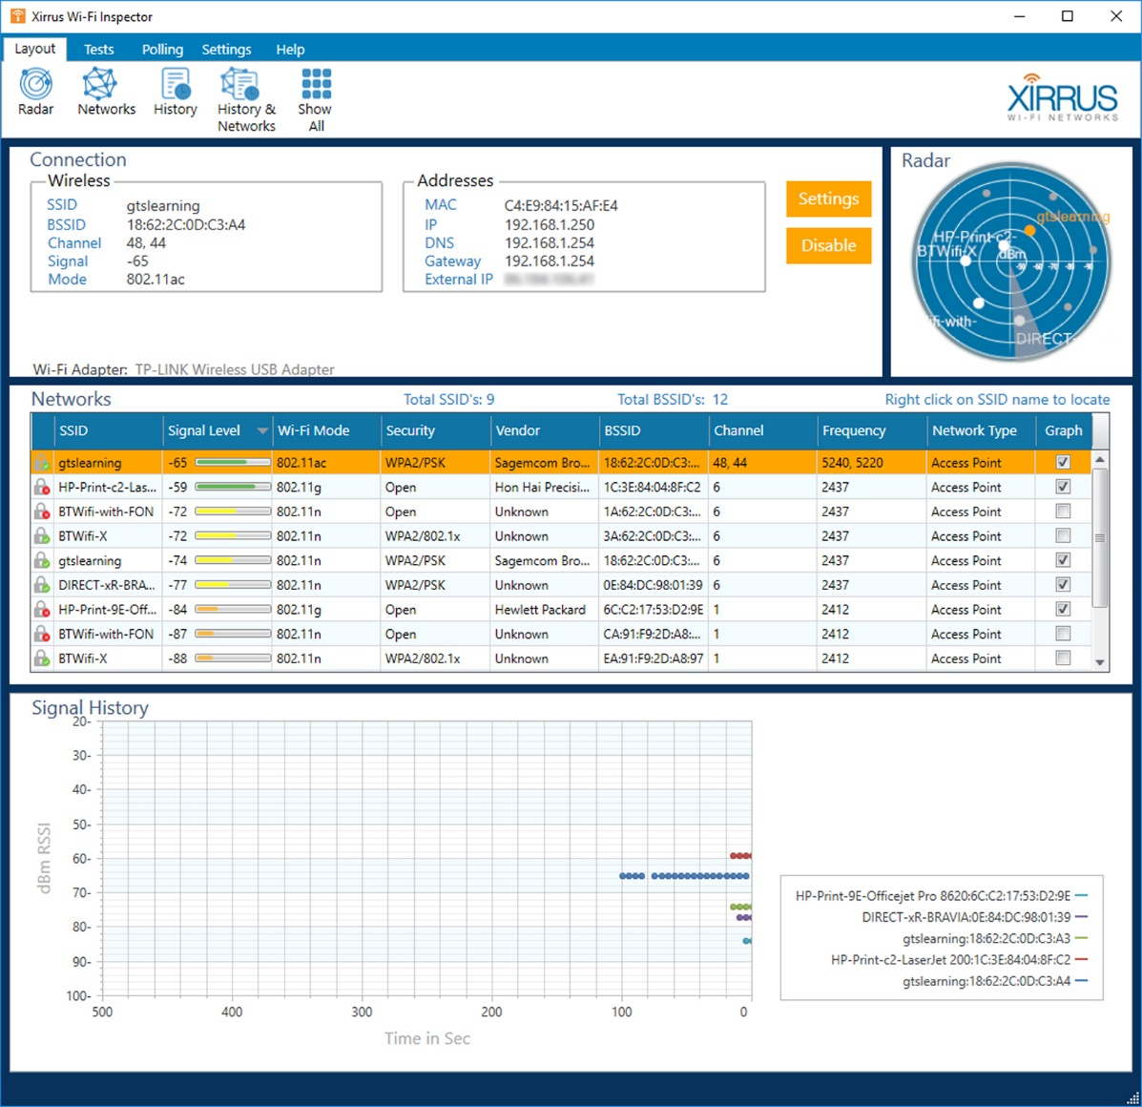
Troubleshooting Wireless Security (2)
Perform surveys to detect rogue wireless networks
Evil twin/rogue AP
Deauthentication/disassociation attack

Slide 26
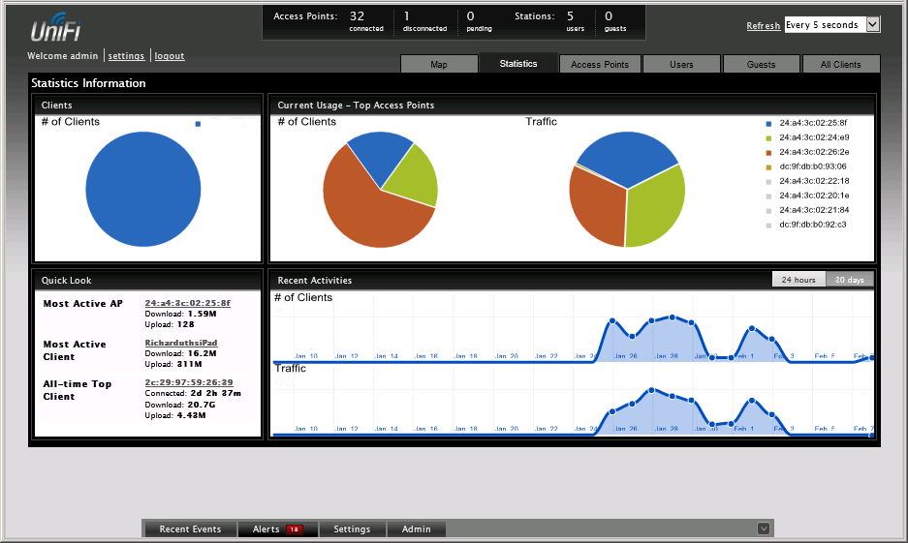
Wireless Controllers
Manage tens or hundreds of access points
Appliance or software solution
Access point governed by controller is “thin” or “lightweight”
Lightweight Access Point Protocol (LWAPP)
VLAN pooling
Power over Ethernet

Slide 27
Wi-Fi includes specifications for transmission using a various radio modulation techniques and frequencies, supporting different speeds and range.
WLANs can be configured in point-to-point (ad hoc), infrastructure (access point), or mesh topologies.
A site survey determines the optimum positioning and tuning of access points and antennas.
Learn the symptoms and causes of common wireless connectivity and configuration issues.
Wireless security should be enforced by enabling WPA. WEP should only be used if there is no other choice.
EAP/802.1X can be used to authenticate users over remote and wireless networks.
Notes:
What mechanism does RTS/CTS support? Collision avoidance (CSMA/CA). Rather than try to detect collisions, a wireless station indicates its intent to transmit by broadcasting a Request To Send (RTS) and waits to receive a Clear To Send (CTS) before proceeding.
Which IEEE WLAN standards specify a data transfer rate of up to 54 Mbps? 802.11a and 802.11g.
What options may be available for an 802.11n network that are not supported under 802.11g? Channel bonding, Multiple-Input-Multiple-Output (MIMO), and use of either 2.4 GHz or 5 GHz frequency bands.
True or false? Stations with 802.11ac capable adapters should be assigned to the 5 GHz frequency band. True - 802.11ac is designed to work only in the 5 GHz frequency band with the 2.4 GHz band used for legacy clients.
What is a BSSID? The MAC address of an access point (or a random address in the case of ad hoc WLANs).
What are the advantages of deploying a wireless mesh topology over an ad hoc one? Stations in a Wireless Mesh Network are capable of discovering one another, forming peering arrangements, and performing path discovery and forwarding between peers (routing).
True or false? Suppressing transmission of the WLAN beacon improves security. False - the beacon cannot be suppressed completely. Increasing the broadcast interval reduces network overhead but increases the time required to find and connect to the network.
What constraints should you consider when planning the placement of an access point? Range, interference and obstructions, number of clients (device density and bandwidth requirements), and access to a network port and power supply.
What is beamforming? Beamforming or Multiuser MIMO (MU-MIMO) is a means of performing primitive switching with an access point. The AP can send a signal more strongly to clients positioned along different axes.
Which frequency band is less likely to suffer from co-channel interference? The 5 GHz band.
What is a heat map? A site survey plotting the strength of wireless signals in different parts of a building.
Widget Corporation has provided wireless access for its employees using several access points located in different parts of the building. Employees connect to the network using 802.11g-compatible network cards. On Thursday afternoon, several users report that they cannot log on to the network. What troubleshooting step would you take first? Check whether the problem machines are trying to utilize the same access point.
Your office block is hosting a conference event. During the morning coffee break, several guests report that they cannot access their webmail. What is the likely cause? Device saturation - the access point is likely to be experiencing greater load than usual and cannot cope with the volume of requests.
What is the main difference between WPA and WPA2? WPA2 supports a stronger encryption algorithm, based on AES.
Why might an attacker launch a jamming attack against a wireless access point? This could be a simple Denial of Service (DoS) attack but the attacker could also be attempting to use an evil twin/rogue AP to intercept network traffic.
What type of access point is designed to work with a wireless controller? A Lightweight or Thin access point (or one working in thin mode).

