Slide 1
CompTIA Network+ Certification
5.2 Installing Cabled Networks

Slide 2
Understand the use of wiring standards when selecting cable for different applications
Describe the types and properties of different cables and connectors (Twisted Pair, Coax, Fiber Optic, Serial)
Understand the use of transceivers and media converters
Identify appropriate tools for network hardware installation and testing
Notes:
The number in the bottom right corner of the slides refers back to the page where this topic starts in the course book.

Slide 3
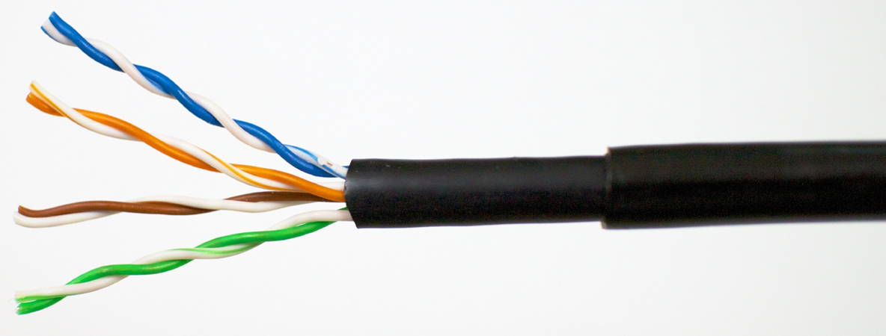
Twisted Pair Cable
Copper cable type where each pair of wires is twisted to reduce interference (crosstalk)
Unshielded Twisted Pair (UTP)
Shielded Twisted Pair (STP)
  Shielding (around each pair) and/or screening (around all pairs) reduces interference
  “STP” was used in old Token Ring networks but is also a generic term for any type of screening/shielding
  Modern foil screened is ScTP or F/UTP or FTP
  Modern screened and shielded cable is S/FTP
Image by Thuansak Srilao © 123rf.com

Slide 4
Copper Cable Standards

Slide 5
Plenum versus Non-plenum Cable
Plenum space for heating and air conditioning
Special fire safety requirements for electrical cable laid in plenum spaces
Plenum-safe cable marked CMP or MMP
Non-plenum cable marked CMG/MMG or CM/MP
Riser cable (CMR/MPR) used in lift shafts etc

Slide 6
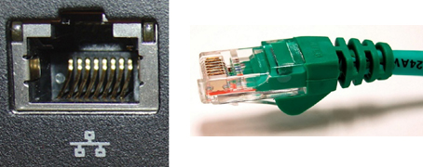
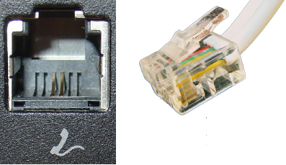
Twisted Pair Connectors
Registered Jack (RJ) or nPosition-nContact (nPnC)
RJ-45 or 8P8C (Ethernet)
RJ-48C (ISDN/T1)
RJ-11 or 6P2C (Phone/Modem)

Slide 7
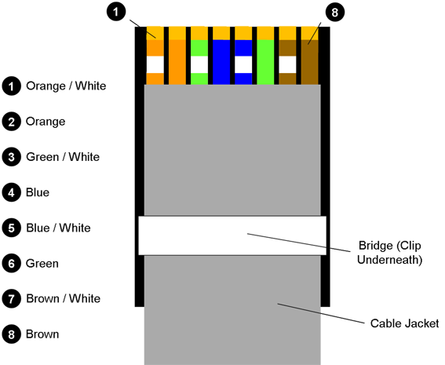
Copper Termination Standards
Straight-through
  T568A/T568B
Crossover
  TX/RX reverse
  Auto-MDI/MDI-X (Medium Dependent Interface)

Slide 8
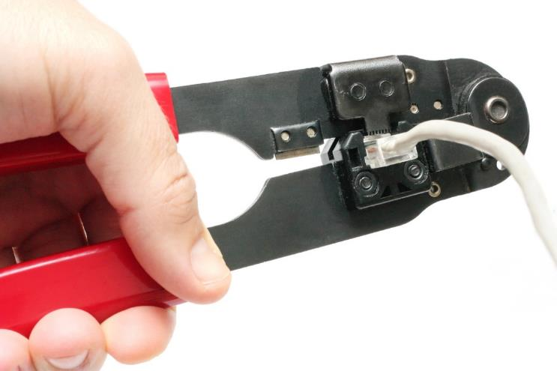
Wiring Tools and Techniques
Pulling cable
Fixed (permanent) cable versus patch cords
Wire stripping/cutting
Termination Tools
  Punch-down
    Terminate cable to Insulation Displacement Connector (IDC)
    Formats (66, 110, Krone)
  Cable crimpers
    Attach jack (e.g. RJ-45) to patch cord
    Avoid excessive untwisting
Image by Georgios Alexandris © fotolia.com

Slide 9
Cable Testing Tools (1)
Loopback adapter
Multimeter/wire map tester
  Continuity
  Shorts
  Incorrect termination
    Reversed pair
    Crossed pair
  Split pair

Slide 10
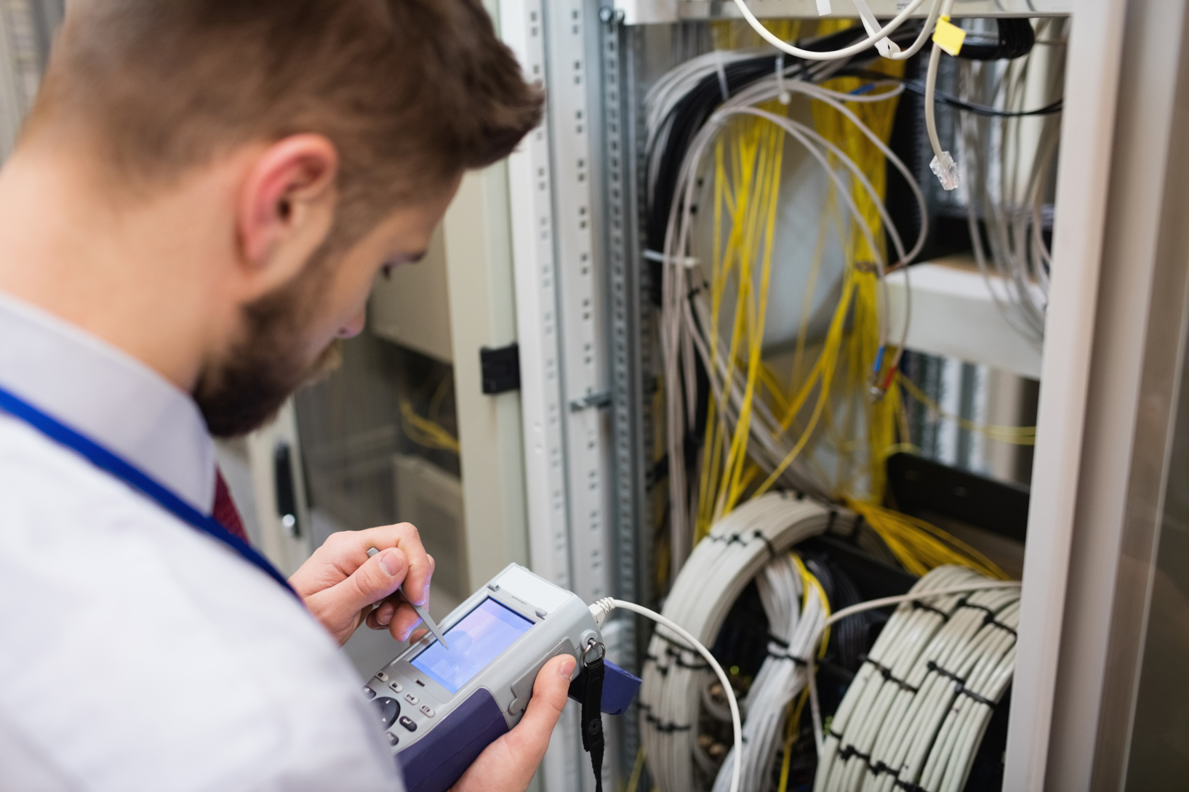
Cable Testing Tools (2)
Tone generator and probe - cable tracing
Time Domain Reflectometer - isolate position of fault
Cable certifier - measure installed cable against defined standard
Image by Wavebreak Media © 123rf.com

Slide 11
Troubleshooting Wired Connectivity
Link LEDs
  Solid green - the link is connected but there is no traffic
  Flickering green - the link is operating normally
  No light - the link is not working or disconnected at the other end
  Blinking amber - some kind of fault has been detected
  Solid amber - the port is disabled
Troubleshooting cables and ports
  Inspect for damage (bent pins, cable kink)
  Verify cable type (inspect jacket)
  Substitute with “known good”
  Use loopback plug to test for bad ports

Slide 12
Troubleshooting Distance Limitations
Attenuation/insertion loss
Ratio of received voltage to source voltage in deciBels (dB)
Standards allow for certain levels of insertion loss
Margin between measured loss and standard

Slide 13
Troubleshooting Interference
Crosstalk
  Often bad wiring or termination
  Near end
  Far end
ElectroMagnetic Interference (EMI)
  Sources
  Alien crosstalk

Slide 14
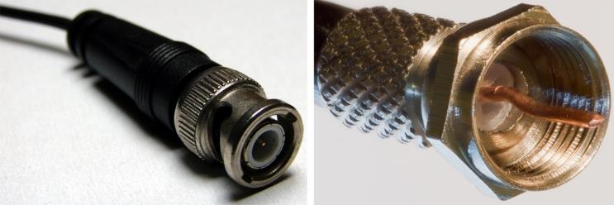
Coaxial Cable and Connectors
Radio Grade (RG) “standards”
  RG-6 for modern Cable Access TV (CATV)/cable modems
  RG-59 for older CATV installs and Closed Circuit TV (CCTV)
Connectors
  BNC (Bayonet-Neill-Concelman)
  F-type
  BNC coupler
Image by Krzysztof Burghardt CCAS 3.0
Image by Colin CCAS 3.0

Slide 15
Serial Cable and Connectors
Serial interface
  DTE (Data Terminal Equipment)
  DCE (Data Circuit-terminating Equipment)
  Straight-through versus null modem cable
RS-232 standard
DB-25 or (on PCs) DB-9 connector
WAN serial links

Slide 16
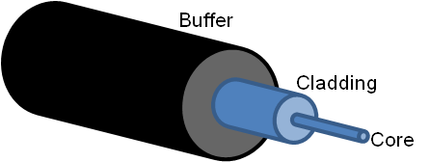
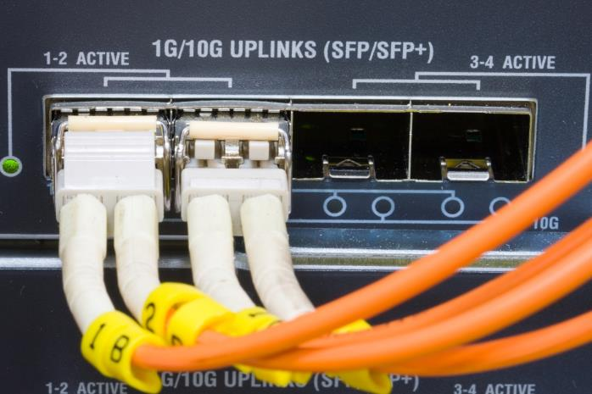
Fiber Optic Cable
Low attenuation, high bandwidth
Construction
  Core
  Cladding
  Buffer
  Jacket
Image by panomacc © fotolia.com

Slide 17
Categories of Fiber Cable
Single Mode Fiber (SMF)
  Expensive optics (long wavelength)
  Used for long-range applications
Multimode Fiber (MMF)
  Cheaper optics (shorter wavelength)
  Shorter range
  Optical Mode (OM) cable categories

Slide 18
Installation and Testing
Topologies – point-to-point, star, or ring
Optical repeaters
Jacket color coding
Duplex pairs for Tx and Rx
Ferrules and finishing types
  Physical Contact (PC)
  Ultra Physical Contact (UPC)
  Angled Physical Contact (APC)
Distance limitations
  dB loss
  Optical Source and Optical Power Meter test kit (light meter)
Detect cable breaks – Optical Time Domain Reflectometer (OTDR)

Slide 19
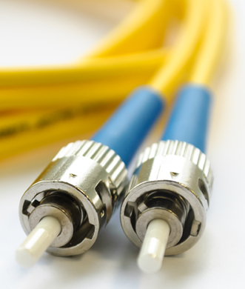
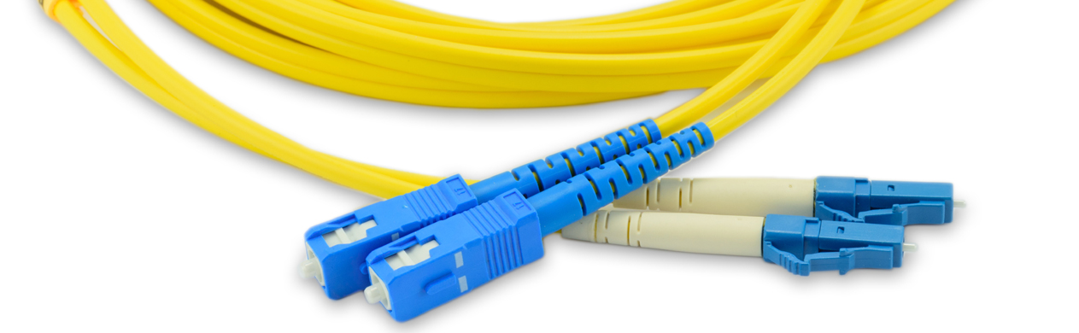
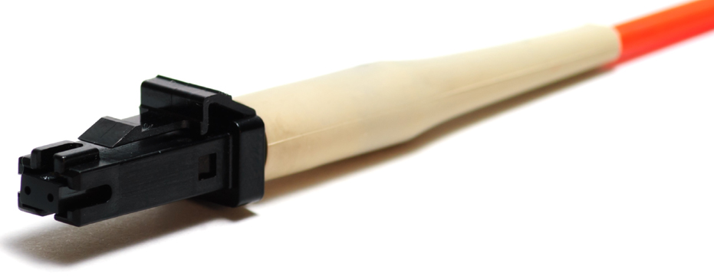
Fiber Optic Connectors
ST (Straight Tip) - push-and-twist locking mechanism
SC (Subscriber Connector) - push/pull design attachment
LC (Lucent or Local Connector) -similar to SC but half the size
Mechanical Transfer Registered Jack (MTRJ) - small form-factor duplex connector with a snap-in design
Image by Aleh Datskevich © 123rf.com
Image by YANAWUT SUNTORNKIJ © 123rf.com
Image by Aleh Datskevich © 123rf.com

Slide 20

Fiber Patch Cords
Connector color coding
Same or different connector type at each end
Link polarity – A to B
Safety issues around lasers
Image by YANAWUT SUNTORNKIJ © 123rf.com

Slide 21
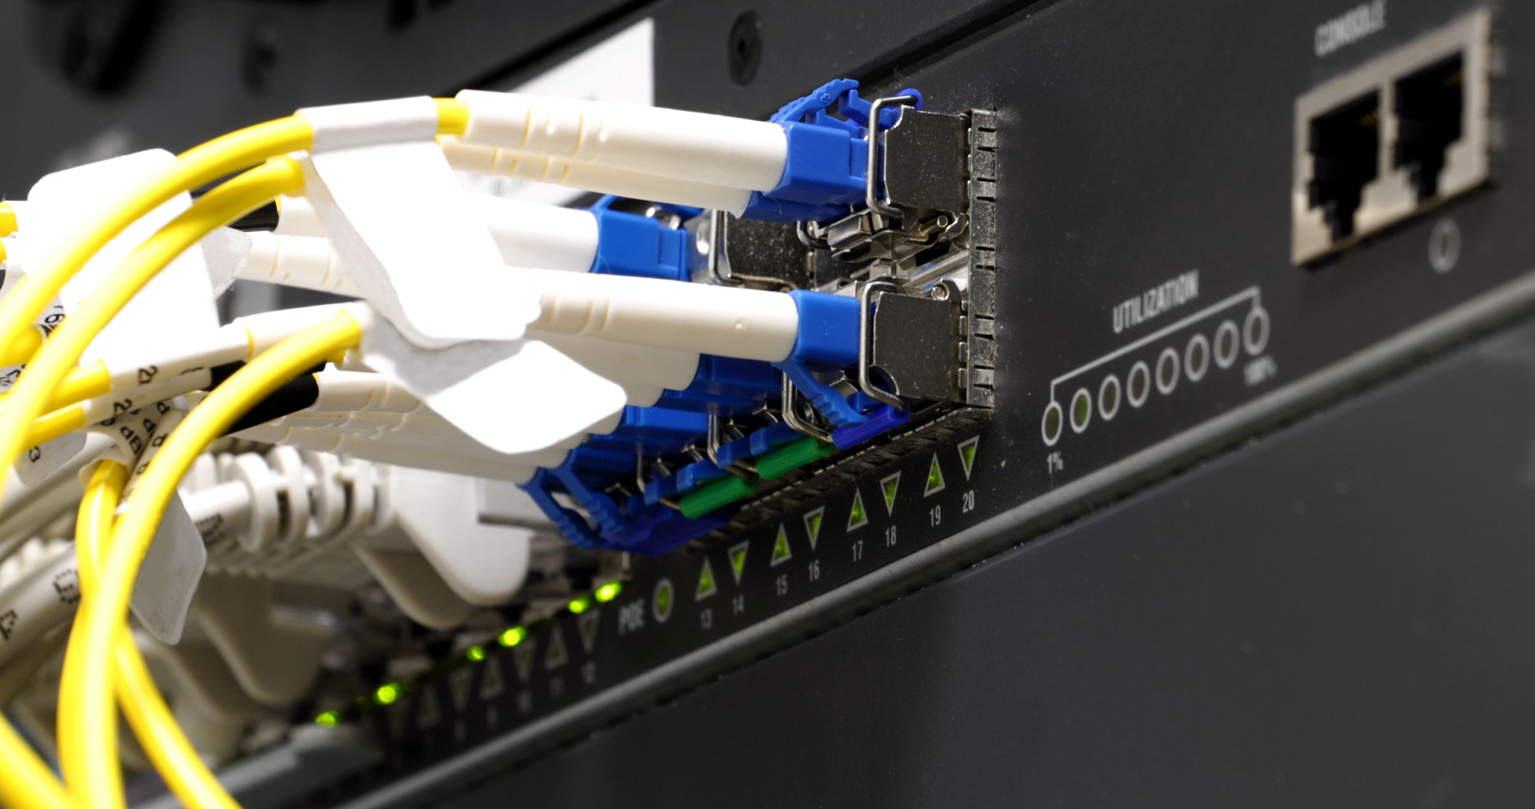
Transceivers
Hot-pluggable transceivers for connecting different media types to enterprise switches
  Gigabit Interface Converter (GBIC)
  Small Form Factor Pluggable (SFP/mini-GBIC) and SFP+
  XFP
  BiDi (BiDirectional) SFP/SFP+
  Quad SFP/SFP+
Troubleshooting transceiver mismatches
Image by Zdenek Maly © 123rf.com

Slide 22
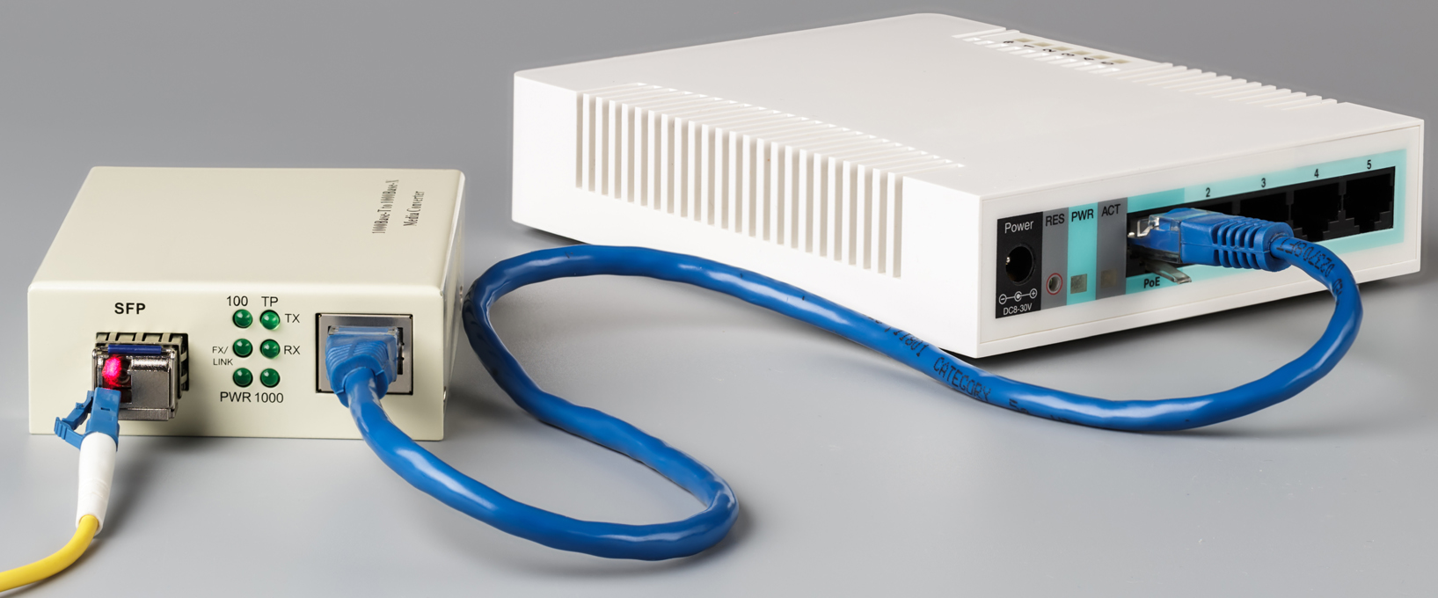
Media Converters
Convert one media type to another
Standalone or rack-mountable units
Usually powered
  Single Mode Fiber to Ethernet
  Multimode Fiber to Ethernet
  Fiber to Coaxial
Usually unpowered
  Single Mode to Multimode Fiber
Image by ironstealth © 123rf.com

Slide 23
Twisted pair with RJ connectors is widely deployed on LANs and is defined by various performance categories. Screened (or shielded) twisted pair gives better noise immunity but is more costly and complex to install.
Devices used to install and test copper cable installations include termination tools, multimeters, toner and probe, TDR, cable certifiers, and protocol analyzers. Learn the symptoms and causes of common cabling issues.
Coax and serial cabling are no longer mainstream networking products but still have specific applications in some circumstances.
Fiber optic cabling supports higher bandwidths and distances but is more costly and complex to install. SMF grade cable is used for long-distance links while MMF is used for LANs. Various types of transceiver are used to interface high bandwidth cabling with switch and router ports.
Media converters work at layer 1 to connect different network media (fiber optic and copper wire for instance).
Notes:
What is the measurement standard for wire thickness? American Wire Gauge (AWG).
What is crosstalk? Signal leakage between adjacent conductors within a single cable or between adjacent cables.
Which categories of unshielded twisted pair cables are certified to carry data transmission faster than 100 Mbps? Cat 5e, Cat 6/6A, and Cat 7.
True or false? "Cat" standards apply only to wiring. False - connectors and interconnects are also rated to cat standards.
Why is plenum-rated cable used when cable is run in an area where building air is circulated? Plenum-rated cable produces minimal amounts of smoke if burned.
100BASE-T transmit pins are 1 and 2. What color-code are the wires terminated to these pins under T568A and T568B? Green/White (pin 1) and Green (pin 2) for T658A or Orange (pin 1)/White and Orange (pin 2) for T568B.
Patch cables are vulnerable to failure because they frequently trail from the PC to the wall socket. What bit of equipment would you use to check that a cable is physically intact? Cable tester.
Which pins are used for the receive pair under 100BASE-T? 3 and 6.
What cabling faults would a wire map tester detect? Opens, shorts, and transpositions (reversed and crossed pairs).
How would you test for excessive attenuation in a network link? Measure the insertion loss in dB using a cable tester.
What is the reason for making power sum crosstalk measurements when testing a link? Power sum crosstalk measures cable performance when all four pairs are used, as Gigabit and 10G Ethernet do.
Which cable type consists of a core made of solid copper surrounded by insulation, a braided metal shielding, and an outer cover? Coax.
What surrounds the core of optical fibers in fiber optic cable? Cladding.
What type of fiber optic cable is suited for long distance links? Single Mode.
What device enables termination of different patch cord types in an appliance such as a switch or router? A transceiver or interface converter such as a GBIC, SFP, SFP+, or QSFP.

