Slide 1
CompTIA Network+ Certification
2.2 IPv4 Addressing

Slide 2
Distinguish unicast, broadcast, and multicast addressing
Understand IP addressing schemes, including address classes, subnetting, classless addressing, CIDR, and VLSM
Identify address ranges for private networks
Configure an IP address scheme for a private network
Notes:
The number in the bottom right corner of the slides refers back to the page where this topic starts in the course book.

Slide 3
Broadcast, Multicast, and Unicast
Unicast (one-to-one)
Broadcast (one-to-all)
  IP address where all host bits are set to 1
  MAC address ff:ff:ff:ff:ff:ff
  Broadcast domain
    For logical network at layer 3
    For local network link at layer 2
    Use Virtual LANs (VLAN) to isolate layer 2 broadcast domains
Multicast (one-to-many or many-to-many)
  Uses special address ranges
  Internet Group Management Protocol (IGMP)

Slide 4
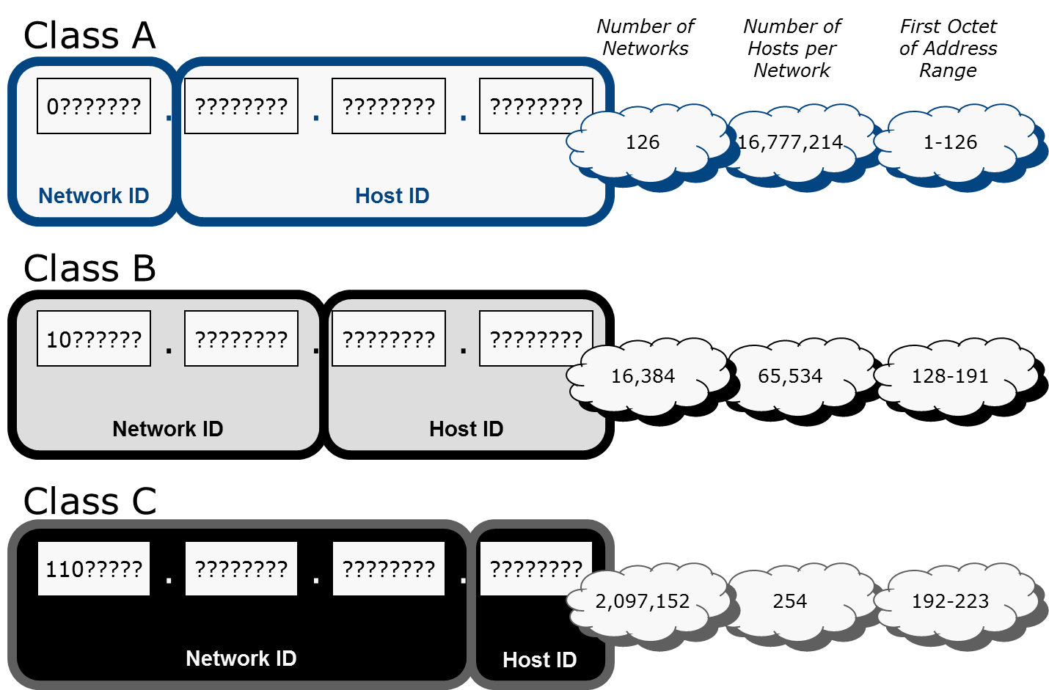
Classful Addressing

Slide 5
Class D and Class E Addresses
Class D
  Multicast addresses
  224.0.0.0 through 239.255.255.255
Class E
  Experimental/reserved
  240.0.0.0 through 255.255.255.255

Slide 6
Private Addressing
Address ranges not routable over the Internet
  10.0.0.0 to 10.255.255.255
  172.16.0.0 to 172.31.255.255
  192.168.0.0 to 192.168.255.255
Hosts on the private network must use some mechanism to access the Internet
  Network Address Translation (NAT)
  Proxy

Slide 7
Loopback Addresses
Address range 127.0.0.0 – 127.255.255.255 (127.0.0.0/8) reserved for loopback
Loopback means packet is sent and received on the local TCP/IP stack only (not transmitted over network)
Host loopback IP is usually 127.0.0.1
Multiple loopback addresses can be configured and use an valid host IP address

Slide 8
Other Reserved Ranges
0.0.0.0/8 - used when a specific address is unknown
255.255.255.255 - used to broadcast to the local network when the local network address is not known
169.254.0.0 to 169.254.255.255 - used by hosts for link-local autoconfiguration/Automatic Private IP Addressing (APIPA)
100.64.0.0/10, 192.0.0.0/24, 192.88.99.0/24, 198.18.0.0/15 - set aside for a variety of special purposes
192.0.2.0/24, 198.51.100.0/24, 203.0.113.0/24 - set aside for use in documentation and examples

Slide 9
Subnet Design
Split up broadcast domains
  Reduce broadcast traffic to improve performance
  Implement VLANs at layer 2
  Map each VLAN to a logical subnet ID
Identify physically distinct networks as logically separate
  Join segments with different topologies (Ethernet and Token Ring)
  Map each segment to separate logical subnet IDs
  Assign subnet ID to each WAN link
Create logically distinct zones for security and administration

Slide 10
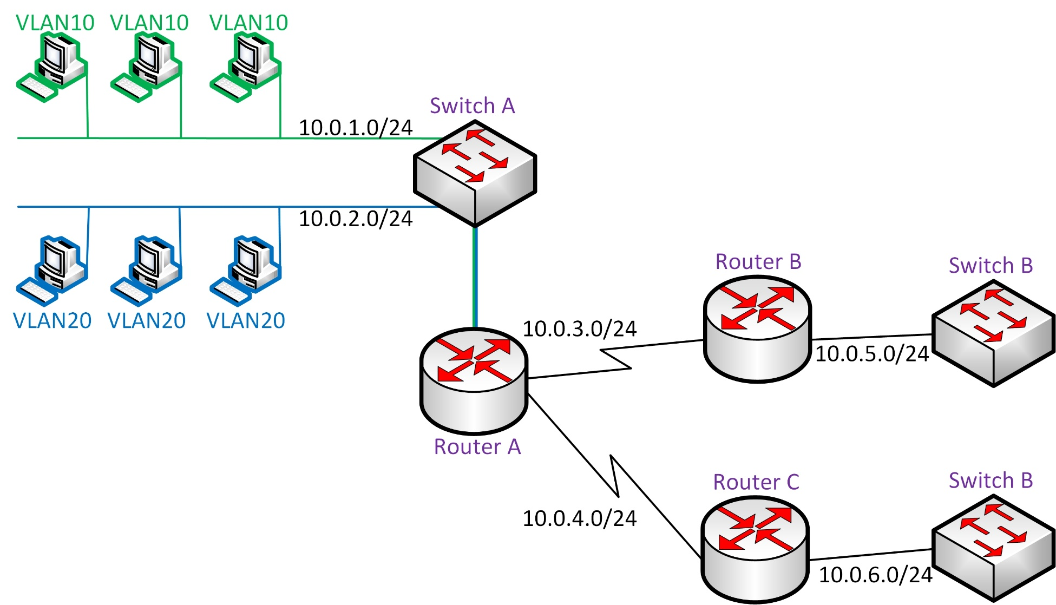
Subnet Design Example

Slide 11
Subnet Mask Format

Slide 12
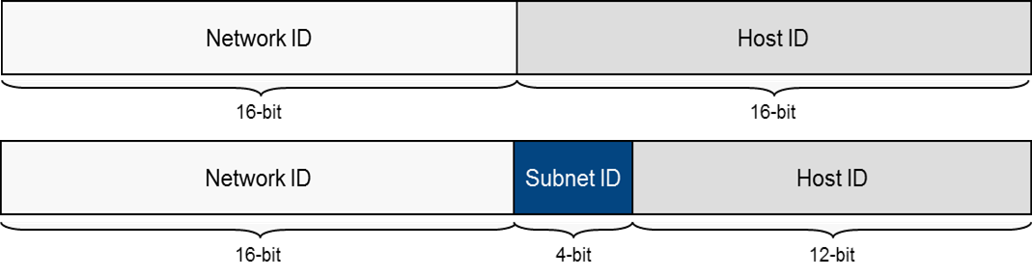
Default Subnet Masks
Aligned along octet boundaries
Use old class terminology
Custom subnet masks
  Modify a default mask
  Allocate host bits to extra mask bits

Slide 13
Classless Addressing
Forget about address classes and octet boundaries and assign a network prefix
Network prefix can still be represented as subnet mask
Alternatively the prefix can be written in slash notation
  /nn – number of bits in the mask
  More compact and easy to understand
New (unofficial) meaning for address “classes”
  Class A network = /8
  Class B network = /16
  Class C network = /24

Slide 14
Planning an IPv4 Addressing Scheme (1)
Consider
  Whether you need a public or private addressing scheme
  How many networks you need
  How many subnetworks you need
  How many hosts per subnet
Addressing Rules
  Network ID cannot be 127
  Network and/or host IDs cannot be all 255 (all 1s in binary)
  Network and/or host ID cannot be 0 (all zeros in binary)
  Host ID must be unique in the subnet
  Network ID must be unique
    On the Internet (if using a public addressing scheme)
    On your internal system of networks (if using a private addressing scheme)

Slide 15
Planning an IPv4 Addressing Scheme (2)
Work out how many subnets are needed
  Must be a power of 2
  Exponent (the value of “n” in 2n) is the number of bits to add to the default network prefix
Check that subnets allow for sufficient hosts (2n-2 where “n” is number of host bits)
Work out the subnets - deduct the least significant octet in the mask from 256
Work out the next subnet ID - the lowest subnet value higher
Work out the host ranges for each subnet
  Take the subnet address and add a binary 1 to it for the first host
  Take the next subnet ID and deduct two binary digits from it

Slide 16
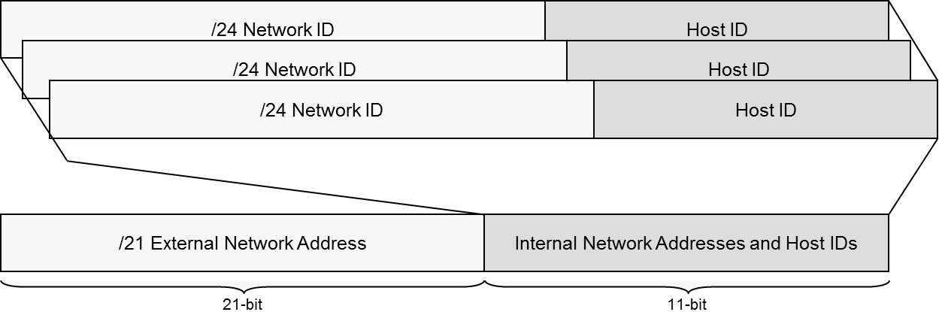
Public Internet Addressing
Classful addressing not sustainable
Classless Interdomain Routing (CIDR)
  Allocate network bits for use as subnet/host bits
  Addresses must be contiguous blocks
  Classless Interdomain Routing (CIDR) collapses entries to single network routing prefix for routers external to the network

Slide 17
Variable Length Subnet Mask (VLSM)
Use the address space available within an IP network more efficiently
Rather than use the same mask for all subnets, use different mask lengths according to host numbers per subnet

Slide 18
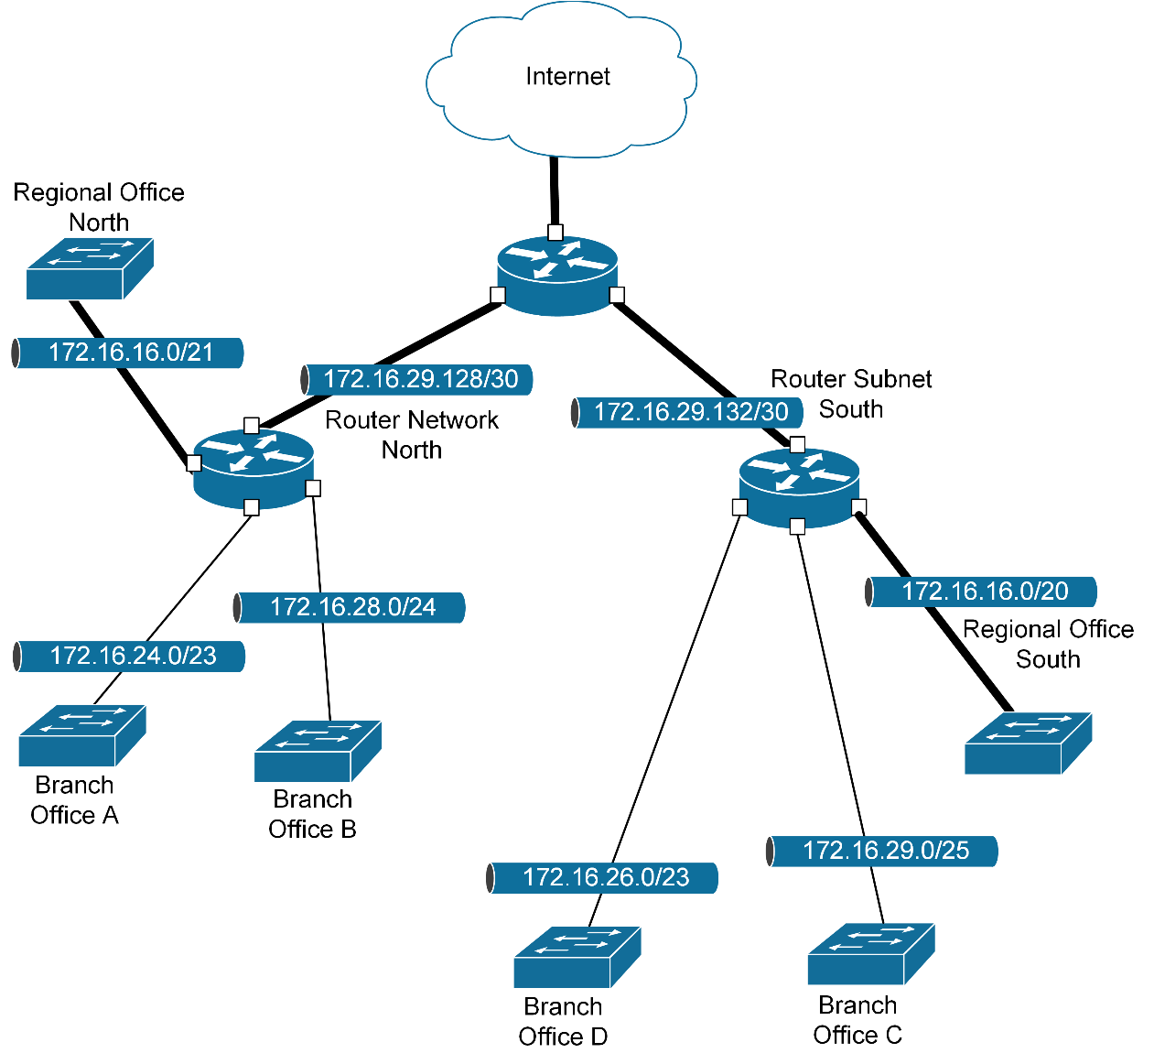
VLSM Addressing Scheme

Slide 19
Designing Subnets

Slide 20
IPv4 traffic can be addressed to unicast, broadcast, or multicast.
Classful addressing uses a system of fixed network IDs based on the first octet of the IP address. Classless addressing, where the mask is defined by a network prefix, allows for subnetting and supernetting (CIDR) plus Variable Length Subnet Masks (VLSM).
Make sure you can calculate the numbers of networks and hosts available for under an addressing scheme and work out the network ID, valid host addresses, and broadcast address of an IP network.
IPv4 provides public and private addressing schemes. Privately addressed hosts can use some type of NAT or proxy to communicate over the Internet.
Notes:
What technology or technologies can you use to isolate broadcast domains? Routers and VLANs.
True or false? The IP address 172.24.0.1 is routable over the Internet. False. 172.16.0.0 - 172.31.255.255 is the "Class B" private address range.
What is a "Class D" address? One used for multicasting.
Which of the following are class C IP addresses? (Choose four)
195.243.67.51 – TRUE
165.247.200.100 – FALSE
190.234.24.6 – FALSE
11001101 01110100 00000100 00101110 – TRUE
11001111 10000001 01111110 10010010 – TRUE
213.54.53.52 – TRUE
233.168.24.6 - FALSE
If a host is configured with the IP address 10.0.10.22 and mask 255.255.255.192, what is the broadcast address of the subnet? 10.0.10.63. To work this out, convert the IP to binary (00001010 00000000 00001010 00010110) then work out the number of bits in the mask (26). Change the remaining host bits (6) to 1s and convert back to dotted decimal.
A host is configured with the IP address 10.0.10.22 and subnet mask 255.255.255.192. How many hosts per subnet would this addressing scheme support? 62. To work this out, either subtract the least significant octet from 256 then subtract two for the network and broadcast addresses or having worked out that there are 6 host bits calculate (2^6)-2.
A technician is troubleshooting a network and has asked your advice. He is trying to ping 192.168.16.192. The network has been subnetted with the custom mask 255.255.255.224. Why might this return a “Destination host unreachable” message? The IP address resolves to the subnet network address not a host address. Windows does not normally allow pinging the network address. Other OS treat it as an alternative broadcast address but most systems are configured to disallow such “directed” broadcasts for security reasons.
Which of the following IP addressing rules is true?
The host ID must be unique on the network – TRUE
Network and host IDs cannot be all zeroes – TRUE
A network ID can be any number – FALSE
A network ID can be 255 - FALSE
If the IP address 10.0.10.22 were used with an /18 mask, how many subnets and hosts per subnet would be available? 1024 subnets each with 16,382 hosts. From the default mask, 10 bits are allocated to the subnet ID and 14 remain as host bits.

Slide 21
Lab 4 / Configuring IPv4 Subnets
Notes:
Note that there are three sets of labs available to use with this course:
Classroom labs that you set up and run yourself (refer to the separate "Labs" book and setup guide on the instructor resource support site).
Learn On Demand (LOD) hosted classroom labs accessed via a browser but following the same general sequence and steps as the classroom lab book.
Self-study Online Labs from Practice Labs accessed by students online - these labs are intended for use by students studying independently and are different from the classroom and hosted classroom labs. If you are using Practice Labs online labs in the classroom, you must specify this at the time of purchase so that the appropriate bandwidth is provisioned in advance. Please ensure that the student PCs meet the requirements for accessing the Self-study Online Labs series. You can obtain a setup guide at gtsgo.to/nf1rc
The sequence of classroom and hosted classroom labs is shown on this slide and in the margins of your instructor edition and in the course timetable. You should guide the students to complete each lab.
If you are not using the classroom or LOD hosted classroom labs you should delete this slide.

