Slide 1
CompTIA Network+ Certification
1.4 Infrastructure and Design

Slide 2
Differentiate between network infrastructure implementations such as LAN, CAN, WLAN, WAN, MAN, PAN, and SAN
Understand the design requirements for enterprise and SOHO networks
Describe the TCP/IP layer model and identify the main protocols in the TCP/IP suite
Notes:
The number in the bottom right corner of the slides refers back to the page where this topic starts in the course book.

Slide 3
Network Infrastructure Implementations (1)
Local Area Network (LAN)
  Home network
  SOHO (Small Office Home Office)
  SME (Small and Medium Sized Enterprise)
  Enterprise LAN - a larger network with hundreds or thousands of servers and clients
Campus Area Network (CAN)
Wireless LAN (WLAN)
Storage Area Network (SAN)

Slide 4
Network Infrastructure Implementations (2)
Wide Area Network (WAN)
  Internet
  Intranet
  Extranet
Metropolitan Area Network (MAN)

Slide 5
Network Infrastructure Implementations (3)
Personal Area Network (PAN)
Wireless Personal Area Network (WPAN)
Close-range links to peripheral devices and wearable technology

Slide 6
Planning an Enterprise Campus Network
List of requirements
  Business goals and scope
  Budget, timeframes, and deliverables
  Staff and stakeholders
Security considerations
Environment limitations

Slide 7
Network Design Goals
Selecting appropriate technology
Vendor interoperability
Scalability
  Add users/devices without re-design
Adaptability
  Add or change services

Slide 8
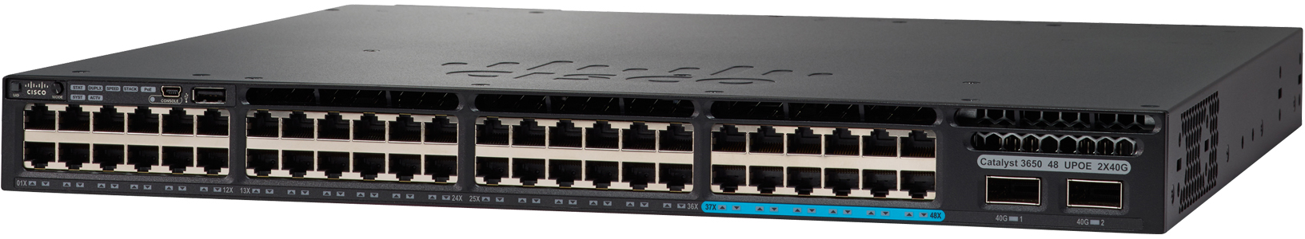
Network Hierarchy and Distributed Switching
Hierarchy and modular design
Access layer
Distribution layer
Core layer
Image © and Courtesy of Cisco Systems, Inc. Unauthorized use not permitted

Slide 9
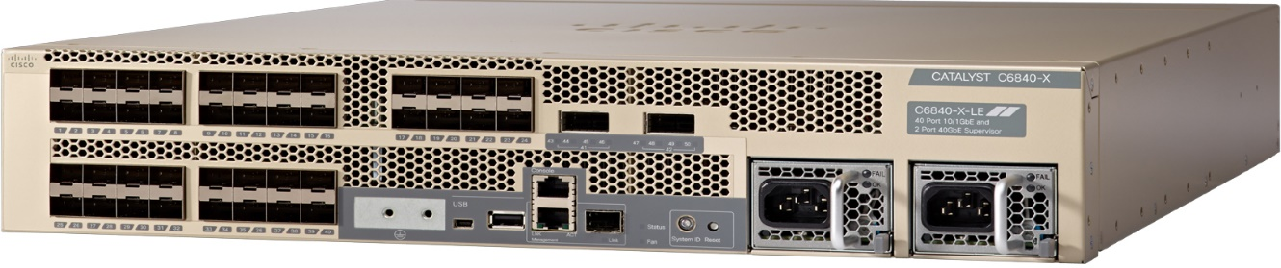
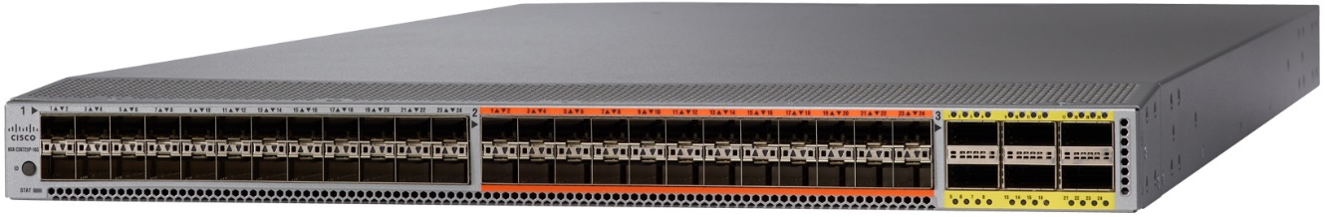
Core/Distribution Appliances
Router
Layer 3 switch
  Optimized for routing within LAN
Aggregation switch
Data center layer/appliances
Modular design
Images © and Courtesy of Cisco Systems, Inc. Unauthorized use not permitted

Slide 10
Software Defined Networking (SDN)
Control Plane, Data Plane, and Management Plane
SDN applications define policies on control plane
Device configurations abstracted to an Application Programming Interface (API)
Network controller implements SDN policies as configuration settings on appliances
  Northbound API: SDN <> Network Controller
  Southbound API: Network Controller <> Appliances

Slide 11
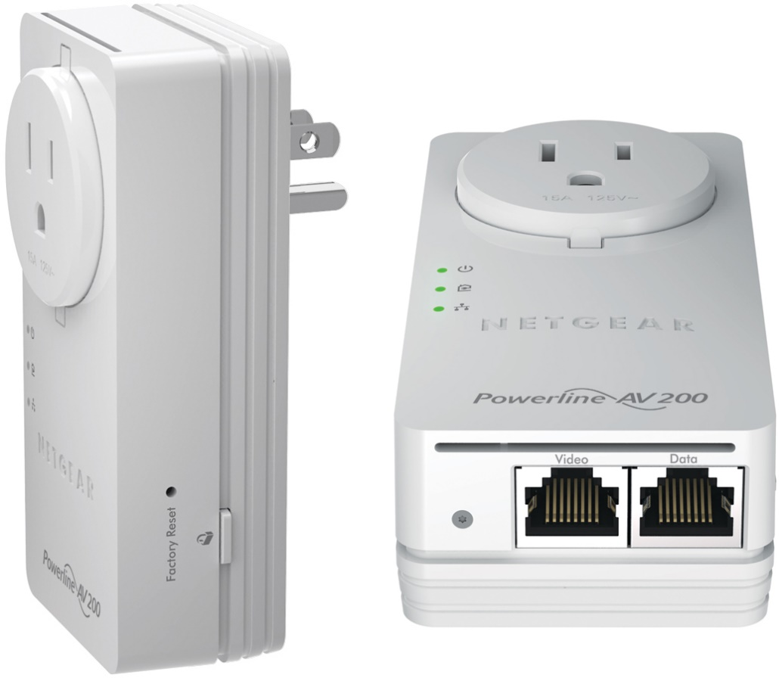
Planning a SOHO Network
Customer requirements
Wired/wireless considerations
Compatibility requirements
Security considerations
Images © and Courtesy of NETGEAR

Slide 12
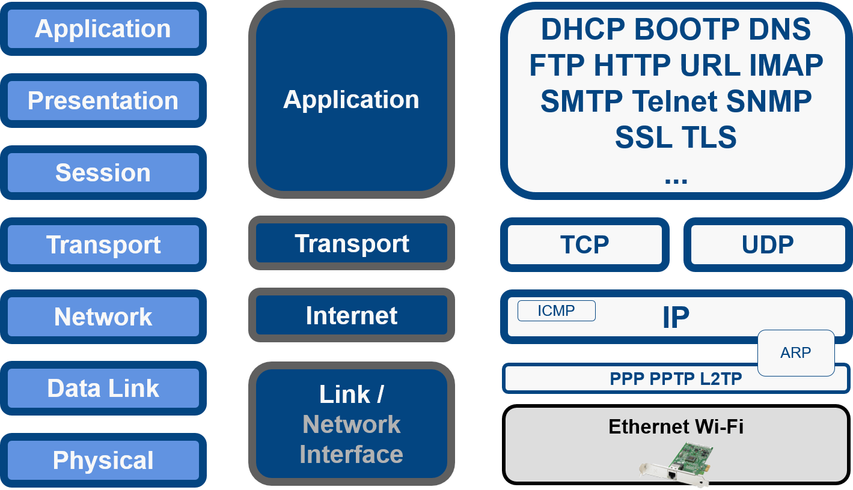
TCP/IP Protocol Suite
Link layer/network interface
  Ethernet/Wi-Fi
  WAN
Internet layer
  Network layer
  IP
Transport layer
  TCP and UDP
Application layer

Slide 13
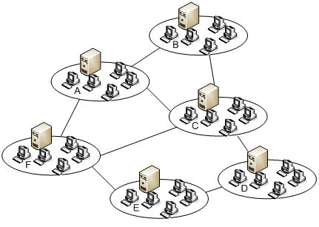
Packet Switching
Rather than establish a circuit, data is broken into packets that can take any path to their destination
Robust as can recover from link failures

Slide 14
TCP/IP and Internet Standards
Internet Society (ISOC)
Internet Architecture Board (IAB)
  Internet Engineering Task Force (IETF)
    Internet and web standards
  Internet Assigned Numbers Authority (IANA)
    IP address allocations and DNS (Domain Name System)
    Regional Registries and Internet Service Providers (ISP)
    Function of the IANA is contracted to the Internet Corporation for Assigned Names and Numbers (ICANN)
Request For Comments (RFC)

Slide 15
Networks can be categorized by size as LAN/CAN, MAN, WAN, or PAN. Networks may also be designated by type, such as Wireless LAN (WLAN) or Storage Area Network (SAN).
Implementing an enterprise or SOHO network requires careful analysis of customer requirements and environmental limitations. Be aware of the different technology solutions for the enterprise and SOHO markets.
Be aware of the design principles for enterprise networks and the use of distributed switching hierarchies and SDN.
The TCP/IP protocol suite is the basis of the Internet and used for many LANs and private WANs. It uses a simpler 4-layer model compared to OSI (Link, Internet, Transport, Application).
Notes:
What is a WLAN? Wireless Local Area Network.
What network infrastructure implementation is larger than a LAN but smaller than a WAN? Metropolitan Area Network (MAN). You could also mention Campus Area Network (CAN).
What is the purpose of a SAN? A Storage Area Network links together different kinds of storage device (RAID array, hard disks, SSDs, tape drives, and so on) and makes "pools" of storage capacity available to servers to access using block-level file read/write commands.
What type of devices are connected in a PAN? A Personal Area Network (PAN) is used to link devices such as laptops and smartphone and provide connectivity with peripheral devices (printers, input, headsets, and so on) plus wearable technology, such as fitness trackers and smart watches.
What general requirements and limitations should you consider when implementing a basic network? Device types, environment, equipment, compatibility, wired/wireless, and security.
What is the function of a network controller? Implements the policies defined by Software Defined Networking (SDN) control applications by interfacing with the configuration interfaces of network appliances.
What four layers can be used to conceptualize network design hierarchy? Access, distribution, core, and data center.
To which layer of the OSI model does the TCP/IP Internet layer correspond? Network.

