Slide 1
CompTIA Network+ Certification
1.1 Topologies and the OSI Model

Slide 2
Describe the key features and components of networks
Understand what is meant by a topology and identify the key physical and logical network topologies, such as star, mesh, and bus
Describe the functions of the layers of the OSI Model
Notes:
The number in the bottom right corner of the slides refers back to the page where this topic starts in the course book.

Slide 3
Key Features of Networks
Two or more computer systems linked by transmission media to share information
Networks are built to provide useful services
  Sharing data and resources
  Email and database applications
  Web applications and social networking
  Voice and multimedia conferencing
Network boundaries
  Local Area Network (LAN)
  Wide Area Network (WAN)

Slide 4
Network Components
Nodes, stations, and hosts
  A node is a device communicating on the network via one or more interfaces
    Can include endpoints such as computers
    Can include forwarding nodes such as switches and routers
  “Station” can be used instead of node when talking about wireless networks
  Host typically refers to a computing device (not a switch or a router)
Transmission media - cabled or wireless links between nodes

Slide 5
Local and Routed Networks
Local network devices
  Nodes that forward communications within the same physical network (switching)
  Physical/local addresses
  Segments and backbones
Routing devices and subnets
  Nodes that forward communications between physically or logically distinct networks (routing)
  Network addresses/IDs
  Subnetworks

Slide 6
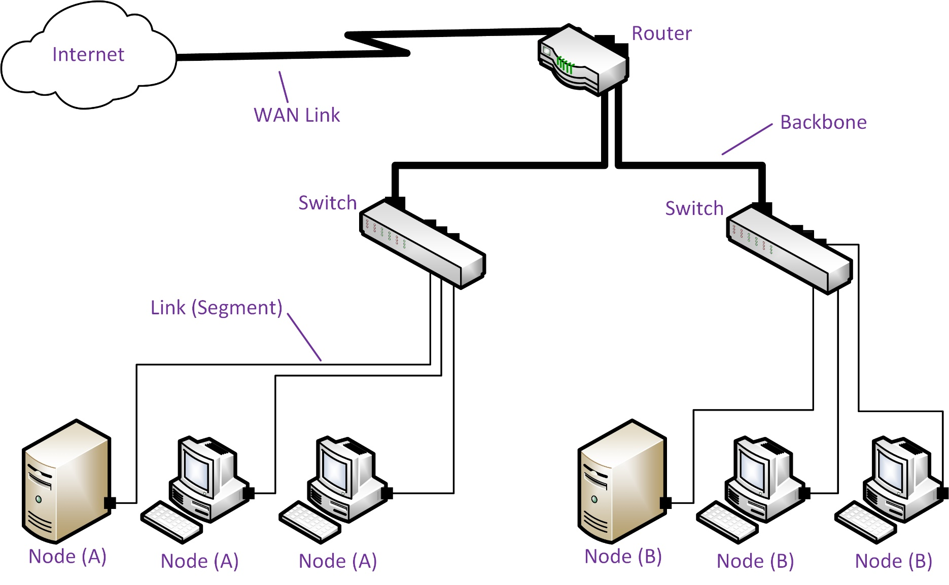
Typical Network Layout

Slide 7
Network Protocols
Rules for exchanging data
Addressing
Encapsulation
  Header
  Payload

Slide 8
Network Topologies
Physical topology is the placement of nodes and media links between them
  Network 1
    Computers A, B, and C are directly connected by a single cable
  Network 2
    Computers A, B, and C are connected to a hub by different cables
  Networks 1 and 2 have different physical topologies
Logical topology is the flow of data
  Network 1
    Computers A, B, and C can exchange messages, with the messages traveling over the shared cable
  Network 2
    Computers A, B, and C can exchange messages, with the messages repeated over each cable by the hub
  Networks 1 and 2 have the same logical topology

Slide 9
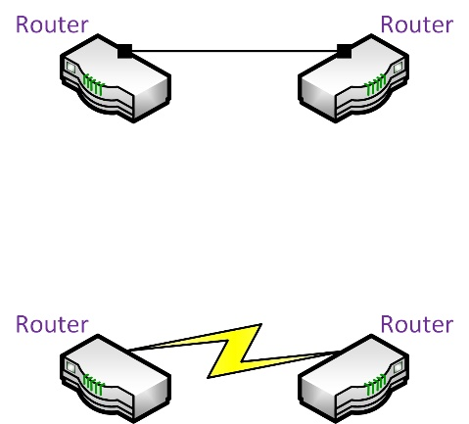
Point-to-Point Links
One-to-one link
Dedicated bandwidth
Physical point-to-point link (cable) or logical circuit

Slide 10
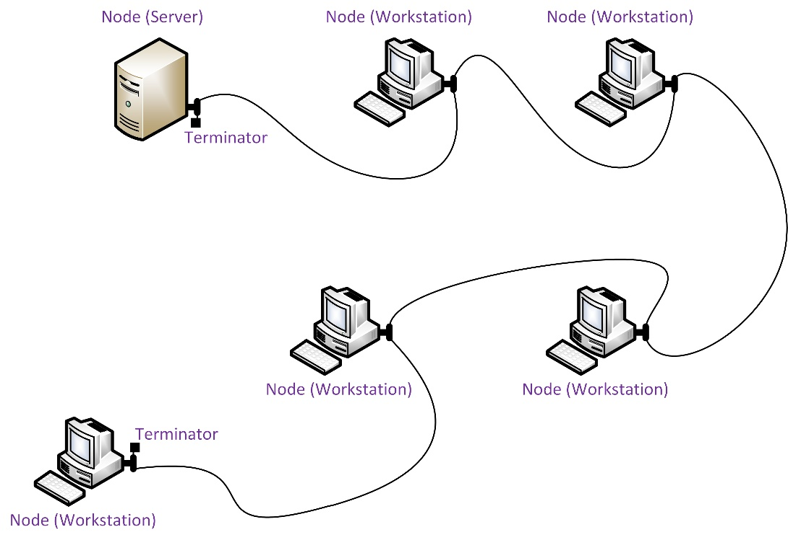
Bus Topology
Nodes attached to same cable segment
  Single length of main cable
  Multiple lengths of cable connected by repeaters
Shared access to media
Cabled bus is practically obsolete
  Moving and adding nodes can cause problems for the whole network
  Limited number of nodes
  Cable faults cause problems for the whole network

Slide 11
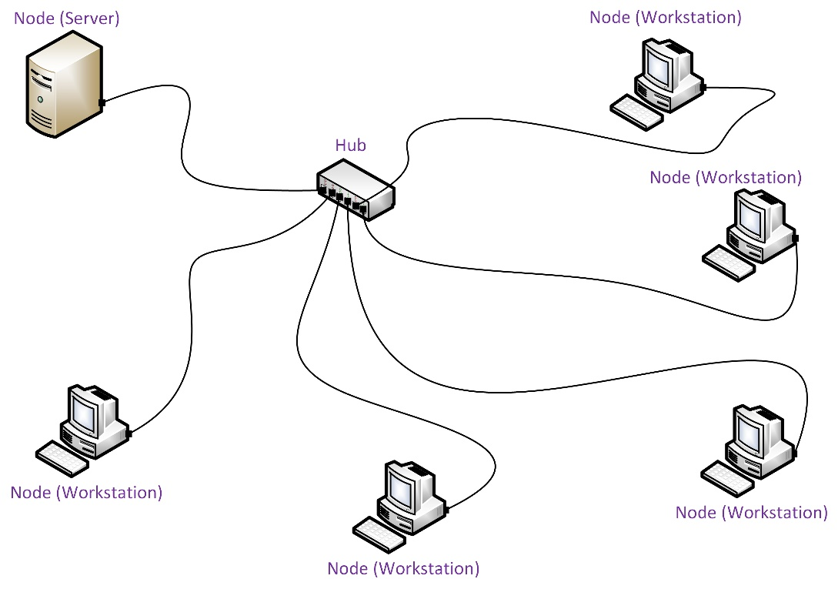
Star Topology
Endpoint nodes connected via a central forwarding node (hub, switch, or router)
Requires more cable but simpler to reconfigure
Cable faults are isolated to each hub port and easier to troubleshoot
Central node can be a single point of failure

Slide 12
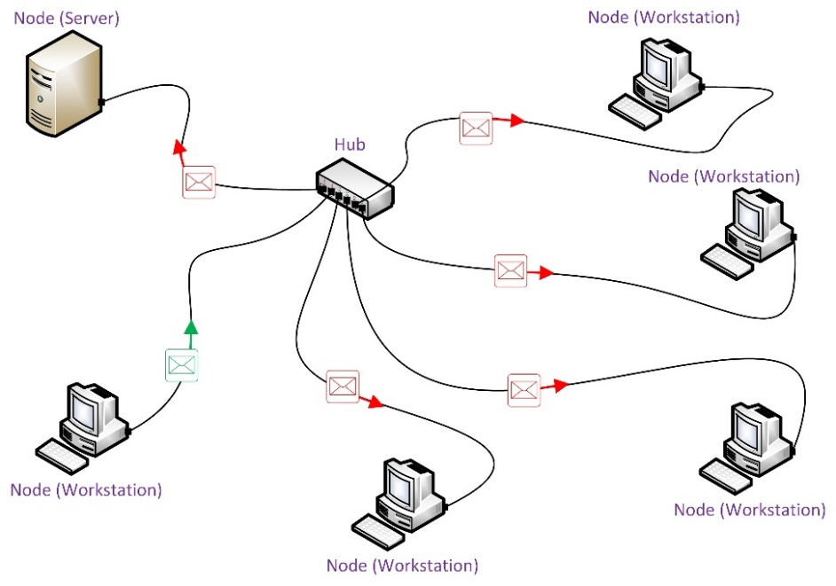
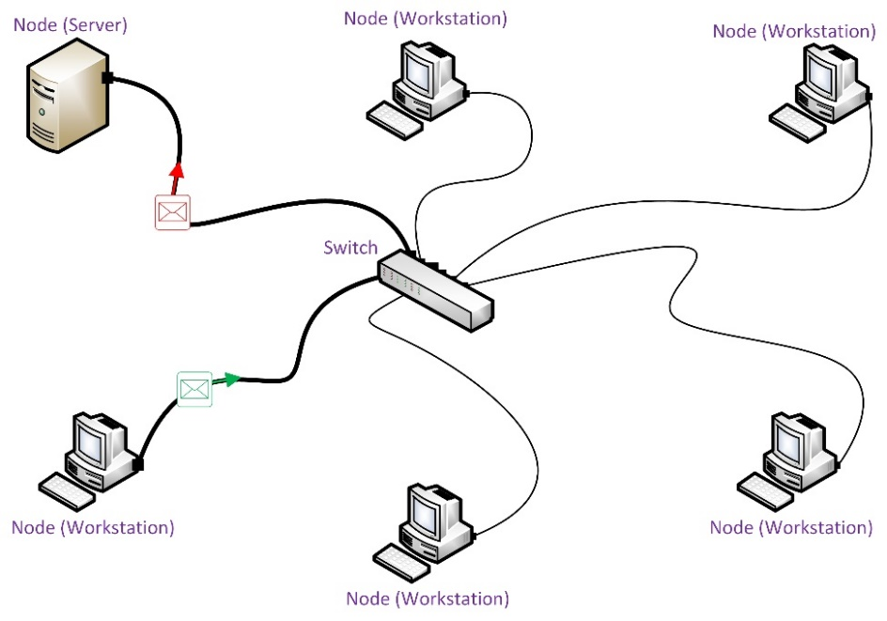
Physical Star – Logical Bus
Hub
  Transmissions repeated to all nodes
  Logical bus with all nodes in the same segment
  Nodes must still contend for access
Switch
  Establishes point-to-point circuits
  Logical bus but each switch port is a separate segment
  No contention – can use full link bandwidth

Slide 13
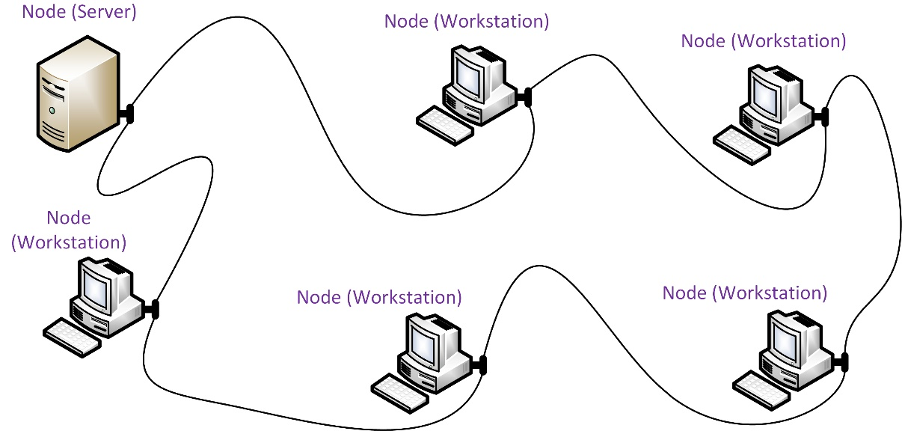
Ring Topology
Nodes are physically wired in a ring (closed loop)
Transmissions travel from node-to-node around the ring until reaching their destination
  Transmission received from upstream neighbor
  Transmission passed to downstream neighbor
Used on WANs

Slide 14
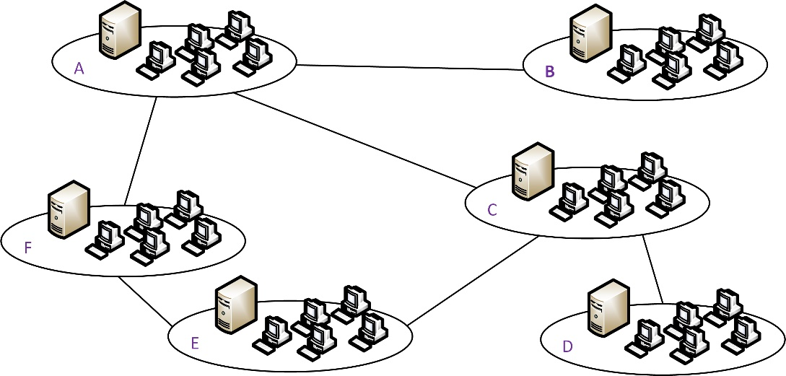
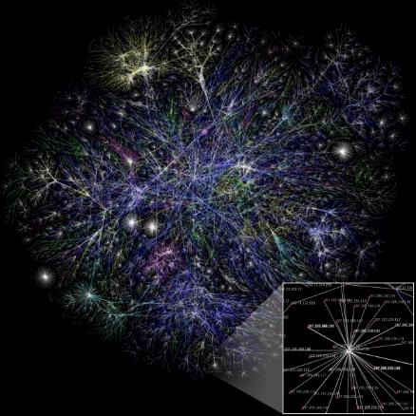
Mesh Topology
Full mesh means that each node is connected to every other node
n(n-1)/2 to calculate number of links required by ‘n’ nodes
Partial mesh more commonly deployed
  Fewer physical links required
  Nodes relay (route) communications to provide interconnections between all nodes
  Provides redundancy and fault tolerance
  Architecture of the Internet

Slide 15
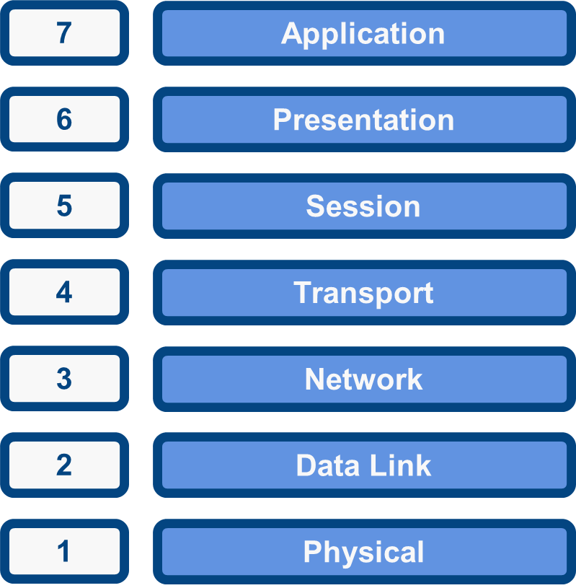
The OSI Model

Slide 16
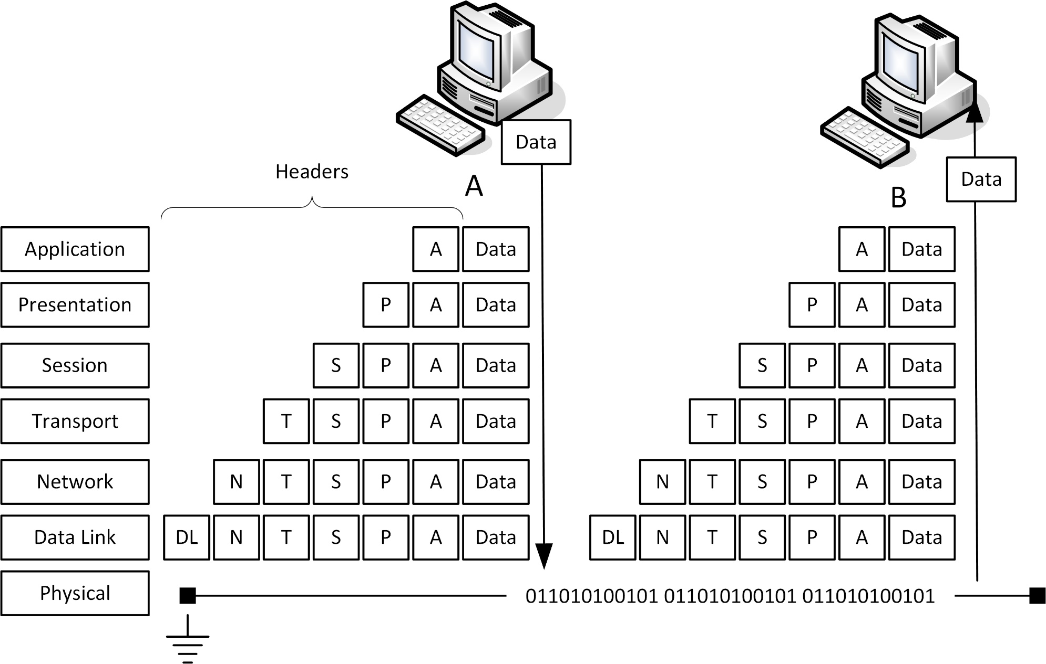
Encapsulation and De-encapsulation

Slide 17
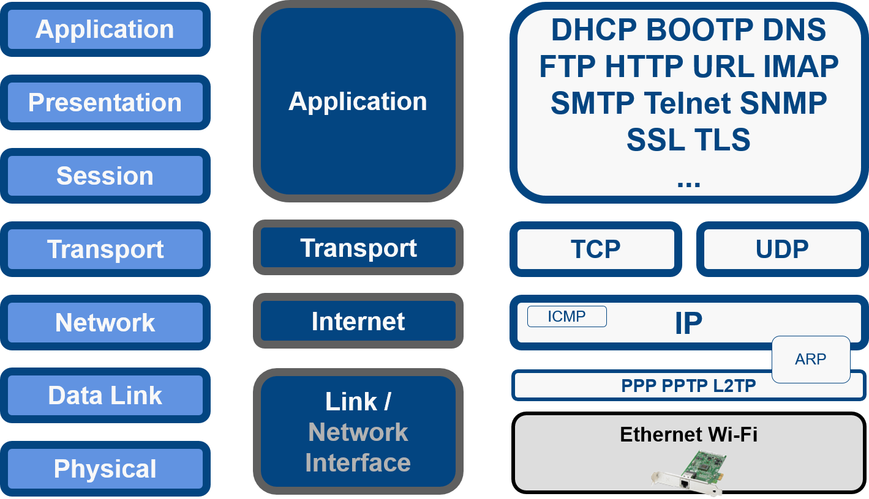
OSI Model and Network Protocols

Slide 18
Physical Layer (Layer 1)
Physical topology
Mechanical specifications for the network medium
  Cable specifications
  Connector form factor and pin-outs
  Radio transceiver specifications
Signaling (bit transmission/encoding)
Devices
  Transceiver
  Media converter
  Hub/repeater
  Modem

Slide 19
Data Link Layer (Layer 2)
Organize bits into frames
  Destination and source hardware addresses
    Media Access Control (MAC) address
  Error detection
  Flow control
Media access rules/logical topology
  Contention (logical bus topology)
  Token-passing (logical ring topology)

Slide 20
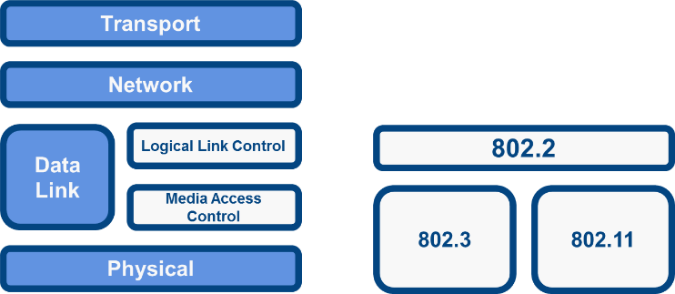
IEEE 802 Standards
802.2 (Logical Link Control)
  Provides standard service interface for network layer regardless of MAC sub-layer
802.3 (Media Access Control)/“Ethernet”
  Logical topology
  Media access method
  Hardware (MAC) addresses
  Error detection
  Frame format
  Physical media specifications

Slide 21
Layer 2 Devices
Network adapter (Network Interface Card [NIC])
Bridge
Basic switch
Wireless Access Point (AP)

Slide 22
Network Layer (Layer 3)
Moving data around a network of networks (internetwork/the Internet)
Logical addressing between networks
Routing
  Route discovery
  Path selection
Devices
  Router
  Layer 3 switch
  Basic firewall

Slide 23
Transport Layer (Layer 3)
Multiplexing and de-multiplexing
  Identifies application data via port numbers
  Packages data in a stream of segments
  Merges segments from different applications over the network link
  Port numbers allow receiving host to de-multiplex and reassemble data for the appropriate application handler
Reliable delivery
  Connection establishment
  Acknowledgements and negative acknowledgments
  Segmentation and sequencing
  Flow control
Unreliable (connectionless) delivery
Devices – multilayer switches and security appliances

Slide 24
Session and Presentation Layers
Divisions between “upper” layers less important in “real world” protocols
Session (Layer 5)
  Identify a sequence of messages belonging to the same “conversation”
  Dialog control (simplex, half-duplex, duplex)
Presentation (Layer 6)
  Character set conversion
  Compression/decompression/encryption/decryption

Slide 25
Application Layer (Layer 7)
Doesn’t encapsulate another protocol – reached the “top”
Provides communications protocols and interfaces for software processes running on different hosts
Application layer versus software implementation of network functions
  Application Programming Interfaces (API) for software programs
  APIs can be written for any layer of the network stack
    Network card drivers (e.g. NDIS) at layer 2 (data link)
    Sockets/WinSock at layer 5 (session)
    High-level API functions (file transfer, email, web browsing, DNS) at layer 7

Slide 26
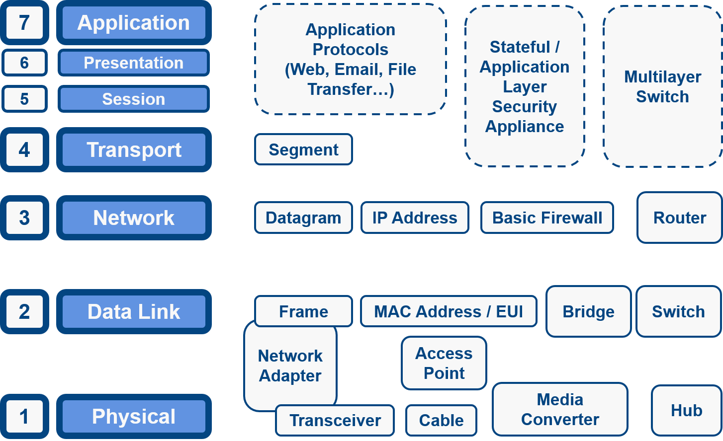
OSI Model Summary

Slide 27
Networks comprise nodes, transmission media, local networking devices, routing devices, and protocols.
Physical and logical topologies used include point-to-point, star, bus, ring, and mesh.
The OSI model is used to analyze network functions in layers (Physical, Data Link, Network, Transport, Session, Presentation, and Application). It is important to be able to relate network hardware and protocols to the appropriate OSI layer
Notes:
What term is used to describe a topology in which two nodes share a single link? Point-to-point.
What is characteristic of the bandwidth of a bus topology? The bandwidth is shared between all nodes connected to the bus.
What type of device is used to implement a star topology? Hub/switch/router.
You need operations to continue if one link fails. How many links does it take to connect three sites? Three.
In which sub-layer of the OSI model do network adapter cards operate? MAC (a Data Link sublayer).
Which component is responsible for translating the computer's digital signals into electrical or optical signals that travel on network cable? Transceiver.
True or false? The Session Layer is responsible for passing data to the Network Layer at the lower bound and the Presentation Layer at the upper bound. False. The session layer is between the transport and presentation layers.
Which OSI layer handles the concept of logical addressing? Network layer.
At which OSI layer is the concept of a port number introduced? Transport layer.
Which two OSI layers define how multiple computers can simultaneously use the network media without interfering with each other? Physical and data link.

Slide 28
Lab 1 / VM Orientation
Notes:
Note that there are three sets of labs available to use with this course:
Classroom labs that you set up and run yourself (refer to the separate "Labs" book and setup guide on the instructor resource support site).
Learn On Demand (LOD) hosted classroom labs accessed via a browser but following the same general sequence and steps as the classroom lab book.
Self-study Online Labs from Practice Labs accessed by students online - these labs are intended for use by students studying independently and are different from the classroom and hosted classroom labs. If you are using Practice Labs online labs in the classroom, you must specify this at the time of purchase so that the appropriate bandwidth is provisioned in advance. Please ensure that the student PCs meet the requirements for accessing the Self-study Online Labs series. You can obtain a setup guide at gtsgo.to/nf1rc
The sequence of classroom and hosted classroom labs is shown on this slide and in the margins of your instructor edition and in the course timetable. You should guide the students to complete each lab.
If you are not using the classroom or LOD hosted classroom labs you should delete this slide.

