Slide 1
CompTIA CySA+ Certification
5.2 Managing Identities and Access

Slide 2
Deploy a Network Access Control (NAC) solution
Describe issues affecting identity management and authentication
Notes:
The number in the bottom right corner of the slides refers back to the page where this topic starts in the course book.

Slide 3
Network Access Control (1)
Apply policies to allow or deny access in addition to user credentials
Health policy
  A-V / HIPS software present and up-to-date?
  Patches up-to-date?
  Host firewall enabled and correctly configured?
Solutions for PC / laptop (Windows / Linux) and for mobile (Android / iOS)
Solutions for the Internet of Things?

Slide 4
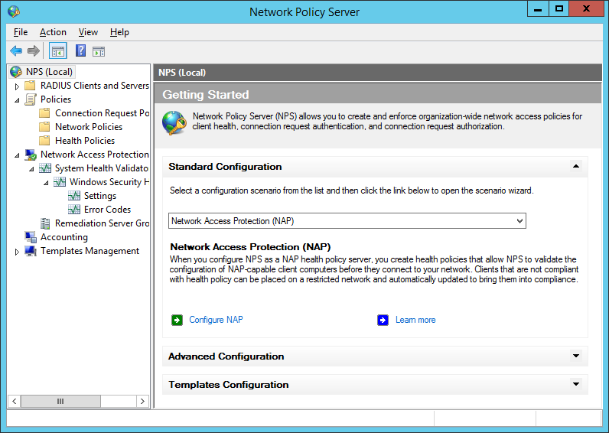
Network Access Control (2)
Gathering data
Remediation
Management
Pre- and post-admission control
Integration

Slide 5
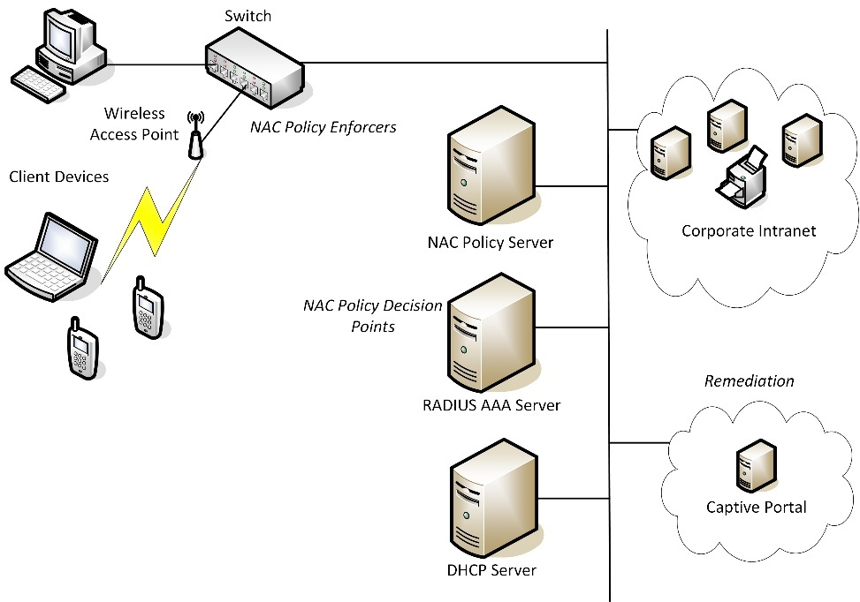
NAC Components

Slide 6
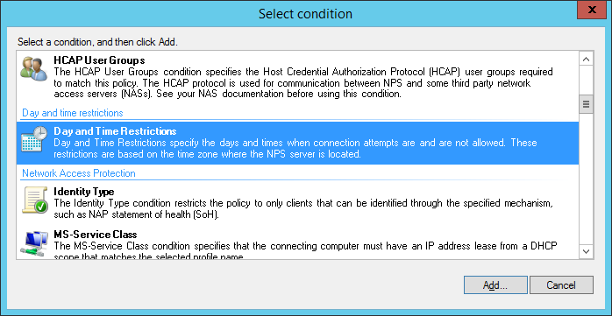
NAC Policies
Time-based
Location-based
Role-based
Rule-based

Slide 7
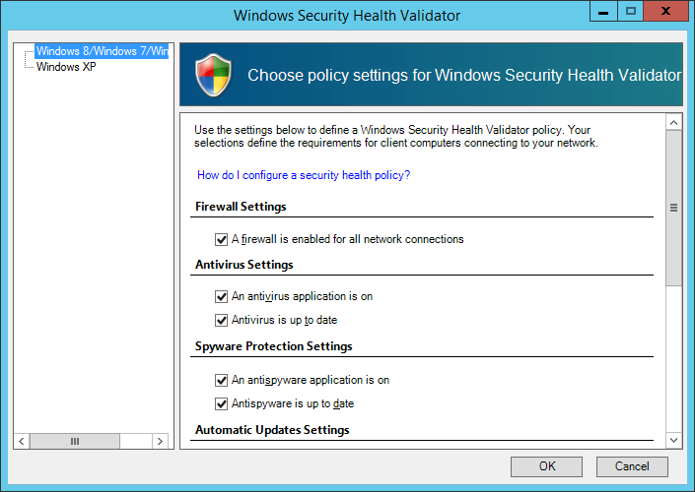
NAC Products and Frameworks
Products
  Cisco Network Admission Control (CNAC
  Network Policy Server (NPS) / Network Access Protection (NAP)
  Trusted Network Connect
  …
Interoperability between NAC products
Compatibility with client devices (exception management)

Slide 8
Identity Management
Identification versus authentication
Account
  Identifier
  Credentials
  Profile
Issuance / enrollment
  Identity proofing
  Ensuring only valid accounts are created
  Secure transmission of credentials
  Revoking the account
Managing digital identities
  Password reset
  Single sign-on

Slide 9
Identity Security Issues (1)
Personnel
  Security awareness training and education
  Control of privileged accounts
  Using shared accounts (appliances, cloud services)
Roles
  Assign privileges based on user context (what role are they performing)
  Fine-grained control over rights
  Regular audits
    Does the role require the permissions it has gained?
    Are users assigned to appropriate roles?
    What are the effective permissions of particular user accounts?

Slide 10
Identity Security Issues (2)
Endpoints and servers
  IP and MAC addresses subject to spoofing
  Identify devices using digital certificates
Rogue devices - wired clients, wireless clients, rogue server instances, VMs
  Visual inspection of ports / switches
  Network mapping / host discovery
  Wireless monitoring
  Network monitoring
  NAC and intrusion detection
Servers and applications
  Code signing
  Execution control (whitelist or blacklist software installation)

Slide 11
OpenSSL
Digital certificates are the mainstay of many identification, authentication, and secure communication systems
Certification Authority (CA) root certificates tell a client device who to trust
OpenSSL is a library of software functions supporting the SSL / TLS protocol
  Create, view, and export digital certificates
  Generate private keys
  Test SSL / TLS functions
Windows environment more likely to use Certificate Services and certutil

Slide 12
Identity Repositories
Directory services
  Identity store database of network objects and their credentials and authorizations
  Means for other servers to query and update the identity store using a protocol such as LDAP or Windows Active Directory (AD)
Authentication, Authorization, Auditing (AAA) services
  Means for devices processing authentication requests (switches and access points) to contact the identity store to validate the request (authenticate, authorize, and audit)
  Protocol such as RADIUS or TACACS+
  Avoids the need to replicate the identity store on network access devices (security risk and resource inefficient)

Slide 13
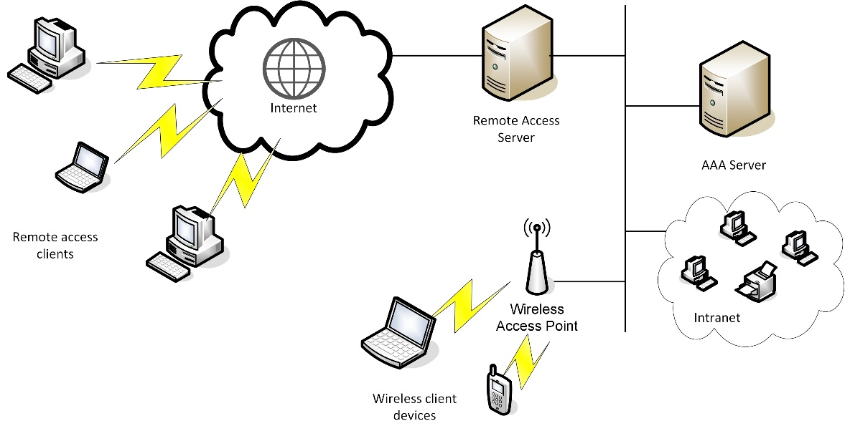
RADIUS (1)

Slide 14
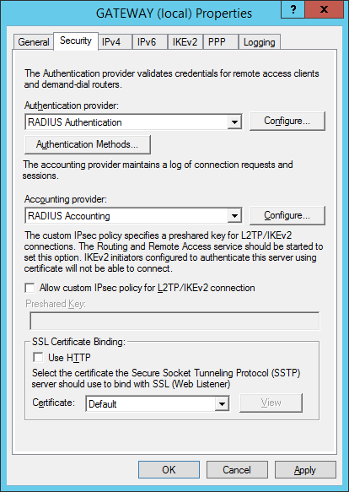
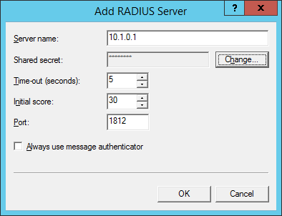
RADIUS (2)
Remote Authentication Dial-in User Service
Configure RADIUS client with RADIUS server address and shared secret
Terminal Access Controller Access Control System (TACACS+)

Slide 15
Securing Identity Repositories
Consider using a secure channel between RADIUS client and server (IPsec)
Generate a long (22 – 128 characters) complex shared secret to ensure non-weak hash values
Patch management, IDS, and other monitoring for servers hosting identity services
Use secure protocols for directory queries and updates
Most stringent hardening processes on administrative user accounts and management stations

Slide 16
Context-based Authentication
Strengthening password credentials
  Access tokens / biometrics
  Can be costly and have their own challenges
Context-based authentication applies behavioral-based policy rules
  Time
    Out-of-hours
  Location
    Geographical or subnet / IP reputation
  Frequency
    Prevent scripted (“bot”) authentication attempts
    Prevent simultaneous logon from two different locations
  User account behavior
    User Access Control (UAC) type reauthorization if a user account attempts to do something “odd”

Slide 17
Single Sign-on and Federation
Single Sign-On (SSO)
  Authenticate once, authorize many
Federation
  Authenticate once, authorize many, across different networks / service providers
  Federated identity management
    Principal (the user)
    Identity provider (IdP)
    Service provider (SP)
  Trust relationships and secure communications
  Session management
  Provisioning / deprovisioning
    How are authorizations granted following authentication?
    How are authorizations removed from a user account?
    Manual versus automatic

Slide 18
Federation Protocols
Security Assertion Markup Language (SAML)
  Uses XML and HTTP / HTTPS with Simple Object Access Protocol (SOAP)
  XML tokens are digitally signed
  XML signature wrapping vulnerability
OpenID and Oauth
  More “user-centric” type of federated identity management
  Identity Provider and Relying Party (RP)
  OpenID for authentication Oauth for authorizations
  Facebook Connect

Slide 19
Self-service Password Reset
Secure transmission of new credentials
Temporary password with “User must change password” policy
User-initiated request – authenticated by
  Challenge questions (PII)
  2-step verification

Slide 20
Exploiting Identities (1)
Impersonation
  Any type of spoofing
  More specifically, obtaining or controlling a user account fraudulently
DNS spoofing
  Redirect clients to malicious host
  Client-side and server-side versions
Session hijacking
  Can exploit at IP, TCP, or application (e.g. cookies) level
Replay attack

Slide 21
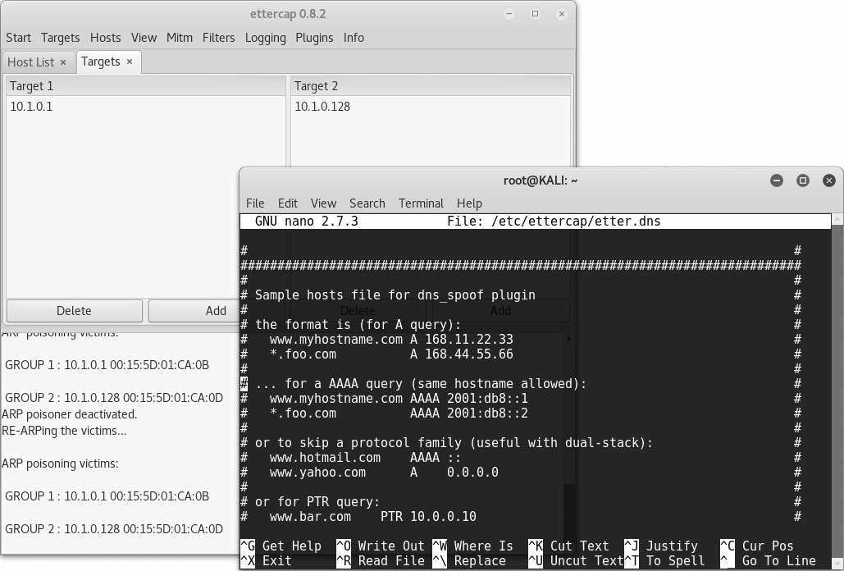
Exploiting Identities (2)
Man-in-the-Middle Attack
  Adversary positions himself as an intercepting proxy
  Can sniff, modify, and forward traffic
  Man-in-the-Browser
ARP spoofing / poisoning
Privilege escalation
Rootkits and Trojans

Slide 22
Exploiting Browsers and Applications (1)
SSLstrip
  Trick users into thinking a site uses HTTP rather than HTTPS
  Mitigate with HTTP Strict Transport Security (HSTS)
Cross-Site Scripting (XSS)
  Attacker identifies an input validation vulnerability in the trusted site
  Attacker crafts a URL to perform a code injection against the trusted site
  User opens URL and becomes victim to the attacker’s arbitrary code / script
  Also stored / persistent XSS and client-side XSS

Slide 23
Exploiting Browsers and Applications (2)
Cookies
  Cookie access control
  Secure session ID management to prevent replay / hijacking
  Secure cookies
Cross-site Request Forgery (XSRF)
  Exploit a valid session
  Confused deputy

Slide 24
Deploy a Network Access Control (NAC) solution
Describe issues affecting identity management and authentication
Notes:
What type of threat is NAC designed to mitigate? Attaching devices that are vulnerable to exploits, such as unpatched systems, systems without up-to-date intrusion detection, unsupported operating systems or applications software, and so on.
Following the CySA+ syllabus, what are the four types of NAC policy? Time-, rule-, role-, or location-based.
What type of test can prevent abuse of a password mechanism by a script? A CAPTCHA (Completely Automated Public Turing Test to Tell Computers and Humans Apart) challenge.
What mechanism can be used to prove the identity of hosts and software applications? Public Key Infrastructure (PKI) encryption - issuing hosts and signing executable code with digital certificates.
What is the difference between a directory service and RADIUS? A directory service is a database of network users and other objects. Remote Authentication Dial-In User Service (RADIUS) is a type of Authentication, Authorization, Auditing (AAA) service. The RADIUS protocol can be used by an access device on the network edge to query a directory service for user information without having to store the information or process credentials locally.
In what way can behavioral or location metrics improve the security of authentication methods? The metrics can reveal intrusion attempts such as a script attempting a large number of logons from different locations.
In the context of federated identity management, what is automated provisioning? Using software to communicate changes in account status and authorizations between systems rather than having an administrator intervene to do it manually.
What is the best means of protecting a host against ARP cache poisoning? Use a host-based intrusion detection agent.
How could SQL injection facilitate an XSS attack? The attacker could use the SQL injection vulnerability to inject malicious HTML or PHP code into the application. When the browser views the infected page, it will run the code.
What is the best means of protecting session cookies? Use encrypted HTTPS only and restrict the use of the cookie to the application path. You can also set the cookie to be accessible only to HTTP and not by JavaScript.

Slide 25
Lab 13 / Secure Appliance Administration
Lab 14 / Email Spoofing and XSS
Notes:
Note that there are three sets of labs available to use with this course:
Classroom labs that you set up and run yourself (refer to the separate "Labs" book and setup guide on the instructor resource support site).
Learn On Demand (LOD) hosted classroom labs accessed via a browser but following the same general sequence and steps as the classroom lab book.
Self-study Online Labs from Practice Labs accessed by students online - these labs are intended for use by students studying independently and are different from the classroom and hosted classroom labs. If you are using Practice Labs online labs in the classroom, you must specify this at the time of purchase so that the appropriate bandwidth is provisioned in advance. Please ensure that the student PCs meet the requirements for accessing the Self-study Online Labs series. You can obtain a setup guide at gtsgo.to/nf1rc
The sequence of classroom and hosted classroom labs is shown on this slide and in the margins of your instructor edition and in the course timetable. You should guide the students to complete each lab.
If you are not using the classroom or LOD hosted classroom labs you should delete this slide.

Slide 26
Configure Verify and Troubleshoot GRE Tunnel Connectivity
Implement SSL VPN using ASA Device Manager
Notes:
This slide shows the sequence of Self-study Online Labs. This sequence is also shown in the student edition by the note at the end of the Review Questions page. Note that the Self-Study Online labs purchased directly by students are NOT suitable for classroom use due to the bandwidth required. Classroom-ready Online Labs can be purchased on request.
If you are not using the self-study online labs you should delete this slide.

