Slide 1
CompTIA CySA+ Certification
4.2 Forensics Tools

Slide 2
Identify the features of market-leading forensic investigation suites
Describe the hardware, software, and documentation required for a forensics kit
Acquire forensically secure data images from hardware evidence
Use password cracking and image analysis utilities
Notes:
The number in the bottom right corner of the slides refers back to the page where this topic starts in the course book.

Slide 3
Digital Forensics Investigations
Collecting evidence from computer systems to a standard that will be accepted in a court of law
Digital evidence is latent – interpreted rather than seen
Full investigations complex and costly and ordinarily the domain of law enforcement
Incident response teams may need to co-operate with investigations
Forensic techniques can also be used for incident analysis

Slide 4
Documentation and Forms (1)
Incident Response Plan
  Scenario-based templates or playbooks for incident identification and response
  Overriding aims of incident response
    Re-establish a secure working system
    Preserve evidence of the incident with the aim of prosecuting the perpetrators
    Prevent reoccurrence of the incident
Call List / Escalation List

Slide 5
Documentation and Forms (2)
Incident Form
  Date, time, and location
  Reporter and incident handler names and contact details
  Observation method
  Classification and prioritization
  Scope
  Description, actions, and outcomes
Letters of authorization
  Seize devices as evidence
  Tap network communications

Slide 6
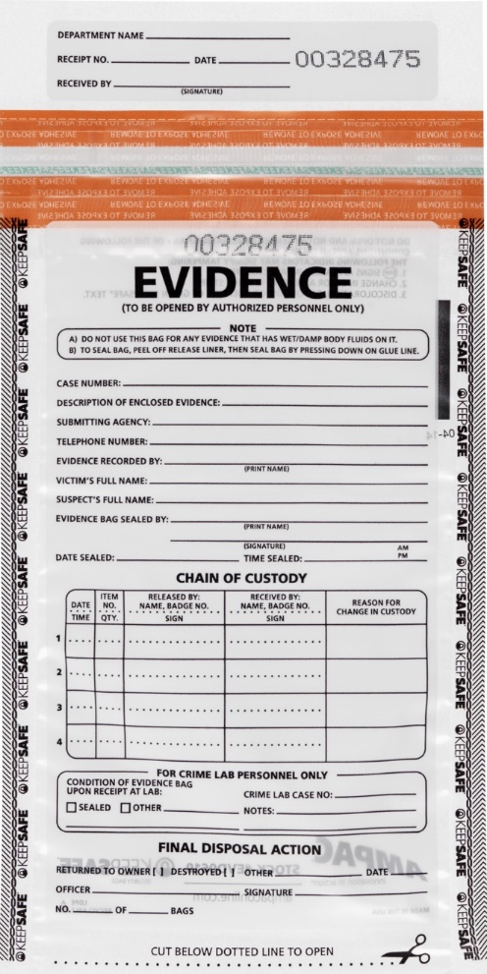
Documentation and Forms (3)
Tamper-proof (tamper-evident) bags
Chain of Custody
Evidence management
  Storage
  Labelling
Ampac KeepSafe™ tamper-evident bag (Image © 2017 Ampac Holdings LLC gtsgo.to/dsf1c)

Slide 7
Digital Forensics Crime Scenes
Using crime tape to isolate the crime scene
  Create single entry point
  Log people entering and leaving
  Log equipment and digital media taken into and out of area
Use cameras / microphones to record the progress of the investigation
Collection of evidence – what and how?
Order of volatility

Slide 8
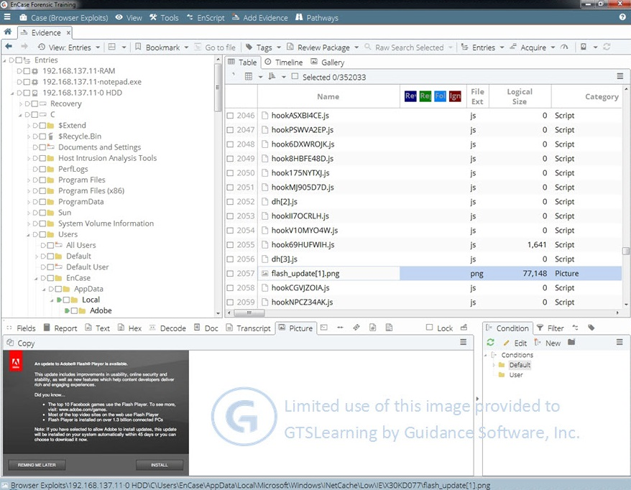
Digital Forensics Suites (1)
Software assisting collection and analysis of evidence
EnCase Forensic (Guidance Software)
Forensic Toolkit (FTK) (AccessData)
EnCase Forensic (Image © 2017 Guidance Software Inc. gtsgo.to/e5joj)

Slide 9
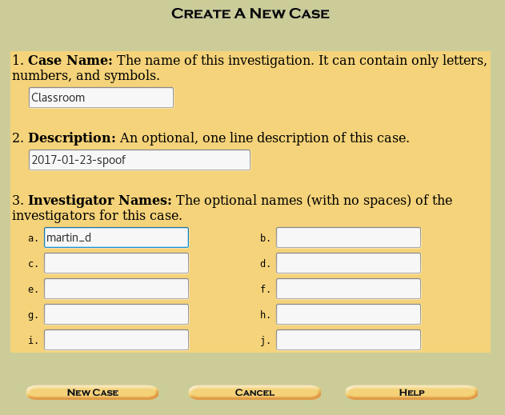
Digital Forensics Suites (2)
The Sleuth Kit / Autopsy
Helix
Cellebrite and mobile device forensics
Sysinternals

Slide 10
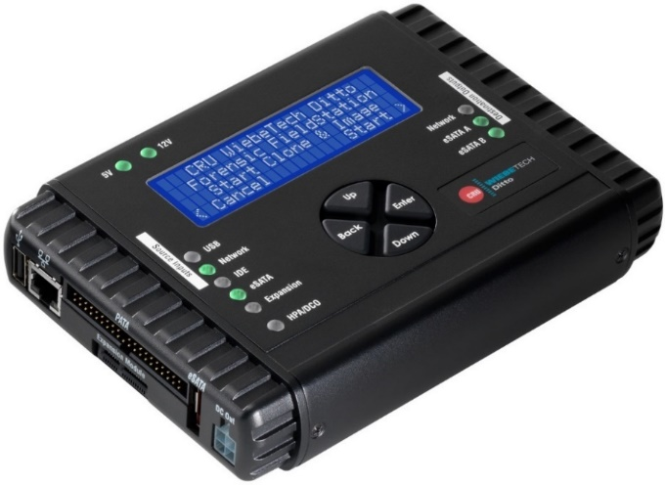
Digital Forensics Workstation
High-end workstation required to process image files
Connectivity for different drive adapter types plus associated cables
High capacity disk or SAN for evidence storage
Sanitized removable media
Hardened security configuration (no or highly restricted Internet access)
Image acquisition appliances
CRU Ditto Forensic Field Station (Image © 2017 CRU Acquisition Group, LLC gtsgo.to/xgaei)

Slide 11
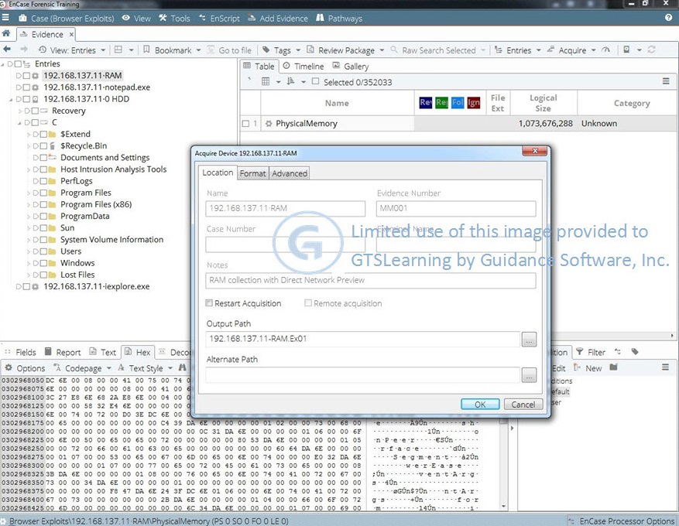
Image Acquisition (1)
System memory image acquisition
  Memoryze
  F-Response TACTICAL
  Difficult to use as evidence but essential analysis tool
EnCase Forensic (Image © 2017 Guidance Software Inc. gtsgo.to/e5joj)

Slide 12
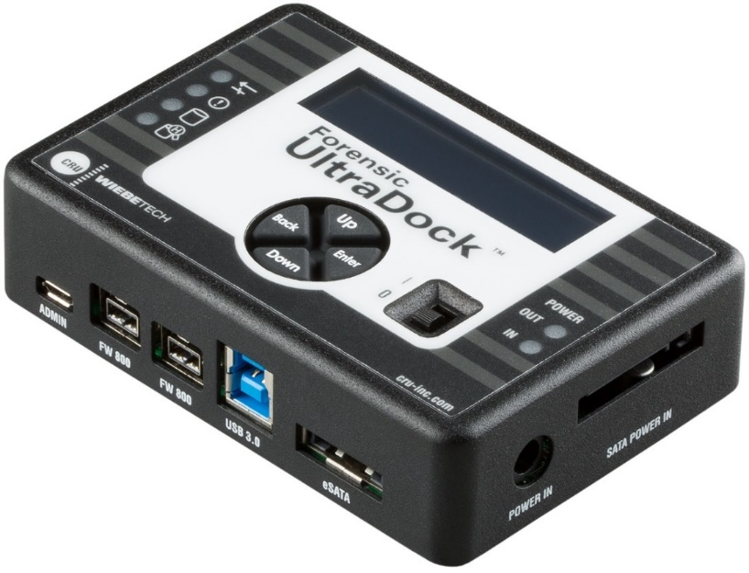
Image Acquisition (2)
Write blockers
  Prevent contamination of the target drive by the acquisition system
Acquisition types
  Live acquisition
  Shut down cleanly
  Pull the plug
CRU Forensic UltraDock(Image © 2017 CRU Acquisition Group, LLC gtsgo.to/y1x90)

Slide 13
Image Acquisition (3)
Hashing utilities
  Digital fingerprint shows image is identical to original evidence source
  Secure Hash Algorithm (SHA)
    SHA-1 versus SHA-2 (SHA 256-bit and SHA 512-bit)
  Message Digest Algorithm (MDA / MD5)
    Vulnerable to collisions but these are difficult to exploit in this context
    Still acceptable for forensic use (though there have been challenges in court)
  Command-line tools
    Certutil (Windows)
    File Checksum Integrity Verifier (Windows)
    md5sum / sha1sum / sha256um / sha512sum (Linux)

Slide 14
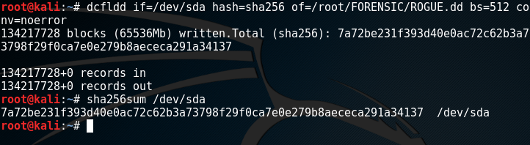
Image Acquisition (4)
Sector-by-sector copy of target disk (or volume)
Image file formats
  Raw – typically .dd or .img or .dmg extension
  .eo1 – EnCase’s vendor format can include disk metadata

Slide 15
Password Cracking
Passwords are stored and transmitted as cryptographic hashes
Password cracking exploits weaknesses in the way the hashes are created or the non-complexity of the plaintext password
Obtaining password hashes
  %SystemRoot%\System32\config\SAM
  %SystemRoot%\NTDS\NTDS.DIT
  /etc/shadow
  Browser password caches
  Network sniffing

Slide 16
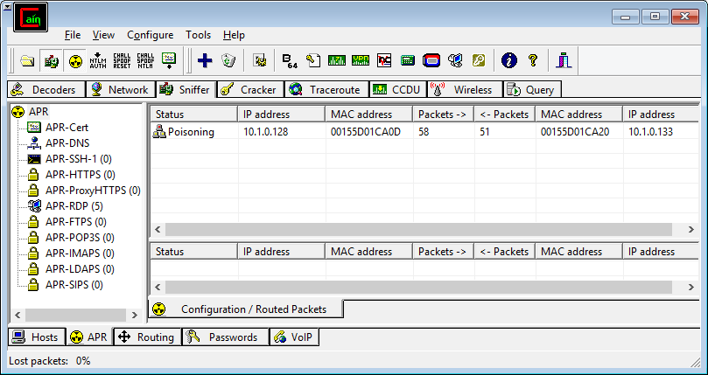
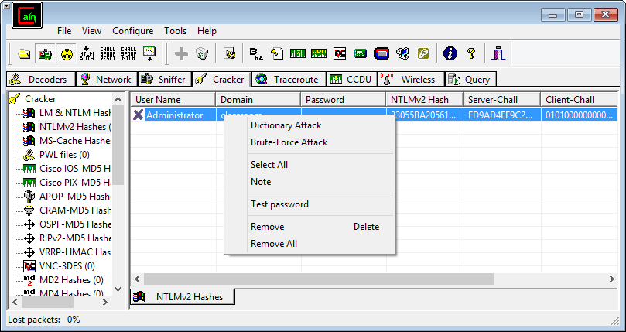
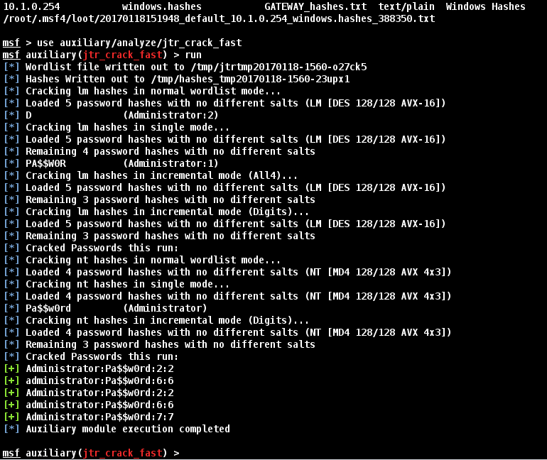
Password Crackers
Cain and Abel
John the Ripper
THC Hydra
Aircrack-ng
L0phtcrack

Slide 17
Password Attack Types
Brute force attack
  Works against weak hashes (LM and NTLMv1)
  Strong passwords and account policies (restrict logon attempts) defend against brute force attacks
  Consider horizontal brute force / password spraying
Dictionary attack
  Match the hash to a common dictionary word
  Compile word lists from data known about the target
  Password dumps show that millions of users choose the same unsecure words or phrases (123456)
  Rainbow tables speed this up by precomputing hashes
Hybrid attack
  Fuzz dictionary lists with typical combinations

Slide 18
Pass-the-Hash (1)
Adversary obtains local admin access to pivot
Scans lsass.exe or file system for hashes of accounts with higher privileges (Domain Admin)
Uses the API of software demanding authorization to pass the hash rather than typing the plaintext password

Slide 19
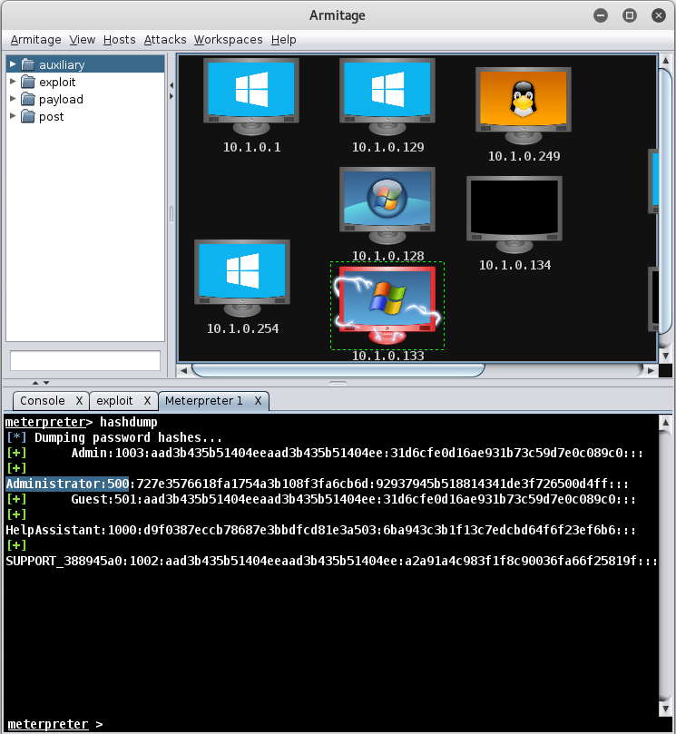
Pass-the-Hash (2)

Slide 20
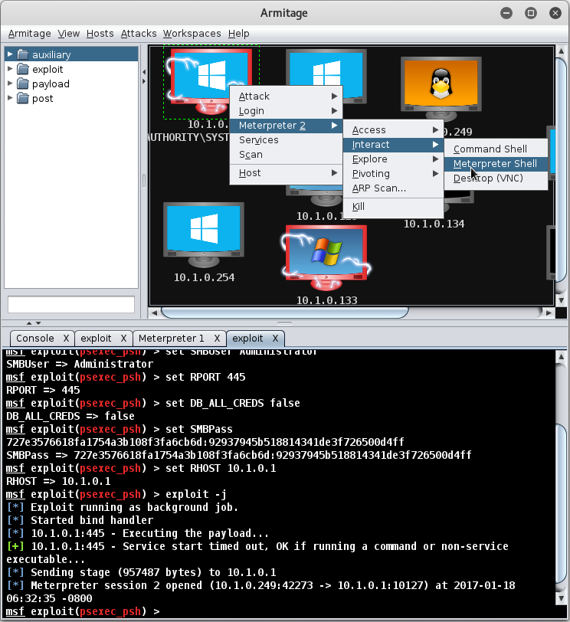
Pass-the-Hash (3)

Slide 21
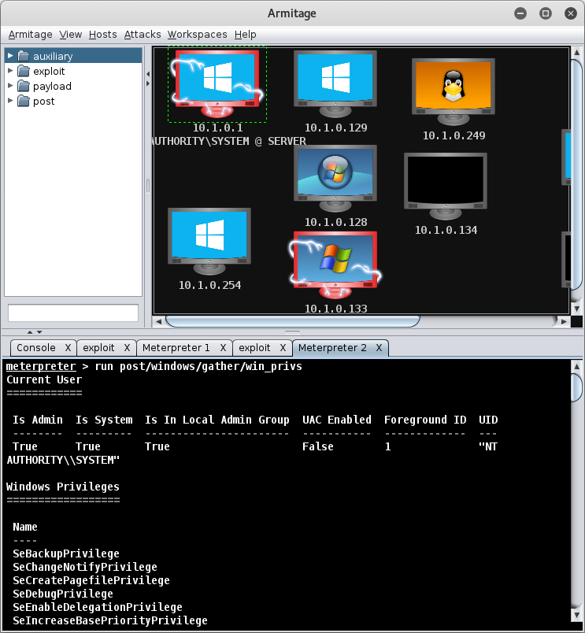
Pass-the-Hash (4)

Slide 22
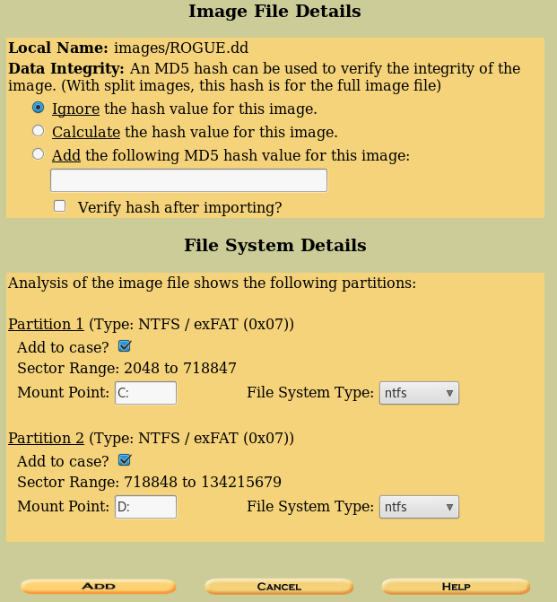
Analysis Utilities (1)
Capture image and identify with digital fingerprint
Load a copy of the image for analysis

Slide 23
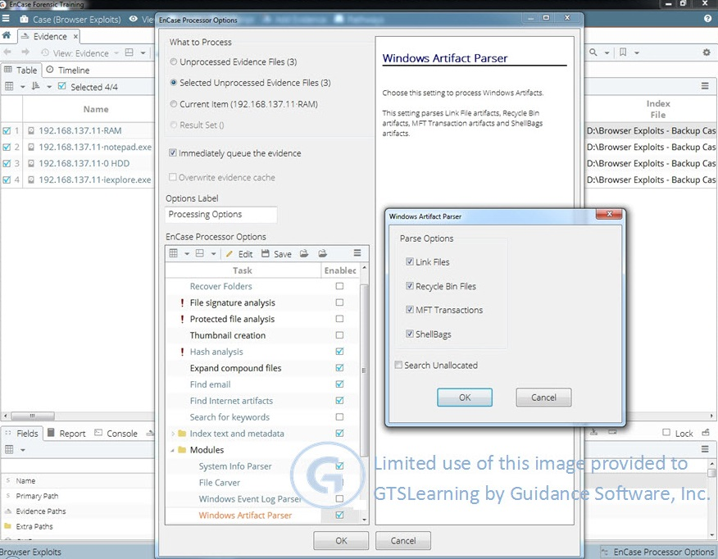
Analysis Utilities (2)
Establish a timeline
    How was access to the system obtained?
    What tools have been installed?
    What changes to system files or applications have been made?
    What data has been retrieved?
    Is there evidence data was exfiltrated over the network or via attached storage?
EnCase Forensic (Image © 2017 Guidance Software Inc. gtsgo.to/e5joj)

Slide 24
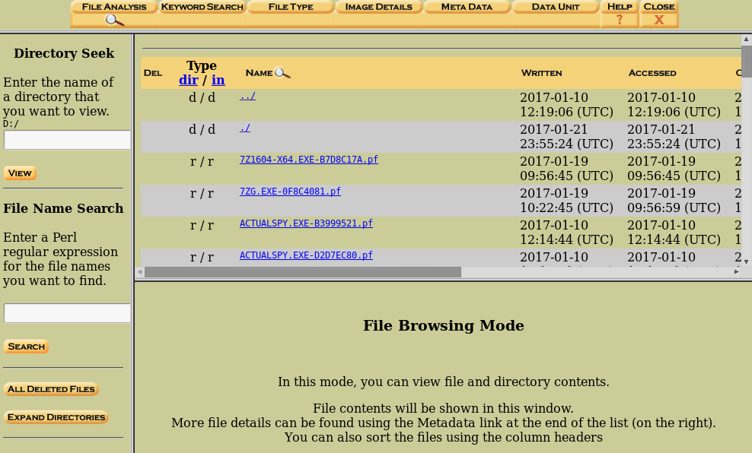
Analysis Utilities (3)
Log viewer
OS and process analysis
  Identify infected process images
  Reconstruct user actions from file system artefacts (shortcuts, prefetch files, jump lists, window positions)

Slide 25
Analysis Utilities (4)
File and file system viewers
  Search system / hidden file system locations
  File carving tools (recover data from deleted files)
  Visualization / keyword search
  File format specific viewers
Cryptography tools
Registry viewer
USB viewer
User account viewer
Application viewers

Slide 26
Identify the features of market-leading forensic investigation suites
Describe the hardware, software, and documentation required for a forensics kit
Acquire forensically secure data images from hardware evidence
Use password cracking and image analysis utilities
Notes:
What documentation is called out as supporting forensics investigations in the CySA+ syllabus? Chain of Custody form, Incident Response plan, Incident form, Call / Escalation lists.
What part of a forensic toolkit preserves the integrity of physical evidence? Tamper-proof seals (or tamper-evident bags).
Which forensics tool is particularly suited to analysis of data on mobile devices? Cellebrite's Universal Forensic Extraction Devices (though both AccessData and EnCase have mobile products for their forensics platforms).
What preparatory step should be taken before using USB media to store forensic images? Sanitize (wipe) the media.
What type of software or hardware should be installed before a forensics workstation is connected to a hard drive seized as evidence? A write blocker.
True or false? When making a cryptographic hash of the contents of a hard drive, the same command line utility must be used to validate the hash? False - the utilities implement standard algorithms so the output of 'certutil sha1' should be the same as 'sha1sum' (for instance).
Which file system locations are of principal interest to an attacker seeking to obtain OS or network password hashes for decryption? On Windows the SAM (Security Account Manager) file or NTDS.DIT (on a Domain Controller). On Linux, typically the /etc/shadow' file.
What is a horizontal brute force attack? Selecting obvious passwords and attempting them against multiple user names. This circumvents the account lockout policies that defeat attempts to brute force a password.
What is PtH? Pass-the-Hash - establishing a session by presenting the hash of a password.
What is the use of a Registry Viewer when performing incident response? A Registry Viewer allows the contents of the Registry in a captured image to be analyzed on the forensics workstation.

Slide 27
Lab 10 / Forensic Image Analysis with Autopsy
Notes:
Note that there are three sets of labs available to use with this course:
Classroom labs that you set up and run yourself (refer to the separate "Labs" book and setup guide on the instructor resource support site).
Learn On Demand (LOD) hosted classroom labs accessed via a browser but following the same general sequence and steps as the classroom lab book.
Self-study Online Labs from Practice Labs accessed by students online - these labs are intended for use by students studying independently and are different from the classroom and hosted classroom labs. If you are using Practice Labs online labs in the classroom, you must specify this at the time of purchase so that the appropriate bandwidth is provisioned in advance. Please ensure that the student PCs meet the requirements for accessing the Self-study Online Labs series. You can obtain a setup guide at gtsgo.to/nf1rc
The sequence of classroom and hosted classroom labs is shown on this slide and in the margins of your instructor edition and in the course timetable. You should guide the students to complete each lab.
If you are not using the classroom or LOD hosted classroom labs you should delete this slide.

Slide 28
Encryption and Hashing
Forensics – Understanding the Digital Forensics Profession and Investigations
Notes:
This slide shows the sequence of Self-study Online Labs. This sequence is also shown in the student edition by the note at the end of the Review Questions page. Note that the Self-Study Online labs purchased directly by students are NOT suitable for classroom use due to the bandwidth required. Classroom-ready Online Labs can be purchased on request.
If you are not using the self-study online labs you should delete this slide.

