Slide 1
CompTIA CySA+ Certification
3.2 Logging and Analysis

Slide 2
Use graphical and command-line tools to perform packet captures
Use software and appliances to consolidate and manage log files from different sources
Analyze results of network reconnaissance data from network traffic, log data, and resource monitors
Notes:
The number in the bottom right corner of the slides refers back to the page where this topic starts in the course book.

Slide 3
Packet Capture
Sniffer
  Read frames from network card driver
    libpcap
    Winpcap
  Hardware sniffer
Promiscuous mode - read all unicast traffic on segment
Switched Ethernet – get visibility over other switch ports
  ARP poisoning attack
  Port mirroring / spanning

Slide 4
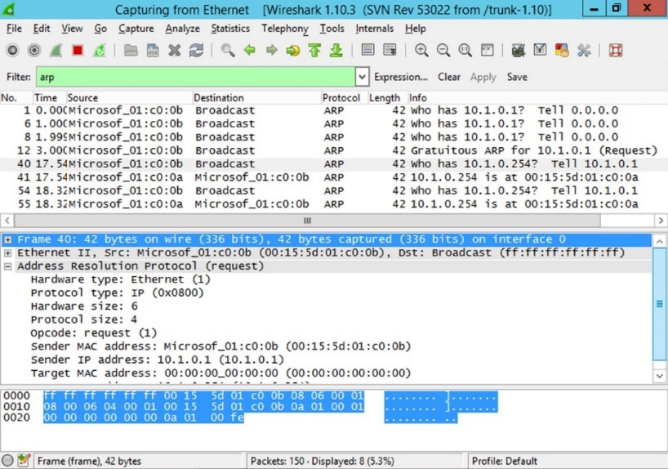
Protocol Analyzers
Decode and analyze frames
  Wireshark
  Kismet
  tcpdump
  Dsniff
  Ettercap
Network monitoring
  Host / bandwidth / packet statistics
  Baselining
  Alerting
Preventing (malicious) eavesdropping

Slide 5
tcpdump
Switches
  -n - show addresses in numeric format
  -nn - show address and ports in numeric format
  -e - include the data link (Ethernet) header
  -v, -vv, -vvv - increase the verbosity of output
  -X - capture the packet payload in hex and ASCII
  -s Bytes – change size of payload capture
  -w File - write the output to a file (.pcap)
  -r File - display the contents of a packet capture file
Filters
  host - capture source and destination traffic from the specified IP or host name
  src / dst - capture only source or destination traffic from the specified IP
  net - capture traffic from the specified subnet (use CIDR notation)
  port - filter to the specified port (or range of ports, such as 21-1024)
  proto - filter to a protocol, such as ip, ip6, arp, tcp, udp, or icmp

Slide 6
Other Packet Capture Tools
Wireshark
  Graphical utility for all major OS
  3-pane view showing frames, decoded frame fields, and raw data
  Tools for analyzing captures
Network General / NetScout
Wireless packet sniffing (Aircrack-ng)
  airmon-ng - enable and disable monitor mode
  airodump-ng - capture 802.11 frames
  aireplay-ng - inject frames to perform an attack to obtain the authentication credentials for an access point
  aircrack-ng - decode the authentication key
Packet injection (Dsniff, Ettercap, hping, Nemesis, scapy)

Slide 7
Monitoring Tools
Work on traffic statistics to visualize traffic flows and generate alerts
MRTG (Multi Router Traffic Grapher) and Cacti
  Open source software
  Poll for SNMP data
SolarWinds and NetFlow Analyzer
  NetFlow is a means of identifying traffic flows – packets sharing the same characteristics
  Other vendor / open source alternatives
Nagios

Slide 8
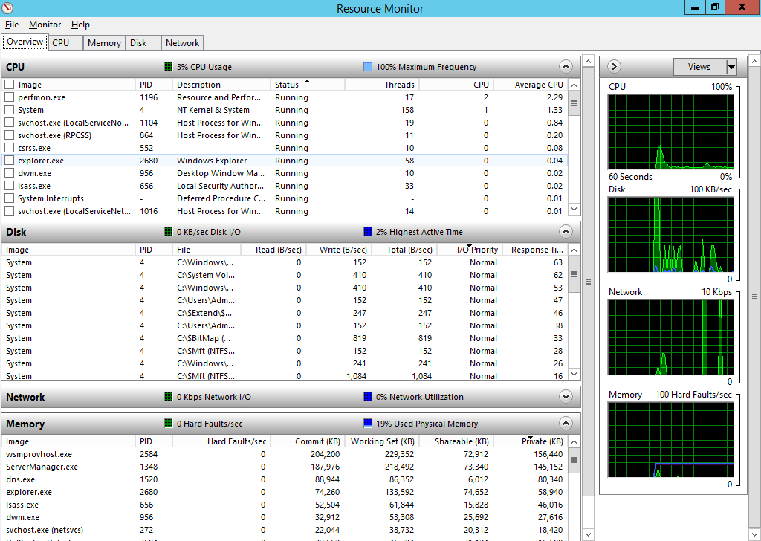
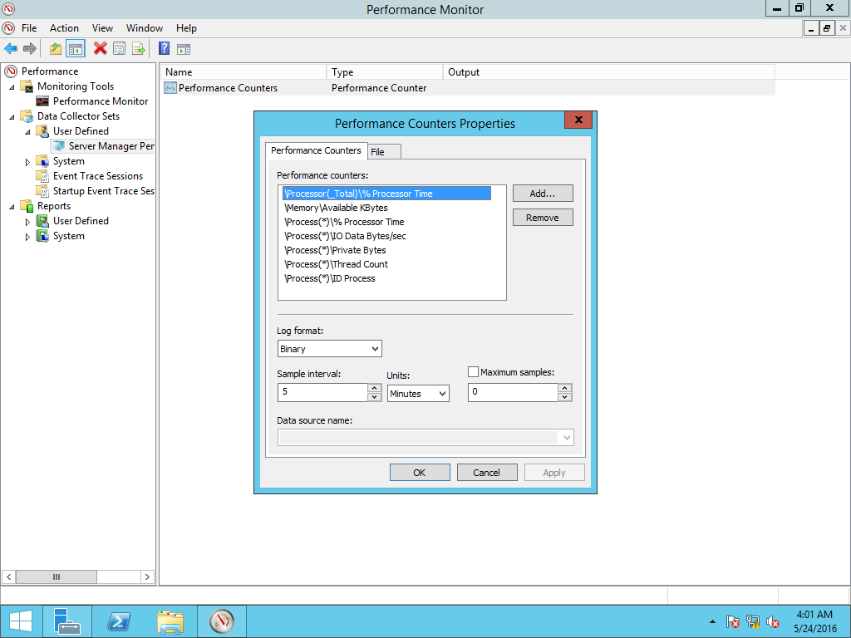
Resource Monitors
Record utilization (CPU, memory, disk, network interface)
Collect statistics from PC hosts and network appliances
Baseline performance and show availability

Slide 9
Log Review and SIEM
Log analysis
  Manual review (how many millions of log entries?)
  Automated event correlation and interpretation
  Identify trends
Security Information and Event Management (SIEM)
  Aggregate logs from different sources
  Correlate observables to Indicators of Compromise (IoC)
  Alert administrators – minimize false positives / false negatives
  Long-term retention and regulator compliance

Slide 10
Big Data and Data Visualization
“Big Data”
  Volume, Velocity, Variety (IBM add Veracity)
  Data acquisition and storage architecture
  Search and analysis tools
  Access controls
Data visualization
  Assists manual review
  Graph traffic flows / usage statistics
  Tag cloud keywords in a data store

Slide 11
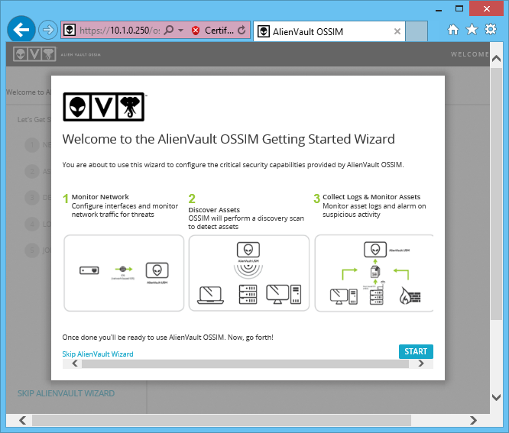
SIEM Tools
Splunk
ArcSight
QRadar
Alien Vault / OSSIM (Open Source Security Information Management
Kiwi Syslog

Slide 12
SIEM Data Outputs (1)
Aggregation
Collect logs in different formats that can all be interpreted (parsed) by the SIEM software
Time stamp issues
Resource-intensive (events per second, storage capacity, processing and analysis)
Secure – prevent tampering

Slide 13
SIEM Data Outputs (2)
Windows Event Log / Event Subscriptions
Syslog
Firewall logs
Packet captures
Nmap scan results
IDS reports
Vulnerability scan reports

Slide 14
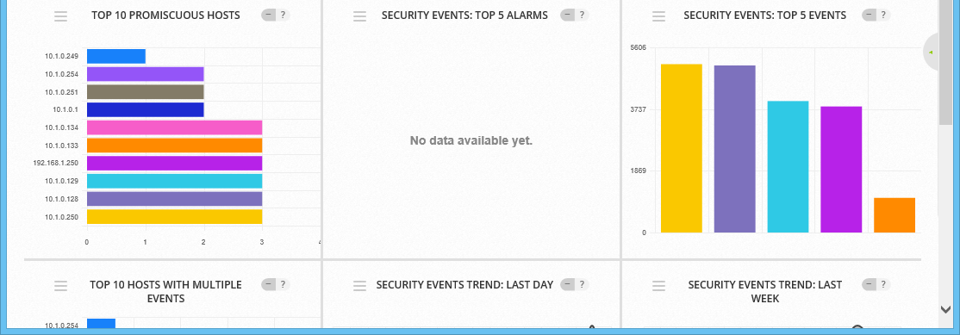
SIEM Data Analysis (1)
Correlation
Signature-detection
Anomaly analysis
Availability statistics
Heuristic analysis and machine learning

Slide 15
SIEM Data Analysis (2)
Behavioral analysis
What do users typically do?
When a user account or host does something atypical is that a threat?
What is the process of a modern cyber-attack?
  DDoS, malware, scanning, C2 / C&C, data exfiltration
Tactics, Techniques, Procedures (TTP)
  Link observables to indicators and indicators to TTPs
  Machine processable threat intelligence

Slide 16
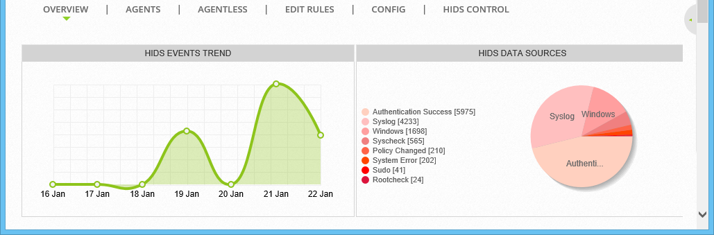
SIEM Data Analysis (3)
Trend analysis
  Identify “sparse” tactics
  Identify changing use patterns that are suspicious
Threat awareness and threat intelligence

Slide 17
Point-in-Time Data Analysis
What should command our attention?
  SIEM dashboards
  Alert configuration
What evidence can we obtain about an intrusion that was only detected after-the-fact?
  Full Packet Capture
  Retrospective Network Analysis

Slide 18
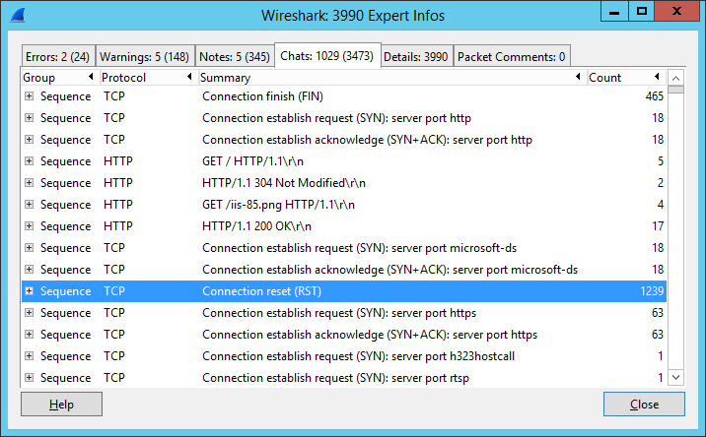
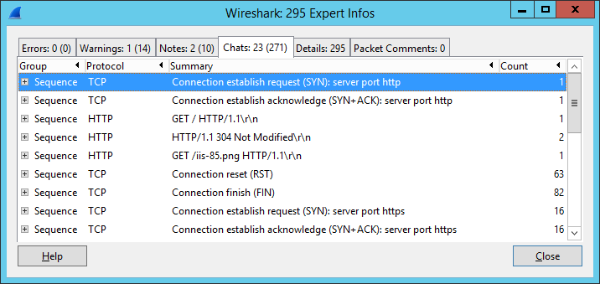
Packet Analysis (1)

Slide 19
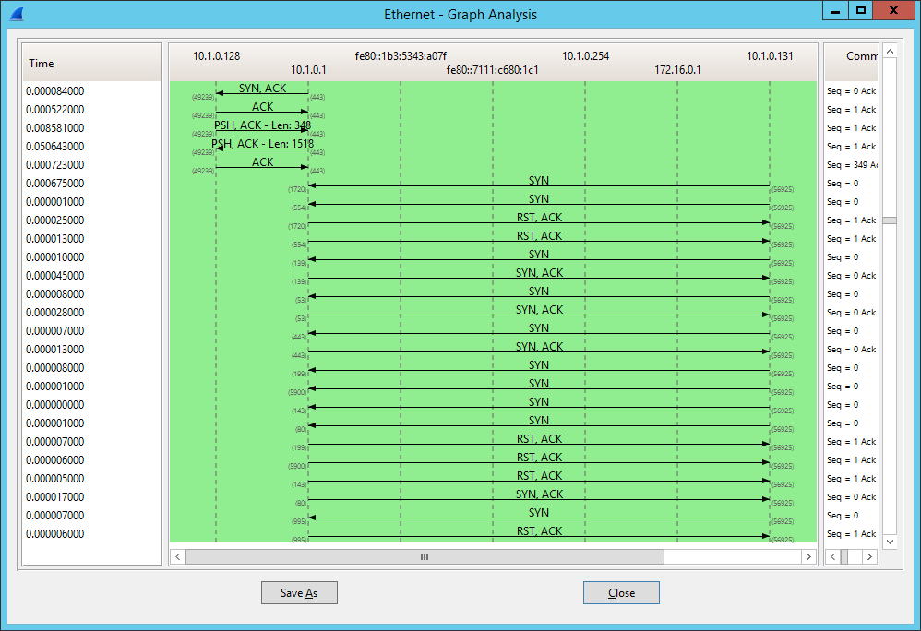
Packet Analysis (2)

Slide 20
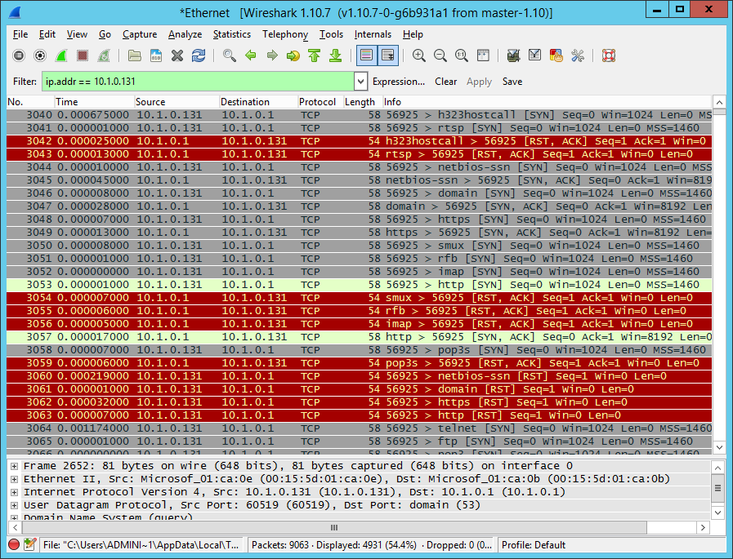
Packet Analysis (3)

Slide 21
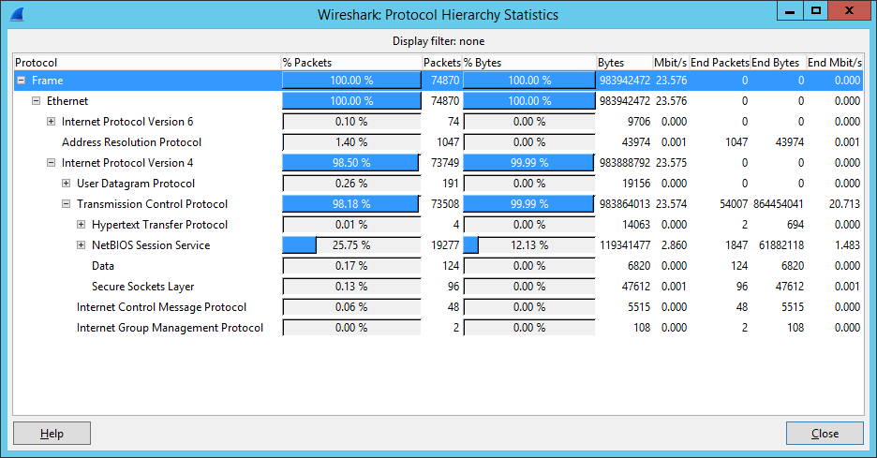
Protocol Analysis (1)

Slide 22
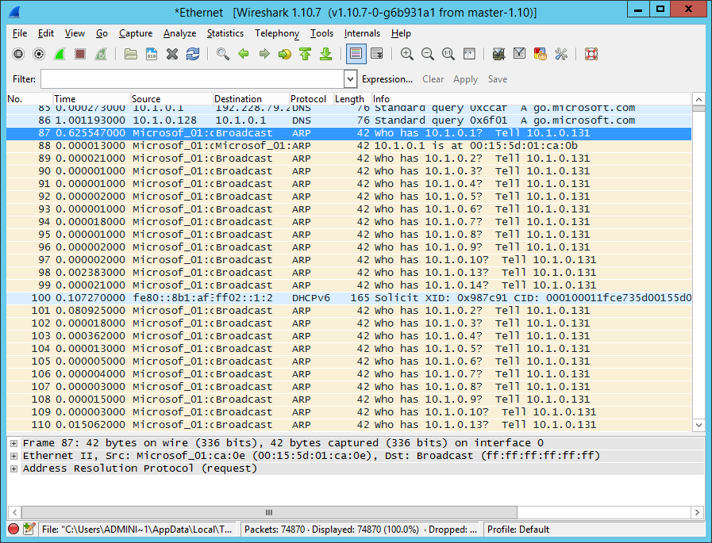
Protocol Analysis (2)

Slide 23
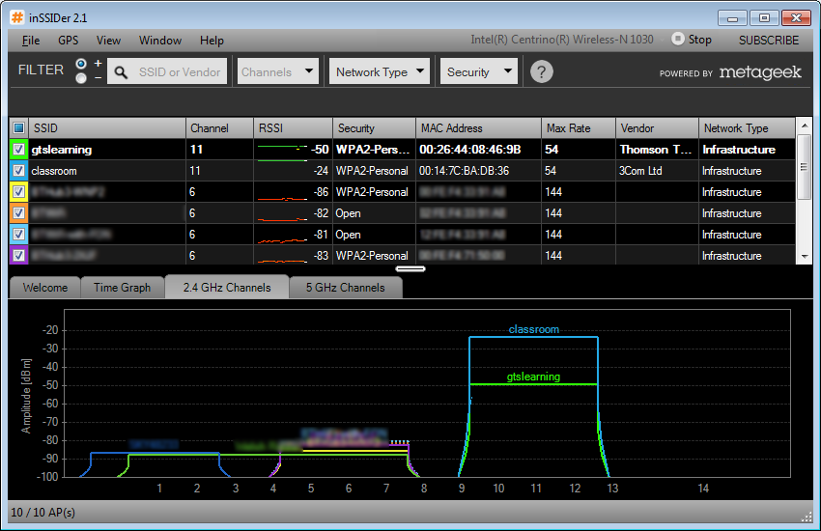
NetFlow and Wireless Analysis
NetFlow – visualize traffic flows
  Unusual ports / protocols / IP endpoints
  Bandwidth / usage
  Vendor tools
  Etherape
Wireless analysis
  Wireless packet capture
  RF surveys

Slide 24
Use graphical and command-line tools to perform packet captures
Use software and appliances to consolidate and manage log files from different sources
Analyze results of network reconnaissance data from network traffic, log data, and resource monitors
Notes:
What API or APIs (software libraries) typically facilitates packet capture on Linux and Windows systems? libpcap on Linux and Winpcap on Windows. You might also mention the Airpcap library for sniffing wireless traffic.
What switch feature allows a NIDS to monitor traffic for all connected hosts? Port mirroring or spanning.
What is the effect of running 'tcpdump -i eth0 -w server.pcap'? Write the output of the packet capture running on network interface eth0 to the 'server.pcap' file.
What is packet injection? Using software to write packets directly to the network stream, often to spoof or disrupt legitimate traffic.
What is the use of "MRTG"? The Multi Router Traffic Grapher is used to visualize traffic flows.
Which of the following is NOT used primarily for traffic analysis: Cacti, NetScout, Solar Winds, Snort. Snort is an intrusion detection tool rather than a packet or traffic analyzer.
Why is "big data" of relevance to security analysis? Big data refers to the ability to store and search high volume, high velocity (constantly changing) unstructured data sets. The data captured by security appliances (log files, packet captures, scan results, and so on) fits this description.
What are the main functions of SIEM? Aggregate data from different sources, analyze it for correlating risk indicators, and alert and present information. Additionally, SIEM is useful for archiving and compliance.
What UNIX / Linux software is a de facto standard for centralized log collection? Syslog.
What is the advantage of the Nmap 'grepable' output format? grep is a Linux command for running a regular expression to search for a particular string. Nmap's grepable output is easier for this tool to parse.
What type of analysis assesses threat levels with regard to historical information? Trend analysis.
What type of wireless analysis would report radio spectrum usage rather than capture packets? A site survey would use spectrum analysis to report RF strength at different locations but from a security point-of-view you might use this to detect rogue access points (or other unauthorized radio stations).

Slide 25
Lab 8 / Packet Analysis with Wireshark and Network Miner
Lab 9 / SIEM with OSSIM
Notes:
Note that there are three sets of labs available to use with this course:
Classroom labs that you set up and run yourself (refer to the separate "Labs" book and setup guide on the instructor resource support site).
Learn On Demand (LOD) hosted classroom labs accessed via a browser but following the same general sequence and steps as the classroom lab book.
Self-study Online Labs from Practice Labs accessed by students online - these labs are intended for use by students studying independently and are different from the classroom and hosted classroom labs. If you are using Practice Labs online labs in the classroom, you must specify this at the time of purchase so that the appropriate bandwidth is provisioned in advance. Please ensure that the student PCs meet the requirements for accessing the Self-study Online Labs series. You can obtain a setup guide at gtsgo.to/nf1rc
The sequence of classroom and hosted classroom labs is shown on this slide and in the margins of your instructor edition and in the course timetable. You should guide the students to complete each lab.
If you are not using the classroom or LOD hosted classroom labs you should delete this slide.

Slide 26
Passive Topology Discovery
Packet Sniffing
Introduction to Syslog
Monitoring Servers
Alien Vault Monitoring - SIEM and NetFlow
Notes:
This slide shows the sequence of Self-study Online Labs. This sequence is also shown in the student edition by the note at the end of the Review Questions page. Note that the Self-Study Online labs purchased directly by students are NOT suitable for classroom use due to the bandwidth required. Classroom-ready Online Labs can be purchased on request.
If you are not using the self-study online labs you should delete this slide.

