Slide 1
CompTIA CySA+ Certification
4.3 Incident Analysis and Recovery

Slide 2
Identify the common symptoms of incidents affecting networks, hosts, and applications
Respond to an incident with appropriate containment, eradication, validation, and corrective techniques
Notes:
The number in the bottom right corner of the slides refers back to the page where this topic starts in the course book.

Slide 3
Analysis and Recovery Frameworks
Coping with incidents at a tactical level
Countering hostile actions
OODA Loop
    Observe
    Orient
    Decide
    Act
Gain and maintain initiative rather than reacting to adversary actions
Avoid “analysis paralysis”

Slide 4
Defensive Capabilities
Detect - identify the presence of an adversary and the resources at his or her disposal
Destroy - render an adversary's resources permanently useless or ineffective
Degrade - reduce an adversary's capabilities or functionality, possibly temporarily
Disrupt - interrupt an adversary's communications or frustrate or confuse their efforts
Deny - prevent an adversary from learning about your capabilities or accessing your information assets
Deceive - supply false information to distort the adversary's understanding and awareness

Slide 5
Courses of Action Matrix

Slide 6
Analyzing Network Symptoms (1)
Unusual traffic spikes
  DDoS – identify malicious traffic and redirect
Irregular peer-to-peer communication
  Analyzing traffic flows
  Endpoints involved
  Protocols / ports used
  Timing of communications (time of day or frequency of transmissions)
  Packet sizes / overall bandwidth

Slide 7
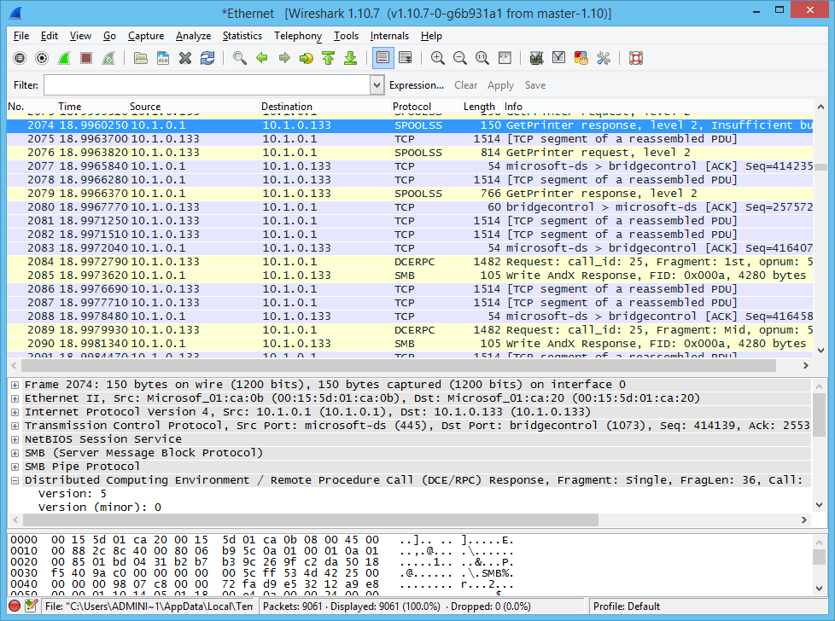
Analyzing Network Symptoms (2)

Slide 8
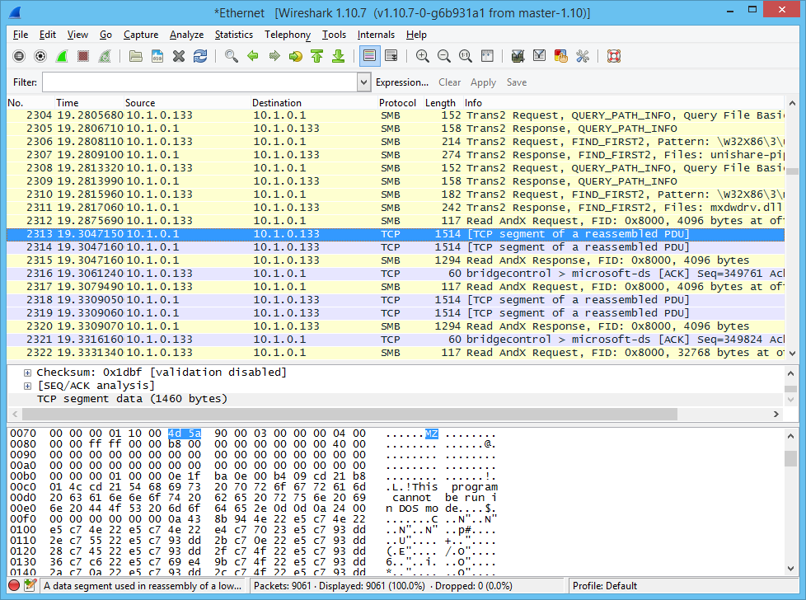
Analyzing Network Symptoms (3)

Slide 9
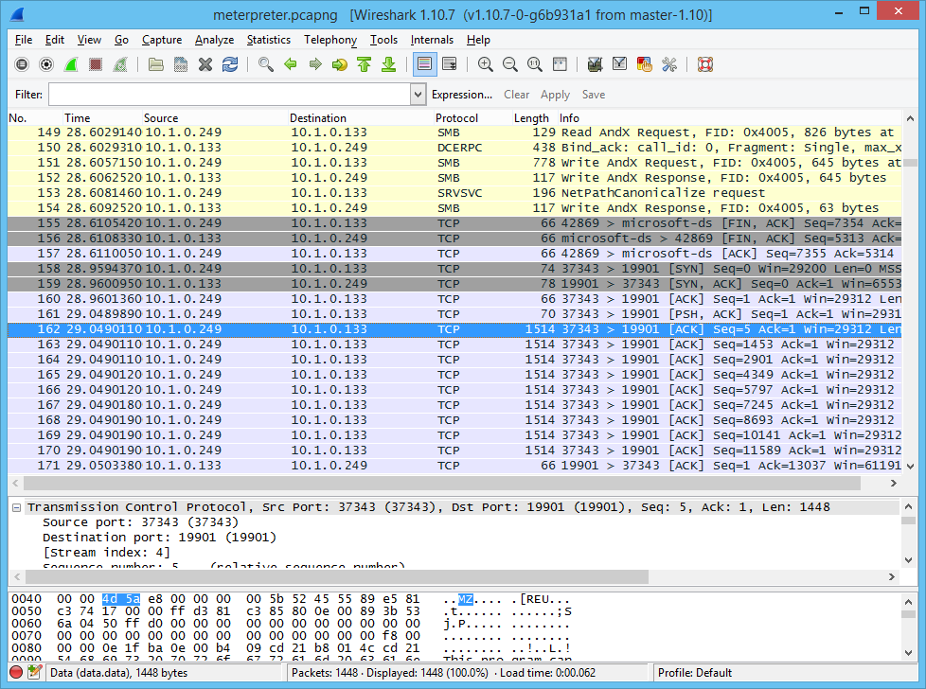
Analyzing Network Symptoms (4)

Slide 10
Analyzing Network Symptoms (5)
Rogue devices
  Network taps
  Network appliances
  Servers
  Workstations / mobile devices
  Smart appliances
Beaconing
Scan sweeps

Slide 11
Analyzing Host Symptoms (1)
System logs
Analysis tools
  Sysinternals
  Digital forensics suites
  Windows Forensic Toolchest (WFT)
  Redline

Slide 12
Analyzing Host Symptoms (2)
Malicious processes – code injection
  Masquerading
  DLL injection
  DLL sideloading
  Process hollowing
Symptoms
  Invalid process names or incomplete information
  Unsigned processes
  Parent / child relationships with valid Windows processes
  Packed (compressed) processes
  Interactions with file system, registry, and network

Slide 13
Analyzing Host Symptoms (3)
Resource consumption
  Processor usage
  Memory consumption
  Drive capacity
Device attachment
Unauthorized software
Unauthorized changes and privileges

Slide 14
Analyzing Data Exfiltration (1)
HTTP (or HTTPS) transfers to consumer file sharing sites or unknown domains
Other overt channels, such as FTP, IM, P2P, email, and so on
Explicit tunnels such as SSH or VPNs
Steganography
File copy to USB, external hard drive, or other media

Slide 15
Analyzing Data Exfiltration (2)
Remote Access Trojans (RAT) and backdoors
netcat / cryptcat
Staging areas
  Split archives using atypical compression or encryption types (RAR or GZIP on Windows)
  Use of system locations (Recycle Bin, System Volume Information)
  Use of Alternate Data Streams (ADS)

Slide 16
Analyzing Application Symptoms
Anomalous activity
Unexpected outbound communication
Introduction of new accounts
Service interruption
Memory overflow
Unexpected output

Slide 17
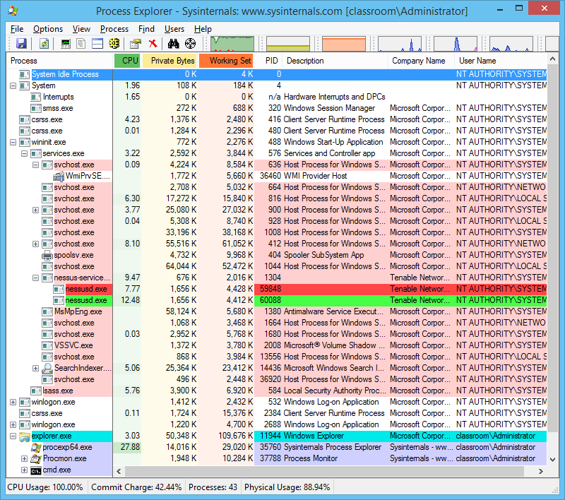
Using Process Explorer (1)

Slide 18
Using Process Explorer (2)
Windows system processes
  System Idle (PID 0) and System (PID 4)
  Client Server Runtime SubSystem (csrss.exe)
  WININIT (wininit.exe)
  Services
  Local Security Authority SubSystem (lsass.exe)
  WINLOGON (winlogon.exe)
  USERINIT (userinit.exe)
  Explorer (explorer.exe)
Show loaded DLLs
Show handles (interactions with file system and registry)

Slide 19
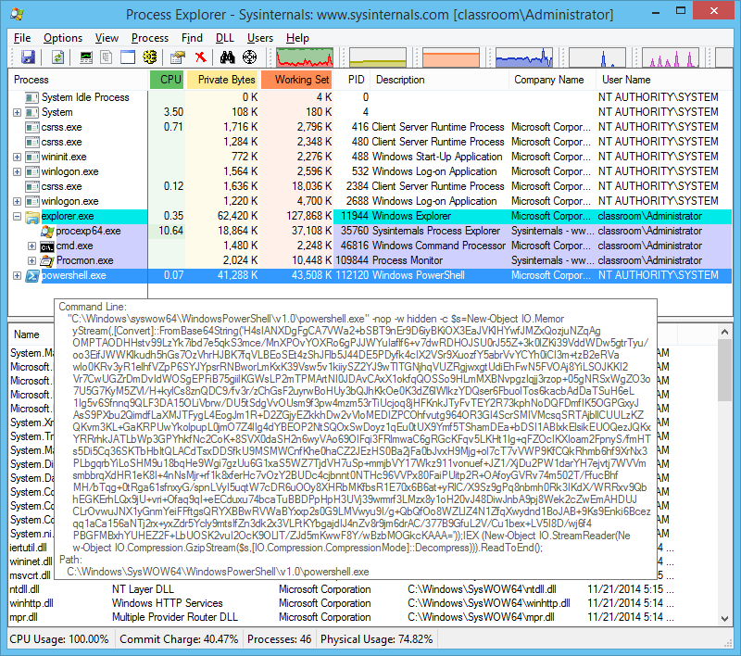
Droppers

Slide 20
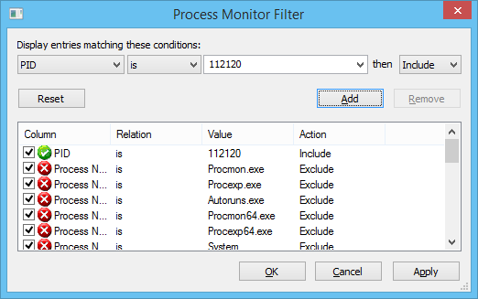
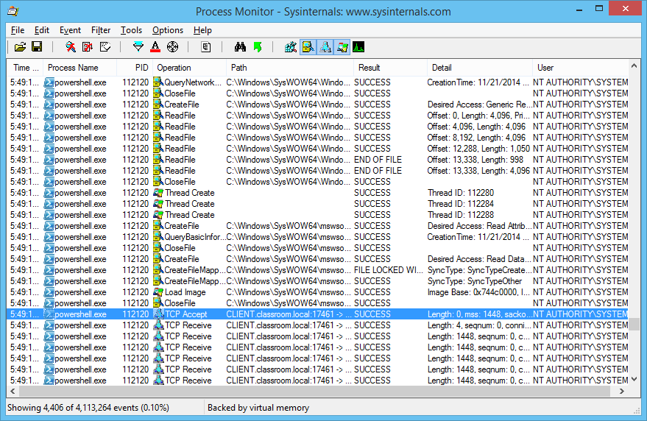
Process Monitor
View events as they occur
Filter to avoid overwhelming host resources

Slide 21
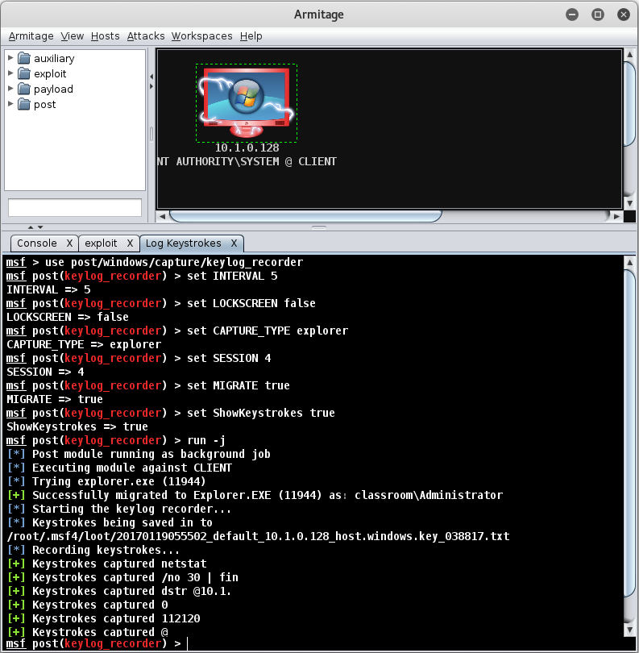
Post-exploitation (1)

Slide 22
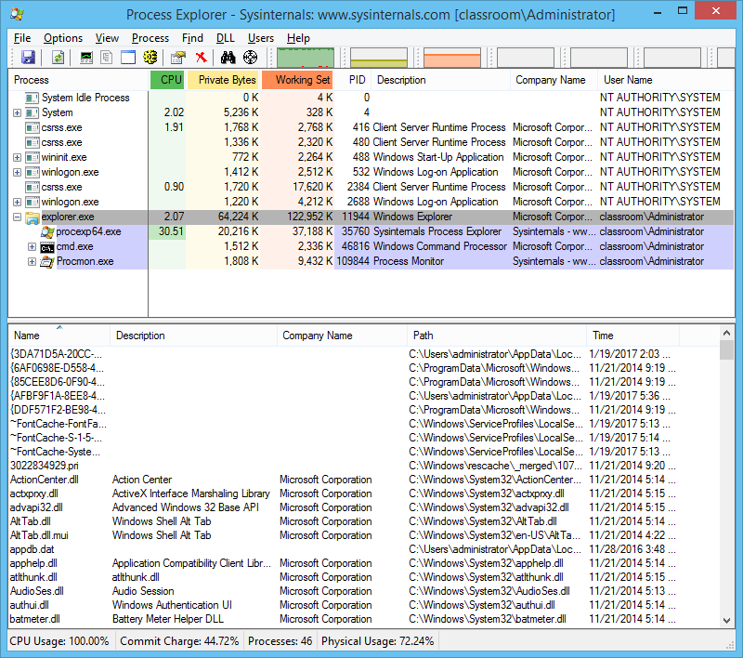
Post-exploitation (2)

Slide 23
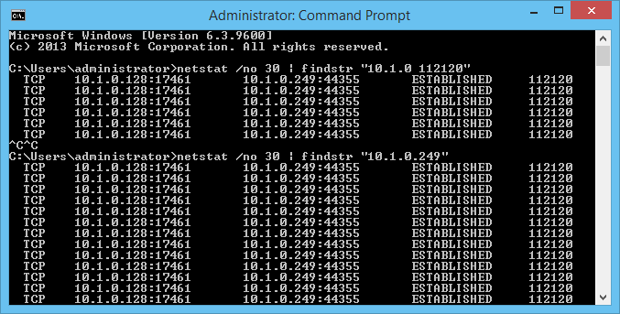
Post-exploitation (3)

Slide 24
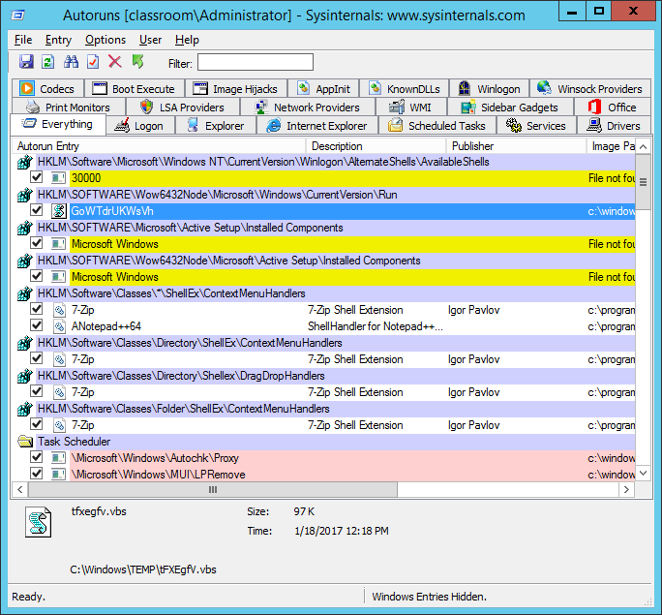
Persistence

Slide 25
Containment Techniques (1)
Prevent ongoing intrusion or data breach
  Likely to be the overriding priority
Identify whether the intrusion is the primary attack or a secondary one
Avoid alerting the attacker to the fact that the intrusion has been discovered
Preserve forensic evidence of the intrusion

Slide 26
Containment Techniques (2)
Removal
Isolation
Segmentation
Reverse engineering

Slide 27
Eradication Techniques
Sanitize media
Replace with clean image / reconstruct by reinstalling applications and data
Manual eradication
  Contain system and analyze
  Terminate suspicious processes and delete
  Recover data if possible
  Identify malware autostart locations and clean
  Restore clean system files
  Reboot and analyze again (still sandboxed)
  If necessary, analyze firmware for contamination
  If successful, restore system to production role, with close monitoring

Slide 28
Validation Techniques
Patching
Permissions
Scanning / verify logging

Slide 29
Corrective Actions (1)
Report writing
  Communicate clearly and effectively
  Organize source material
  Structure report appropriately
  Consider target audience(s)
Lessons learned report
  Meeting to review incident and procedures
  Structure meeting – 6 questions or timeline
  Report to show technical features and recommendations
Incident summary report
  More general report for wider stakeholders

Slide 30
Corrective Actions (2)
Update incident response plan
Change control process

Slide 31
Identify the common symptoms of incidents affecting networks, hosts, and applications
Respond to an incident with appropriate containment, eradication, validation, and corrective techniques
Notes:
How does the Intelligence-Driven Computer Network Defense white paper categorize defensive capabilities? Detective, destructive, degrading, disruptive, denying, deceptive.
What steps would you take to investigate irregular peer-to-peer communication? Start an incident response ticket and log all actions taken. Identify the IP addresses involved. On a LAN work out the identity of each host and the accounts and services running on them. On the Internet, use IP reputation services and geoIP to identify the host(s). Raise the logging and packet capture level to monitor the communications. Try to identify the traffic - if it contains sensitive data consider closing the channel to prevent further release of information.
Your SIEM has alerted you to ongoing scanning activity directed against workstations and servers. The host intrusion detection on each target has blocked access to the source IP automatically. What are your options and considerations for investigating this incident? You will want to identify the actor behind the scanning attempts, possibly without alerting him to the fact that he has been discovered. Log the incident and initiate a confidential response process. Gather information about the source IP and how it has been compromised. Verify that no successful exploits have been launched against critical systems. If you require additional evidence, consider using a honeypot to draw the attacker out. Ensure heightened monitoring across the network.
Your UTM has prevented the transfer of SQL data from a sales database containing customer records to an external IP address from a workstation on the Windows domain network. A partial transfer of information has already occurred. What are your priorities and how should the incident be managed going forward? Initiate a lockdown of premises and urgently review the physical system and network traffic / system logs to determine whether the attacker was physically present and could attempt to remove the data on physical media. If possible, analyze a packet trace to determine what information was breached. Prepare for a forensic investigation of the compromised system and for a report to stakeholders about what information could have been disclosed.
Your SIEM has flagged unusually high incidence of CPU spikes on multiple workstations across the network, mostly occurring early in the morning. No server systems seem to be affected. What (if any) incident response actions should you perform? Log a low priority incident and attempt to correlate (is a faulty patch causing the issue for instance?) Discount malicious actors by analyzing network traffic, looking for scan attempts. Continue at a heightened alert level if no definitive cause can be identified.
A technician attending a user who has been complaining about frequent lockups and logoffs with his machine has discovered a large cache of encrypted zipped files stored within the "System Volume Information" folder. What are your priorities for incident response and what tools will you use? This must be flagged as an important incident that requires the attention of multiple skilled incident responders. You must learn the content of the files, discover whether there has been a data breach, and try to identify the adversary. You will need to use forensic tools to investigate the presence of APT malware and network transmissions, analyzing log files and Registry changes on the compromised host. You may also try to use decryption tools to try to decipher the encrypted archives.
Which of the following processes would you NOT expected to be running under services.exe? Csrss.exe, Lsass.exe, Svchost.exe, SearchIndexer.exe, Spoolsv.exe. Csrss.exe and Lsass.exe.
What containment technique requires most resources to implement? Reverse engineering.
What are the main four actions that must be performed in validating that an infected host has been remediated? Establish patch management, audit permissions, scan for software or configuration vulnerabilities, and verify continuous monitoring via logging and event recording.
What distinguishes an incident summary report from a lessons learned report? A lessons learned report is a technical report designed for internal use. An incident summary report may be distributed more widely to stakeholders.

Slide 32
Lab 11 / Red Team Versus Blue Team
Notes:
Note that there are three sets of labs available to use with this course:
Classroom labs that you set up and run yourself (refer to the separate "Labs" book and setup guide on the instructor resource support site).
Learn On Demand (LOD) hosted classroom labs accessed via a browser but following the same general sequence and steps as the classroom lab book.
Self-study Online Labs from Practice Labs accessed by students online - these labs are intended for use by students studying independently and are different from the classroom and hosted classroom labs. If you are using Practice Labs online labs in the classroom, you must specify this at the time of purchase so that the appropriate bandwidth is provisioned in advance. Please ensure that the student PCs meet the requirements for accessing the Self-study Online Labs series. You can obtain a setup guide at gtsgo.to/nf1rc
The sequence of classroom and hosted classroom labs is shown on this slide and in the margins of your instructor edition and in the course timetable. You should guide the students to complete each lab.
If you are not using the classroom or LOD hosted classroom labs you should delete this slide.

Slide 33
Forensics - E-mail and Social Media Investigations
Notes:
This slide shows the sequence of Self-study Online Labs. This sequence is also shown in the student edition by the note at the end of the Review Questions page. Note that the Self-Study Online labs purchased directly by students are NOT suitable for classroom use due to the bandwidth required. Classroom-ready Online Labs can be purchased on request.
If you are not using the self-study online labs you should delete this slide.

