Slide 1
CompTIA Network+ Certification
4.5 Authentication and Endpoint Security

Slide 2
Understand the components of an access control system and the importance of role separation
Summarize social engineering-based attacks
Identify the features and uses of different authentication and directory service products and protocols
Understand the use and components of enforcing port security and Network Access Control
Notes:
The number in the bottom right corner of the slides refers back to the page where this topic starts in the course book.

Slide 3
Authentication and Access Controls
Identification - creating an account or ID that identifies the user or process on the computer system
Authentication - proving that a subject is who or what it claims to be when it attempts to access the resource
Authorization - determining what rights subjects should have on each resource and enforcing those rights
Accounting - tracking authorized and unauthorized usage of a resource or use of rights by a subject

Slide 4
Trusted, Untrusted, and Privileged Users
Trusted users
  Employees, partners, contractors...
  Must be authenticated and authorized
  Can be managed by organization security policies
Untrusted users
  Visitors, guests, customers, suppliers
  Could be authenticated or unauthenticated
  Outside organization security policies
Privileged user accounts and role separation
Insider threat
Logic bombs

Slide 5

Social Engineering
Dominate or charm targets into revealing information or providing access
Exploit “weak authentication” over telephone/IM/email
Phishing/pharming
What makes attacks effective?
  Authority/intimidation
  Consensus/social proof
  Scarcity/urgency
  Familiarity/liking/trust

Slide 6
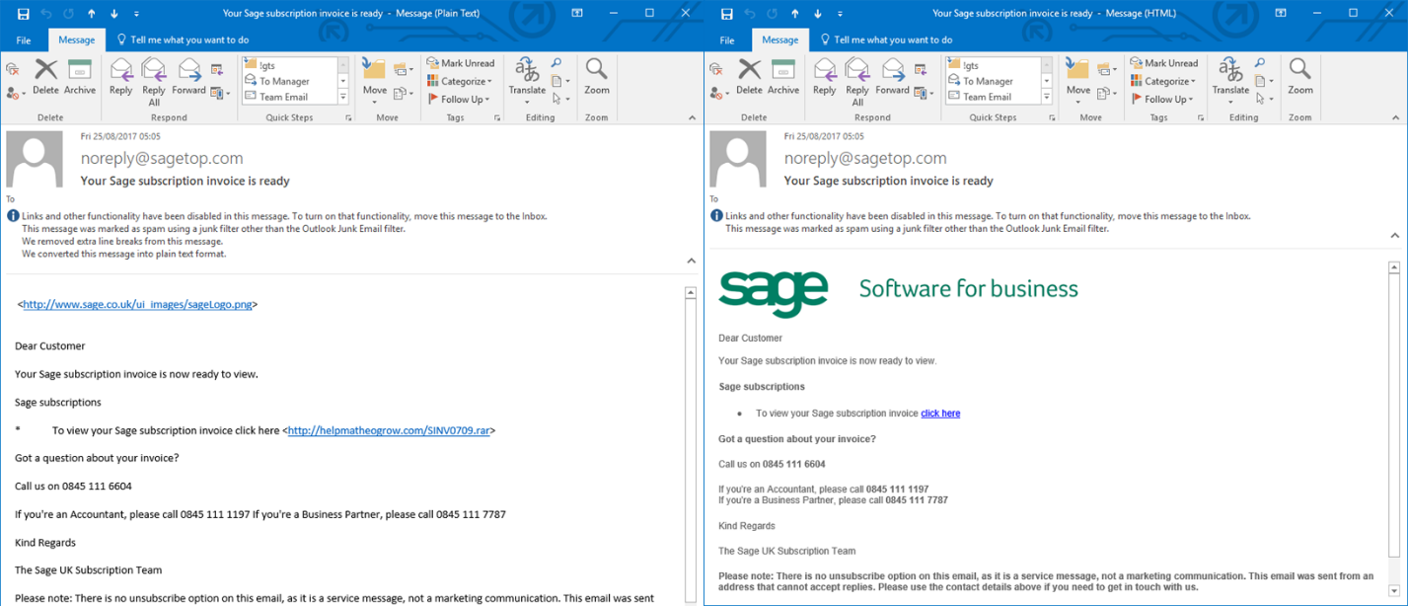
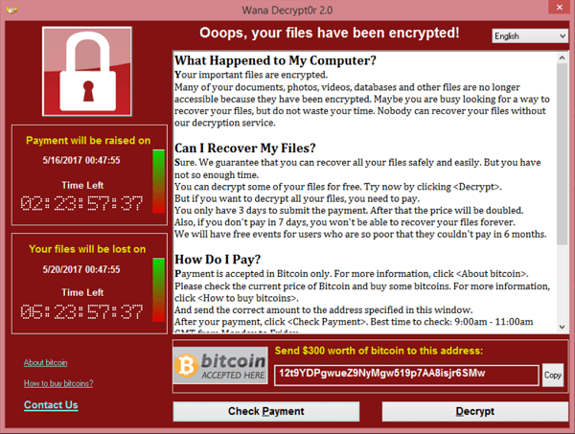
Phishing, Pharming, and Ransomware
Used with permission from Microsoft
Phishing/pharming
  Using spoofed electronic communications to trick a user into providing confidential information
  Spoof emails or faked/hacked websites
Ransomware/Crypto-malware
  Nuisance (“lock out” user by replacing shell)
  Serious (encrypt data files or drives)

Slide 7
Mitigating Social Engineering
Tailgating and shoulder surfing
What makes attacks ineffective?
  Policy and standard procedures
  Education and training
  Accounting (auditing and surveillance)

Slide 8
Authentication Technologies
Factors
  Something you know (such as a password)
  Something you have (such as a smart card)
  Something you are (such as a fingerprint)
  Something you do (such as making a signature).
  Somewhere you are (such as using a mobile device with location services
Single and multifactor systems
  Two-factor
  Multifactor

Slide 9
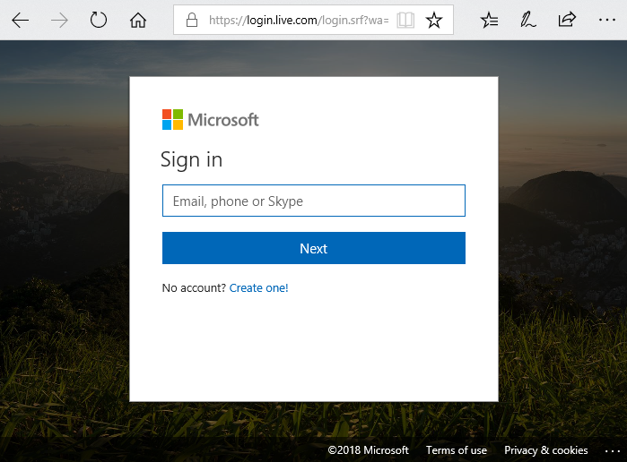
Single Sign On (SSO)
Authenticate once – authorize many
  User authenticates to obtain an access token
  Token is used to authenticate silently to other applications
  User and application both trust token provider
Simplifies account management
But compromising an account may compromise multiple applications
Difficult to implement on public networks
Used with permission from Microsoft

Slide 10
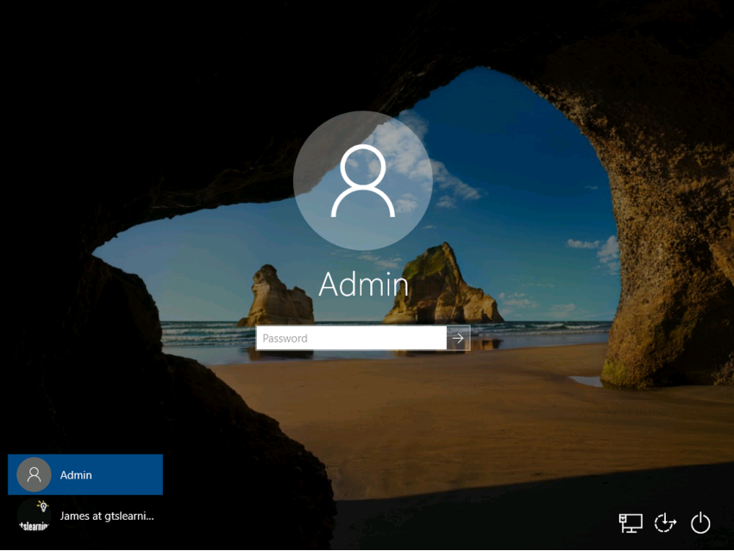
Something You Know
Username and password
Passphrase
Person Identification Number (PIN)
Swipe/pattern unlock
Personally Identifiable Information (PII)/password reset
Used with permission from Microsoft

Slide 11
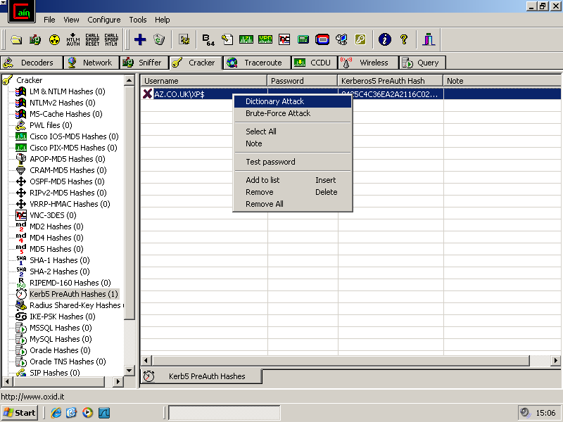
Password Attacks
Cleartext credentials
Dictionary
Brute force

Slide 12
Something You...
Have
  Smart card and token-based access mechanisms (such as key fobs)
Are
  Biometric access control
Do
  Behavioral recognition
  More likely to be used for continuous authentication or extra validation
Or Somewhere You Are
  Geographic location or logical network address
  Global Positioning System (GPS), Indoor Positioning System (IPS), GeoIP
  More likely to be used for continuous authentication or extra validation

Slide 13
PKI and Digital Certificates
Public key cryptography (asymmetric encryption)
Key pairs (public and private) used for two purposes
  Used for confidentiality - if a public key (known to anyone) encrypts a message – only the linked private key (kept secret by the holder) can decrypt the message
  Used for authentication – if a private key encrypts a digital signature, only the linked public key can decrypt it, proving the sender is the holder of the private key
Public Key Infrastructure (PKI) authenticates the public key
  Public key is wrapped in a digital certificate signed by a Certificate Authority (CA)
  If client trusts the CA, they can also trust that a certificate is valid
Subject is the certificate holder (user or server)

Slide 14
LAN Manager/NTLM
LM authentication for Windows 9x
  Susceptible to password cracking
NTLM/NTLMv2 still provides local logon for standalone Windows
  Stronger than LM
Linux local authentication

Slide 15
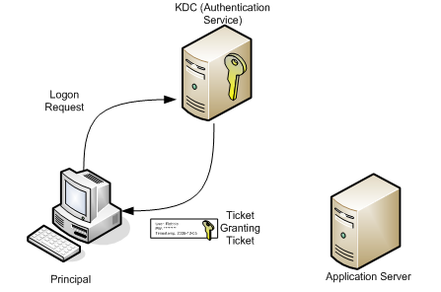
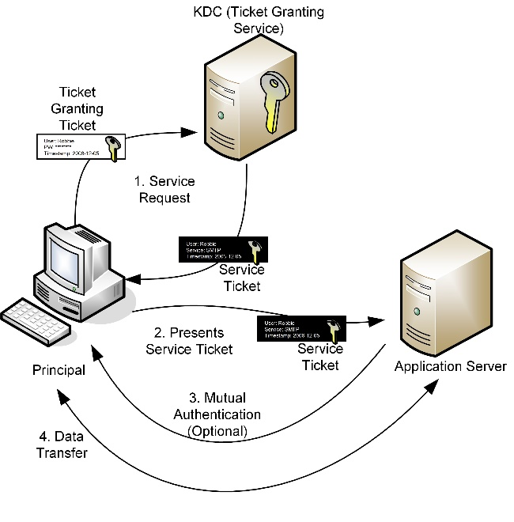
Kerberos
Single sign-on and mutual authentication
Three parts
  Client
  Server
  Key Distribution Center (KDC)
Authentication Service – Ticket Granting Ticket
Ticket Granting Service – Service Ticket

Slide 16
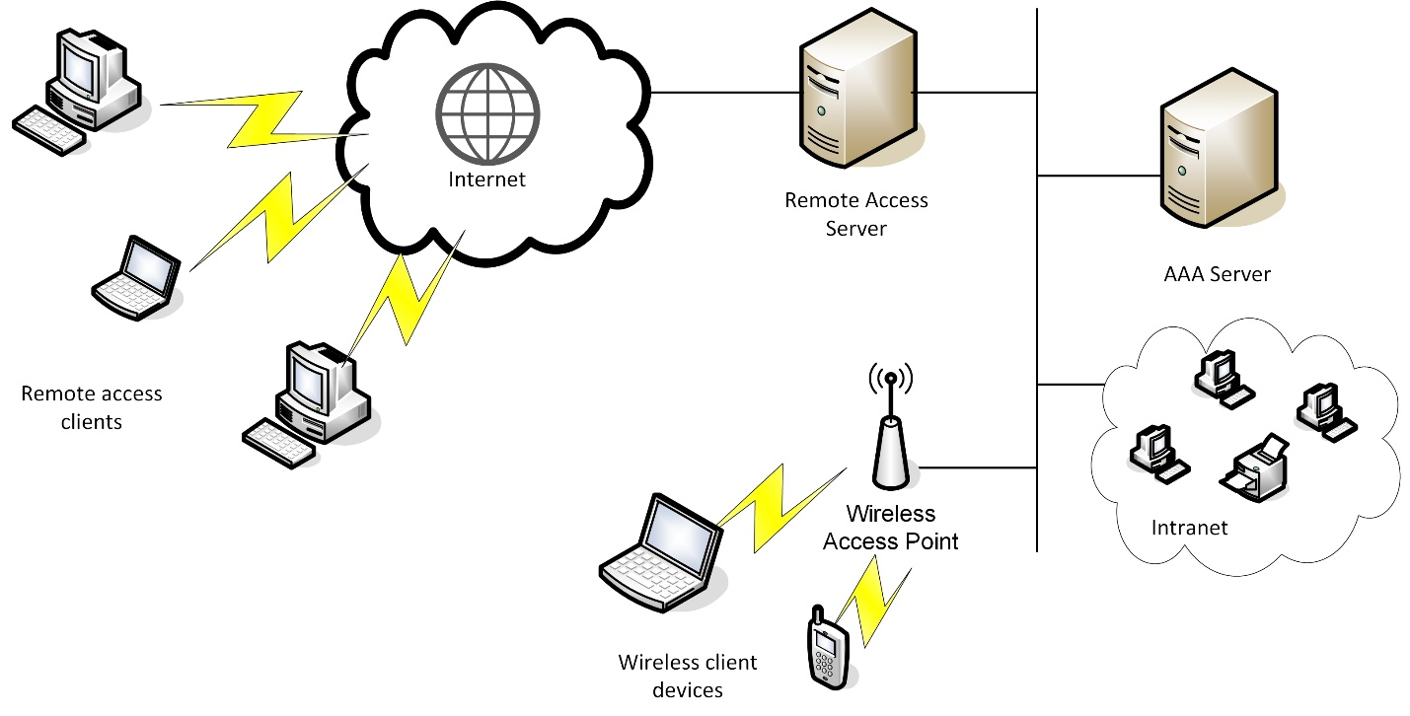
RADIUS and TACACS+
Network access devices are a bad place to store user accounts and credentials
Thousands of accounts might need synchronizing across hundreds of devices
Authentication, Authorization, and Accounting (AAA) architecture
  Access devices are clients of AAA servers, which host the credentials
  Remote Authentication Dial-in User Service (RADIUS)
  Terminal Access Controller Access-Control System (TACACS+)

Slide 17
Directory Services and LDAP
List of network users and resources
Access Control Lists (Authorizations)
Directory database
  Objects
  Attributes
X.500
Lightweight Directory Access Protocol (LDAP)

Slide 18
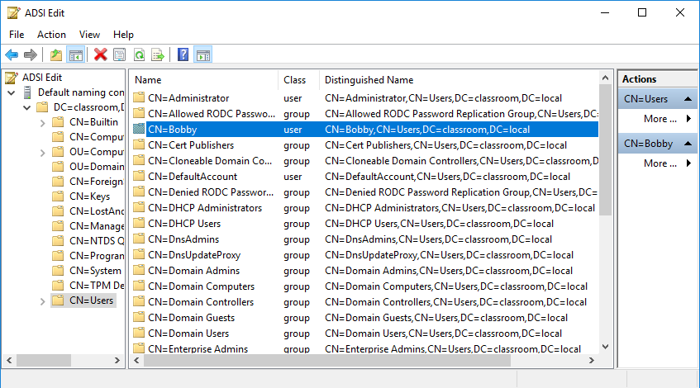
X.500 Distinguished Names
Distinguished Names
Attribute=Value pairs
Schema
Used with permission from Microsoft

Slide 19
LDAP Security
Binding methods
  None
  Simple authentication
  Simple Authentication and Security Layer (SASL)
  LDAPS (TLS over TCP port 636)
Access control policy
  Read-only
  Read/write
LDAP injection

Slide 20
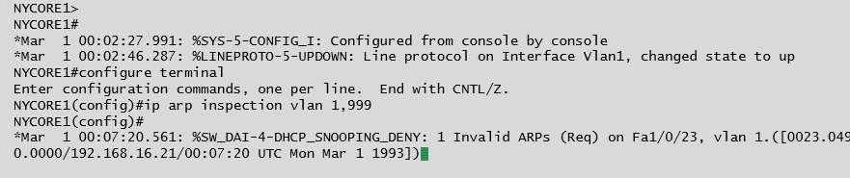
Endpoint Security
Defense-in-depth
Device control
Physical port security
MAC address filtering and limiting
ARP inspection and DHCP snooping
IEEE 802.1X (Port-based Network Access Control [PNAC])

Slide 21
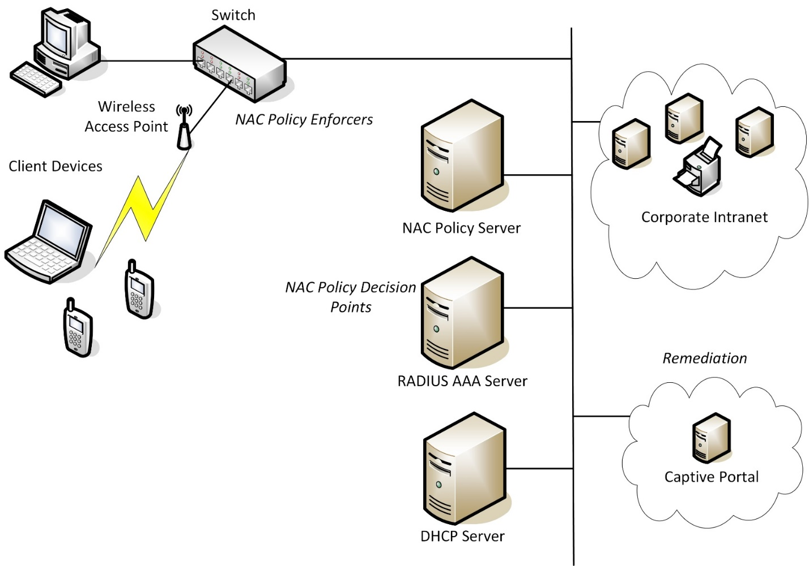
Network Access Control
Enforce device “health policies” in addition to authentication
Pre- and post-admission control
NAC policy enforcer
NAC policy server

Slide 22
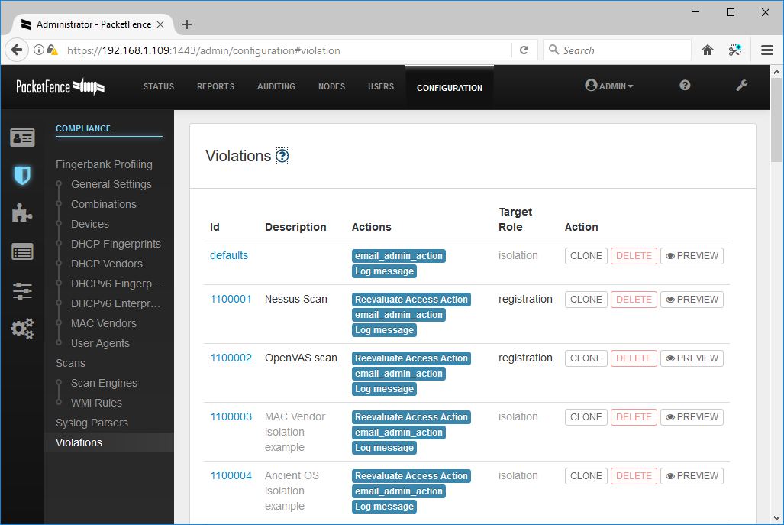
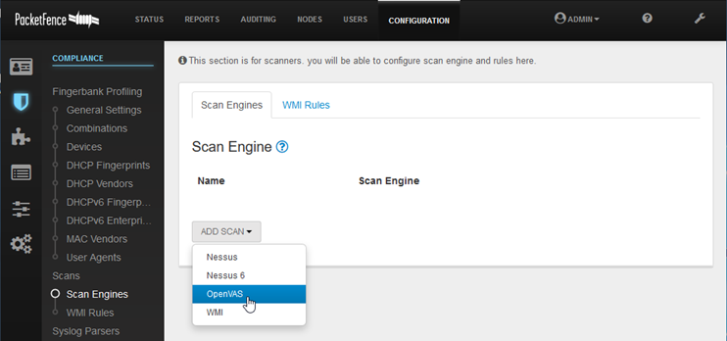
Posture Assessment
Verify compliance against health policy
Agent-based
  Persistent
  Non-persistent
Agentless
  Scanning software
  Device polling

Slide 23
Remediation
Remediation options for non-compliant hosts
  Guest network - a VLAN or firewalled subnet (DMZ) granting limited access to network resources
  Quarantine network - another type of restricted network, usually based on a captive portal

Slide 24
Make sure you understand the basic AAA principles of an access control system and the importance of role design and privilege management.
Social engineering refers to using human or social weaknesses to circumvent access controls.
Authentication credentials can use different factors (password, token, biometric) together for better security.
NTLM and Kerberos are used for authentication on Windows networks.
RADIUS and TACACS+ provide enterprises with user credential management, allowing authentication decisions to be centralized rather than completed by access devices.
Port authentication and NAC can be used to control the attachment of devices to a network.
Notes:
What element is missing from the following list and what is its purpose: identification, authentication, accounting. Authorization - assigning privileges over the network object to the subject.
Why do malicious insider threats often pose greater risk than malicious users generally? Malicious insiders are trusted users, meaning they have existing privileges to work on the network and access resources.
Why is a logic bomb unlikely to be detected by anti-virus software? Most anti-virus software depends on signatures of known malware to detect threats. A logic bomb is a specially crafted script or program that runs according to specific triggers, usually perpetrated by an insider threat, and so unlikely to be detectable by routine scans.
What is the purpose of SSO? Single Sign-on allows users to authenticate once to gain access to different resources. This reduces the number of logins a user has to remember.
How do social engineering attacks succeed? They generally depend on lack of security awareness in users. An attacker can either be intimidating (exploiting users' ignorance of technical subjects or fear of authority) or persuasive (exploiting the "customer service" mindset to be helpful developed in most organizations).
How might an attacker recover a password from an encrypted hash? By using a password cracking tool. This may recover the password if it uses a simple dictionary word or if it is insufficiently long and complex (brute force).
What are the main features of a digital certificate? A digital certificate contains the subject's public key, which can be used to cryptographically authenticate the subject and encrypt messages sent to it. The certificate is signed by a Certificate Authority (CA) that has validated the subject's identity. The certificate contains other information to identify the subject and describe its purpose.
What are the main features provided by Kerberos authentication? Single sign-on and support for mutual authentication.
What is a RADIUS client and how should it be configured? A device or server that accepts user connections. Using RADIUS architecture, the client does not need to be able to perform authentication itself; it passes the logon request to an AAA server. The client needs to be configured with the RADIUS server address and pre-shared key.
How does the "ARP inspection" security feature of a switch mitigate against ARP flooding? It maintains a trusted database of IP:ARP mappings and blocks any non-conforming gratuitous ARP replies from untrusted ports.
True or false? A switch implementing 802.1X would be described as an "authenticator". True.
What is meant by "remediation" in the context of NAC? The options provided to a client that does not meet the health policy - for example, allowed basic internet access only, given access to required patches, and so on.

Slide 25
Lab 13 / Secure Appliance Administration
Notes:
Note that there are three sets of labs available to use with this course:
Classroom labs that you set up and run yourself (refer to the separate "Labs" book and setup guide on the instructor resource support site).
Learn On Demand (LOD) hosted classroom labs accessed via a browser but following the same general sequence and steps as the classroom lab book.
Self-study Online Labs from Practice Labs accessed by students online - these labs are intended for use by students studying independently and are different from the classroom and hosted classroom labs. If you are using Practice Labs online labs in the classroom, you must specify this at the time of purchase so that the appropriate bandwidth is provisioned in advance. Please ensure that the student PCs meet the requirements for accessing the Self-study Online Labs series. You can obtain a setup guide at gtsgo.to/nf1rc
The sequence of classroom and hosted classroom labs is shown on this slide and in the margins of your instructor edition and in the course timetable. You should guide the students to complete each lab.
If you are not using the classroom or LOD hosted classroom labs you should delete this slide.

