Slide 1
CompTIA Network+ Certification
4.2 Virtualization, SAN, and Cloud Services

Slide 2
Identify the technologies used to implement virtualization
Describe different types of virtual network components (NICs, switches, routers, and firewalls)
Understand the use of Storage Area Networks (SAN) and the technologies underpinning them
Understand the use of virtualization and cloud computing to provision on-demand cloud and * as a Service infrastructure
Notes:
The number in the bottom right corner of the slides refers back to the page where this topic starts in the course book.

Slide 3
Virtualization Technologies
Host(s) – computing platform
Hypervisor - controls access to resources, networking, and security
Guest operating systems/Virtual Machines (VM)

Slide 4
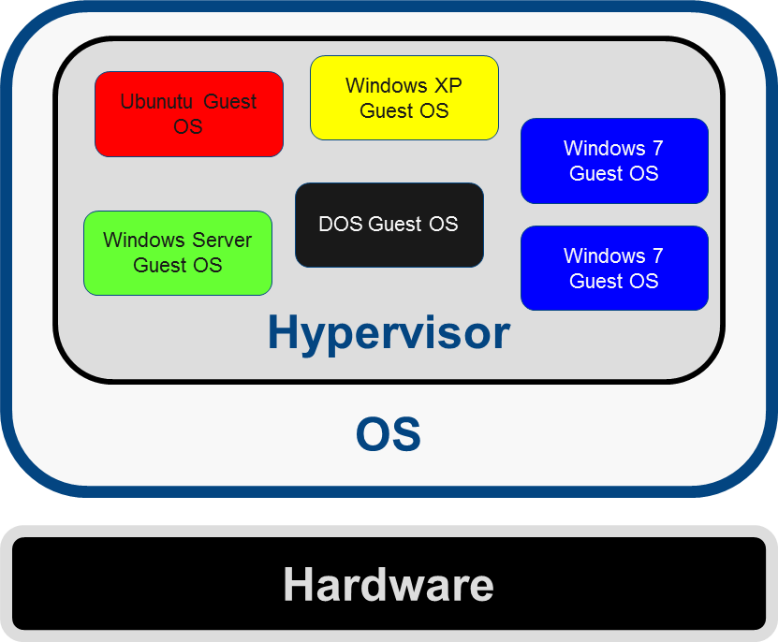
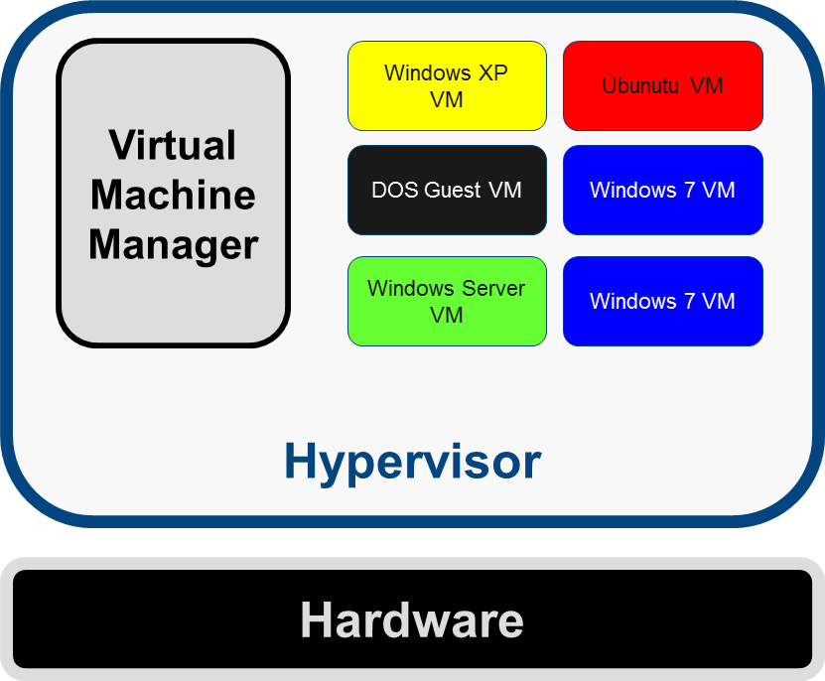
Hypervisor Types
Hypervisor manages guest VMs
Host-based versus bare metal

Slide 5
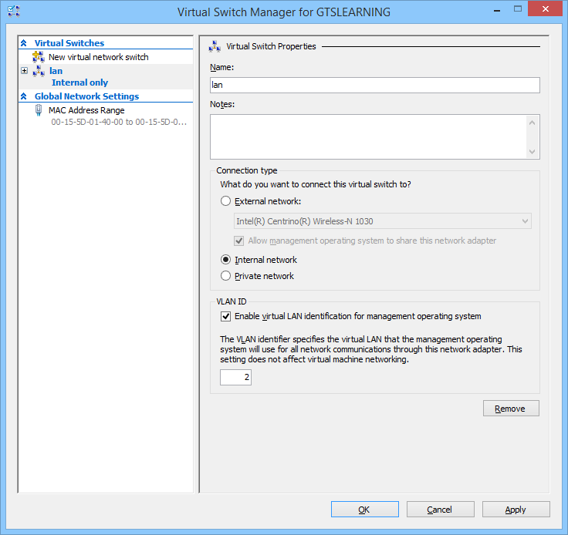
Virtual Networks
Guest OS can have one or more virtual network adapters
Guests can be connected to VM-only networks or join the host network
Virtual switch is implemented by hypervisor to connect VMs in different types of network
Virtual routers/firewalls
Used with permission from Microsoft

Slide 6
Storage Virtualization
OS passes control of physically locating data on disks to a virtualized layer
Data de-duplication
Storage hierarchies
  Online
  Nearline
  Offline

Slide 7
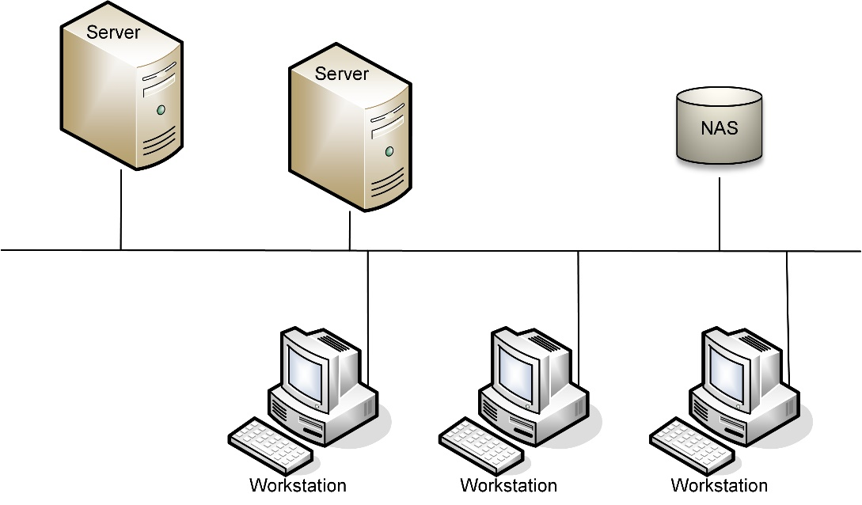
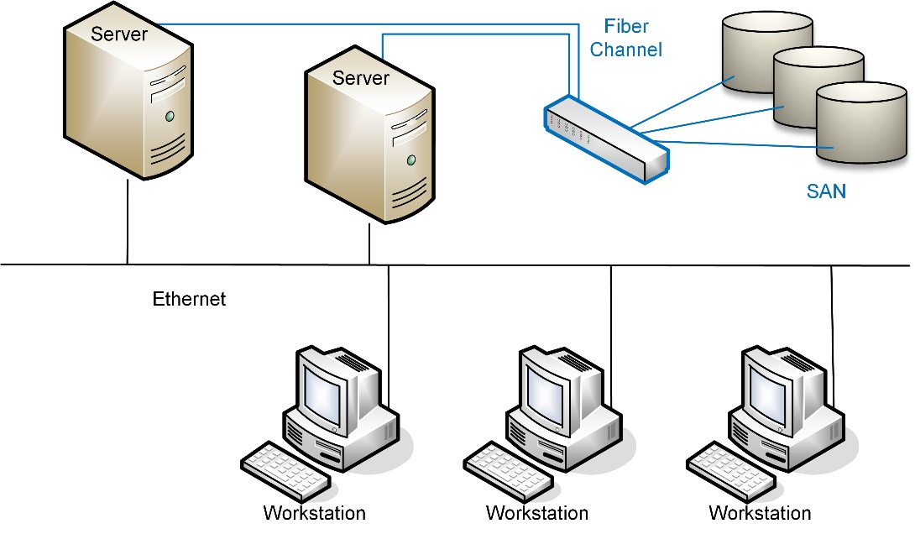
Network Storage Types
Direct-attached storage
Network Attached Storage (NAS)
  File-level access
  Typically SOHO/SME single box solution
  Assigned IP address/DNS host record
Storage Area Networks (SAN)
  Block-level access
  No direct client workstation access
  Enterprise/Data Center
  Multiple switches and devices

Slide 8
Fibre Channel
Initiator (host bus adapter in client server)
Target (network port of storage device)
  Logical Unit Number (LUN)
  World Wide Name (WWN)
    World Wide Node Name (WWNN)
    World Wide Port Name (WWPN)
FC switch
Fabric (cabling) (1-16 Gbps)

Slide 9
FCoE and InfiniBand
Fibre Channel over Ethernet (FCoE)
  Running FC protocol over 10GbE links
  Requires Converged Network Adapters and switch support
Jumbo frames
InfiniBand
  Competitor technology to FC and Ethernet
  Low-latency switched fabric supporting very high bandwidth

Slide 10
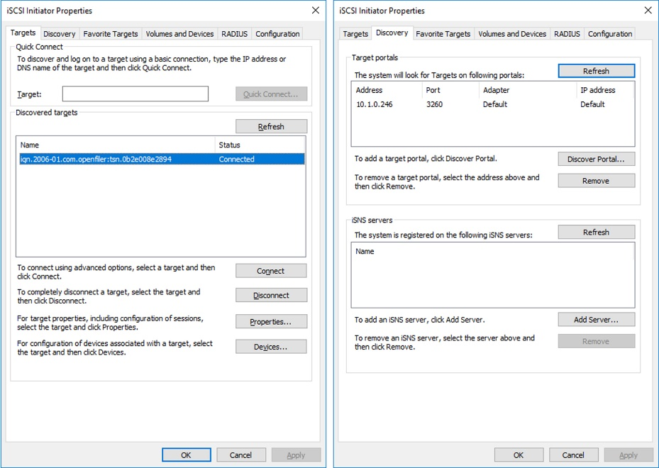
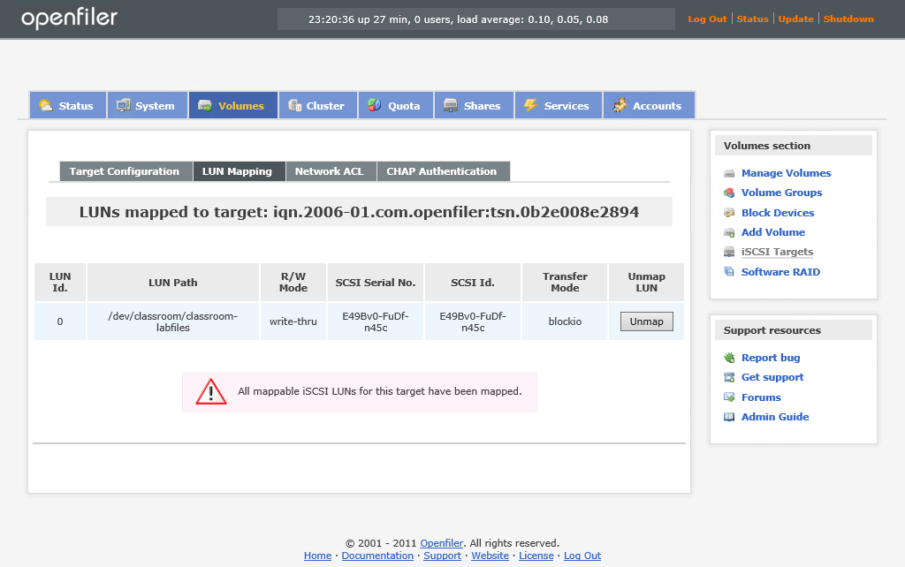
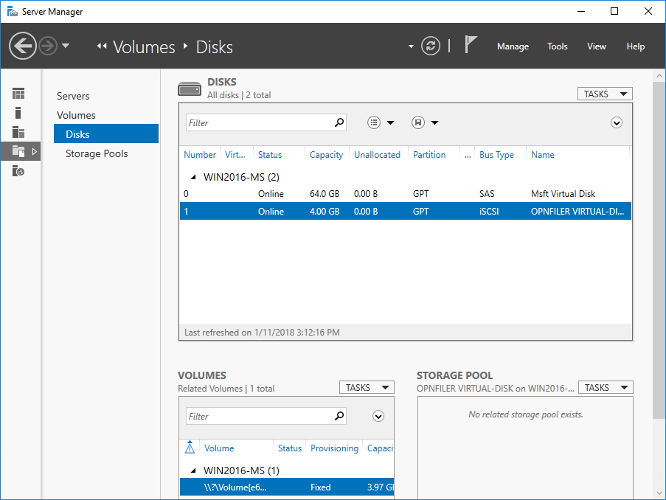
iSCSI
Tunneling protocol that enables the transfer of SCSI data over an IP-based network
Can be used to link SANs or create low-cost SANs

Slide 11
Cloud Computing
IT infrastructure provided as a service
  Elasticity
  Pay-per-use
Cloud delivery models
  Public (multi-tenant)
  Hosted private
  Private
  Onsite or offsite
  Hybrid models

Slide 12
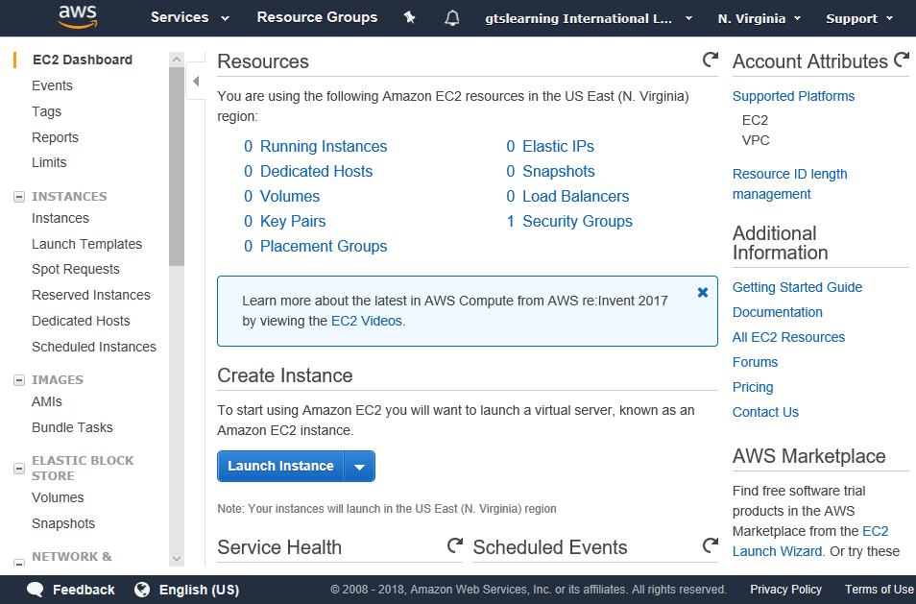
* as a Service
Infrastructure as a Service
Software as a Service
Platform as a Service

Slide 13
Connectivity with the Cloud
Internet/Virtual Private Network (VPN)
  Interface with cloud application over the web
  Use VPN for better security and congestion control
  Still limited by public Internet latency and bottlenecks
Direct/private connection/co-location
  Direct link between enterprise servers and cloud servers within data center

Slide 14
Local and Cloud Resources
Local storage requirements
  Store data locally for security, regulatory, or performance reasons
Synchronization and version control
  Latency and service disruptions can cause inconsistent updates to shared data
  Synchronization between local site and cloud site – which copy is “master”...
  Systems to allow multiple users to work on shared data

Slide 15
Security and Resilience
Transfer of risk/Service Level Agreement (SLA)
Identify responsibilities
Verify service provider’s performance of key tasks
Legal/regulatory responsibility
Insider threat (from service provider)

Slide 16
Cloud Access Security Broker (CASB)
Mediate access to cloud services by enterprise users across all types of devices
  Enable single-sign on authentication and enforce access controls
  Scan for malware and rogue or non-compliant device access
  Monitor and audit user and resource activity
  Mitigate data exfiltration
Interfaces
  Proxy
  Application Programming Interface (API)

Slide 17
Virtualization allows swift deployment of clients and servers and also virtual switch, router, and firewalls to implement virtualized networks.
SAN solutions allow different types of storage technology to be mixed. They are usually provisioned using Fibre Channel networks.
Cloud computing allows the lease of infrastructure and software on an as-needed basis but carries the same risks as other contracted services.
Notes:
What is a hypervisor? The software that hosts, configures, and manages multiple "guest" operating systems or Virtual Machines (VM). A hypervisor can be implemented as an OS itself ("bare metal") or as an application running within the host OS.
True or false? It is only possible for VMs to be networked via a virtual switch (vSwitch). False - it is possible to configure a VM to use either switches virtualized by the hypervisor or the network's physical switches (via the host's NIC).
What are the main differences between NAS and SAN? Network Attached Storage (NAS) is typically a single appliance providing file-level access to clients. Storage Area Networks (SAN) provide block-level access to multiple storage devices to file servers.
What protocol can be used to implement a SAN without provisioning dedicated storage networking adapters and switches? iSCSI.
Is InfiniBand a competitor technology to Fiber Channel or an upgrade path allowing integration with legacy infrastructure? InfiniBand is a competitor technology to Fiber Channel.
What would be the key difference between purchasing cloud web server instances and a virtual hosted server? The cloud instances should offer better elasticity (being able to provision and pay for peak resources as needed rather than trying to anticipate demand and provision for peak resources at the outset).
What are the main options for implementing connections to a cloud service provider? You can use the Internet and the provider's web services (possibly over a VPN) or establish a direct connection for better security and performance. A direct connection could be established by co-locating resources in the same data center or provisioning a direct link to the data center.

