Slide 1
CompTIA Network+ Certification
3.3 Name Resolution and IPAM

Slide 2
Describe the format of host names and Fully Qualified Domain Names
Understand the process of name resolution using HOSTS and DNS
Identify basic configuration parameters for a DNS server, including different types of DNS records
Use nslookup and dig to verify and troubleshoot name resolution
Understand the role of IPAM tools
Notes:
The number in the bottom right corner of the slides refers back to the page where this topic starts in the course book.

Slide 3
Host Names and FQDNs
Host name
  Letters, numbers, and hyphen
  Cannot be all numbers
  Cannot start or end with hyphen
  Not case sensitive
Fully Qualified Domain Name (FQDN)
  Host name + domain suffix
  Host name must be unique within domain
  Labels separated by periods
  Max length of 253 characters overall and 63 characters per label (excluding periods)
Name resolution – application layer/layer 7

Slide 4
Name Resolution using HOSTS
HOSTS was a text file containing list of IP > host name or FQDN mappings
Distributed manually between network administrators
Long replaced by Domain Name System (DNS) but each host is still installed with HOSTS file
  Windows
    %SystemRoot%\System32\drivers\etc\hosts
  Linux
    /etc/hosts
Administrators can configure static mappings in HOSTS and these take precedence over DNS

Slide 5
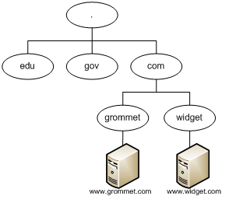
Domain Name System (DNS)
Hierarchical database of IP and name records
Root domain contains 13 servers (A…M)
Top Level Domains (TLD) managed by ICANN and regional registries
Domains can be registered within an appropriate TLD

Slide 6
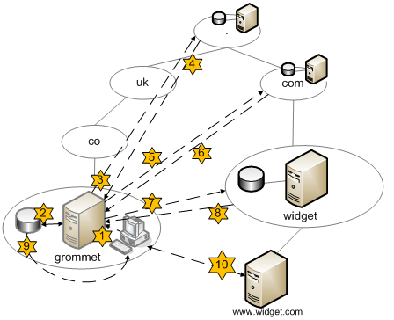
Name Resolution using DNS

Slide 7
Configuring DNS Servers (1)
Service port
  UDP Port 53
  TCP Port 53
Zones
  Primary
  Secondary
  Cache-only
DNS forwarder (internal versus external DNS)
Iterative versus recursive queries

Slide 8
Configuring DNS Servers (2)
Secure configuration
Third party/cloud-hosted DNS
Dynamic DNS
  Allows clients to notify DNS server of IP address changes
  Might be implemented through DHCP on enterprise network – update packets must be authenticated
  Update to DNS server records may be requested by host
  Internet dynamic DNS services can be used with SOHO routers (where ISP does not allocate fixed IP address)x

Slide 9
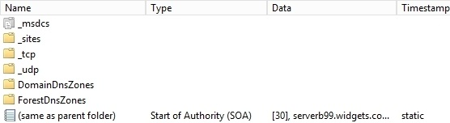
Resource Records (1)
Start of Authority (SOA)
  Primary DNS name server that is authoritative for the zone
Name Server (NS)
  Two or more NS records are usually configured for redundancy
Used with permission from Microsoft

Slide 10

Resource Records (2)
A/AAAA
  Host records resolve a name to an IPv4 (A) or IPv6 (AAAA) address
CNAME
  Canonical Name (or alias) is used to represent an alias for a particular host (A or AAAA)
Used with permission from Microsoft

Slide 11
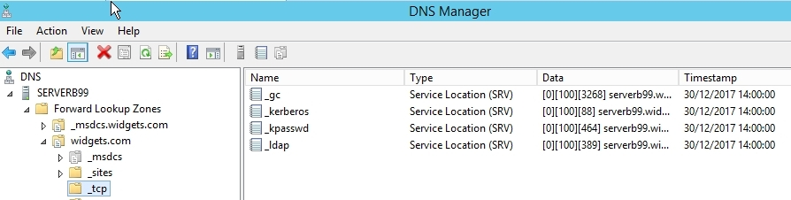
Resource Records (3)
MX
  Mail Exchanger (MX) is used to identify an email server for the domain
SRV
  Service record is used to identify a record that is providing a particular network service or protocol
TXT
  Stores any free form text that may be needed to support other network services
  Sender Policy Framework (SPF)
  DomainKeys Identified E-mail (DKIM)
Used with permission from Microsoft

Slide 12
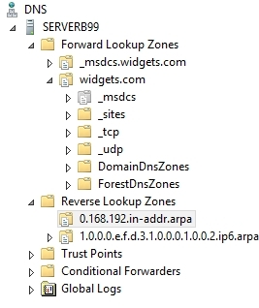
Resource Records (4)
PTR
  Forward versus reverse lookup zones
  Pointer record is found in reverse lookup zones and used to resolve an IP address to a host name
  in.addr.arpa domain
  ip6.arpa domain
Used with permission from Microsoft

Slide 13
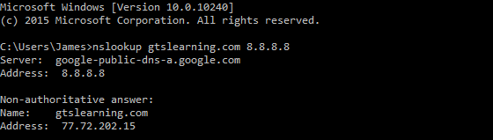
nslookup
Query a name server for resource records
nslookup –Option Host Server
Interactive mode
Used with permission from Microsoft

Slide 14
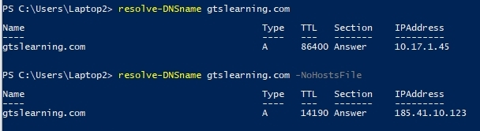
Powershell Name Resolution
Resolve-DnsName host
Resolve-DnsName host -NoHostsFile
Resolve-DnsName host -DnsOnly
-Server IPofDNSserver
Used with permission from Microsoft

Slide 15
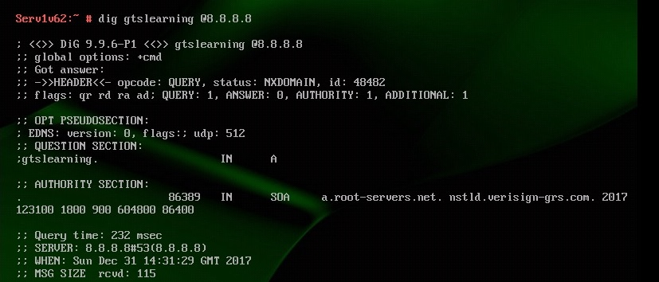
dig
Domain Information Groper (dig) is a Linux command-line tool for querying DNS servers
  dig host
  dig @ns1.isp.com host
  dig @ns1.isp.com host all
  dig @ns1.isp.com host MX
Output parameters (+nocomments or +nostats)

Slide 16
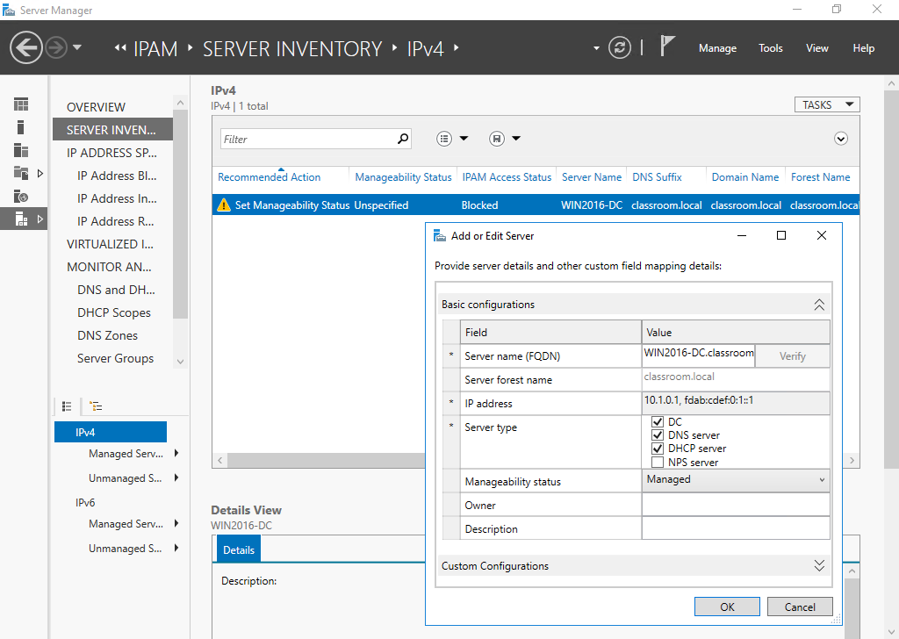
IP Address Management (IPAM)
Scan DHCP and DNS servers and log IP address usage to a database
Scan IP address ranges to detect use of statically-assigned addresses
Tie in with asset/inventory management
Manage and reconfigure DHCP and DNS services
Analyze address space
Log use of IP addresses over time
Used with permission from Microsoft

Slide 17
A computer can be configured with a host name to provide a simpler means for users to address the system on the network.
A Fully Qualified Domain Name provides a unique identity for hosts communicating on an Internet.
Name resolution services such as DNS map IP addresses to host names and FQDNs. DNS provides other record types to allow for the discovery services such as email or SIP.
nslookup and dig can be used to troubleshoot DNS.
IPAM tools give administrators visibility into IP address allocation and usage.
Notes:
What is a generic top-level domain? FQDNs are arranged in a hierarchy from the root. Top-level domains are those farthest to the right. Generic TLDs are those maintained by ICANN (.com, .org, .net, .info, .biz) - the other main sets of TLDs are country codes and sponsored.
What characters are allowed in a DNS host name? Up to 63 alphanumerics and the hyphen, though the hyphen cannot be used at the beginning or end of the name.
What is the location of the hosts file? Under Windows it is %SystemRoot%\system32\drivers\etc\ while under Linux it is usually placed in the /etc directory.
What type of DNS record resolves IPv6 addresses? AAAA.
What type of DNS server is likely to accept recursive queries? A local name server providing DNS resolution for ordinary workstations. Queries between name servers are usually iterative.
What use is a PTR DNS record? A pointer maps an IP address to a host name enabling a reverse lookup. Reverse lookups are used (for example) in spam filtering to confirm that a host name is associated with a particular IP address.
What types of DNS records have priority or preference values? Typically mail (MX) and service (SRV) records.
What type of DNS record is used to prove the valid origin of email? Sender Policy Framework (SPF) and DomainKeys Identified E-mail (DKIM) records can be used to validate the origin of email and reject spam. These are configured in DNS as TXT (text) records.
What type of DNS enables clients to report a change of IP address to a DNS server? Dynamic DNS.
What is the function of the command “nslookup – 8.8.8.8”? To start nslookup in interactive mode with the DNS server set to 8.8.8.8 (Google’s public DNS server).
What is the function of a dig subcommand such as "+nostats"? Control what is shown by the tool. You can use these commands to suppress certain kinds of output, such as sections of the response from the DNS server.
What type of server infrastructure is IPAM designed to monitor? IP Address Management (IPAM) is used to monitor (and manage) DHCP and DNS services (and Domain Controllers in a Windows network environment).

Slide 18
Lab 9 / Configuring Name Resolution and IPAM
Notes:
Note that there are three sets of labs available to use with this course:
Classroom labs that you set up and run yourself (refer to the separate "Labs" book and setup guide on the instructor resource support site).
Learn On Demand (LOD) hosted classroom labs accessed via a browser but following the same general sequence and steps as the classroom lab book.
Self-study Online Labs from Practice Labs accessed by students online - these labs are intended for use by students studying independently and are different from the classroom and hosted classroom labs. If you are using Practice Labs online labs in the classroom, you must specify this at the time of purchase so that the appropriate bandwidth is provisioned in advance. Please ensure that the student PCs meet the requirements for accessing the Self-study Online Labs series. You can obtain a setup guide at gtsgo.to/nf1rc
The sequence of classroom and hosted classroom labs is shown on this slide and in the margins of your instructor edition and in the course timetable. You should guide the students to complete each lab.
If you are not using the classroom or LOD hosted classroom labs you should delete this slide.

