Slide 1
CompTIA Network+ Certification
3.1 Routing

Slide 2
Understand the features and functions of IP routers, such as path selection, routing tables, routing algorithms, and routing metrics
Understand the functions of and distinctions between dynamic routing protocols (RIP, EIGRP, OSPF, and BGP)
Understand highly available and fault tolerant routing design
Install, configure, and troubleshoot basic routers using command line tools, such as tracert/traceroute, pathping, mtr, and route
Notes:
The number in the bottom right corner of the slides refers back to the page where this topic starts in the course book.

Slide 3
Routing Basics
Is the destination IP address on the same network?
  Network prefix tells a host how much of the IP address it should interpret as the network ID
    IPv4 can use a subnet mask (dotted decimal) or slash notation
    IPv6 uses only slash notation
  This sort of classless addressing was applied retrospectively in IPv4
  IPv6 was designed this way so network prefixes contain more information about the routing hierarchy (Internet Registries > ISPs > End Users)
Routers are Intermediate Systems (IS) while non-routing hosts are End Systems (ES)
Hosts must use routers to forward packets for remote networks
Routers are IP hosts configured with multiple interfaces
  Could be server or even workstation computers
  More likely to be dedicated router appliances

Slide 4
Routing Tables and Path Selection
Routers use the same sort of process to forward packets to the destination via a complex internetwork
Paths recorded in routing table
  Destination network address and netmask
  Gateway/next hop address
  Interface
  Metric

Slide 5
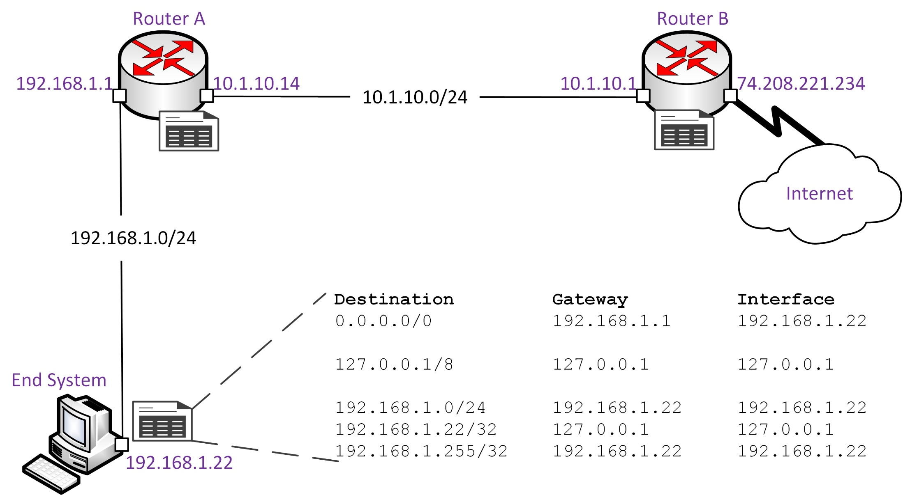
Routing Tables – End System

Slide 6
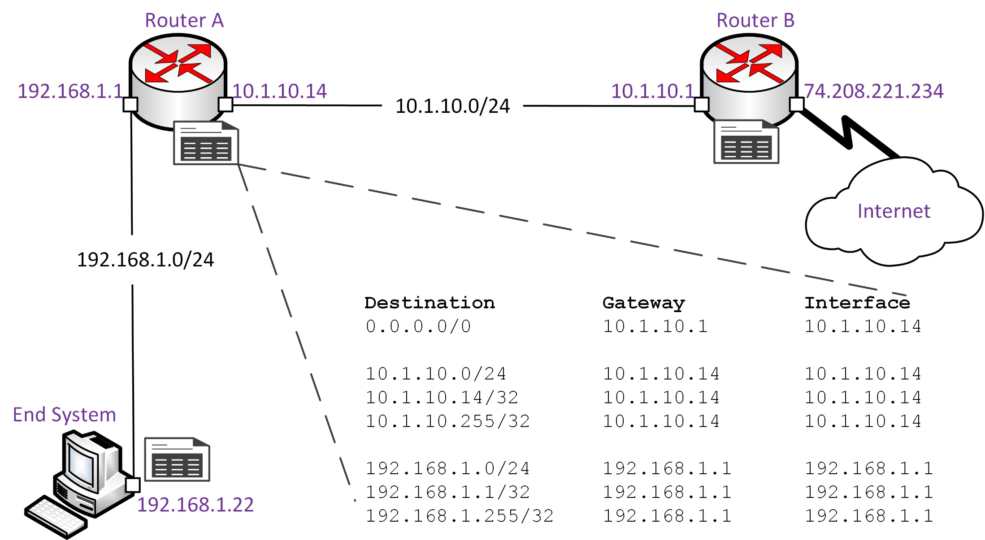
Routing Tables – Router A

Slide 7
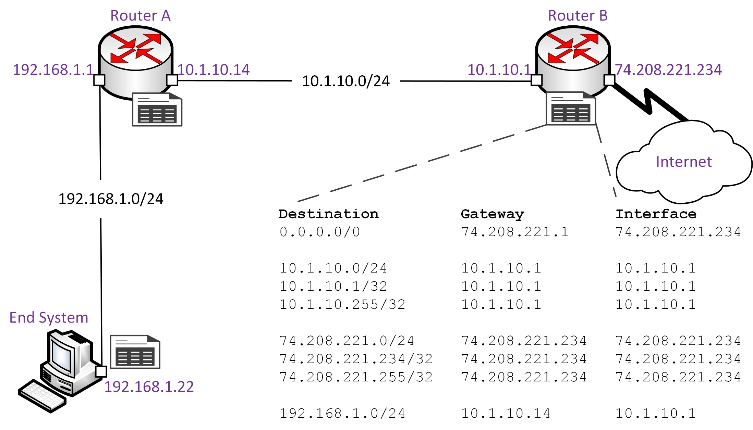
Routing Tables – Router B

Slide 8
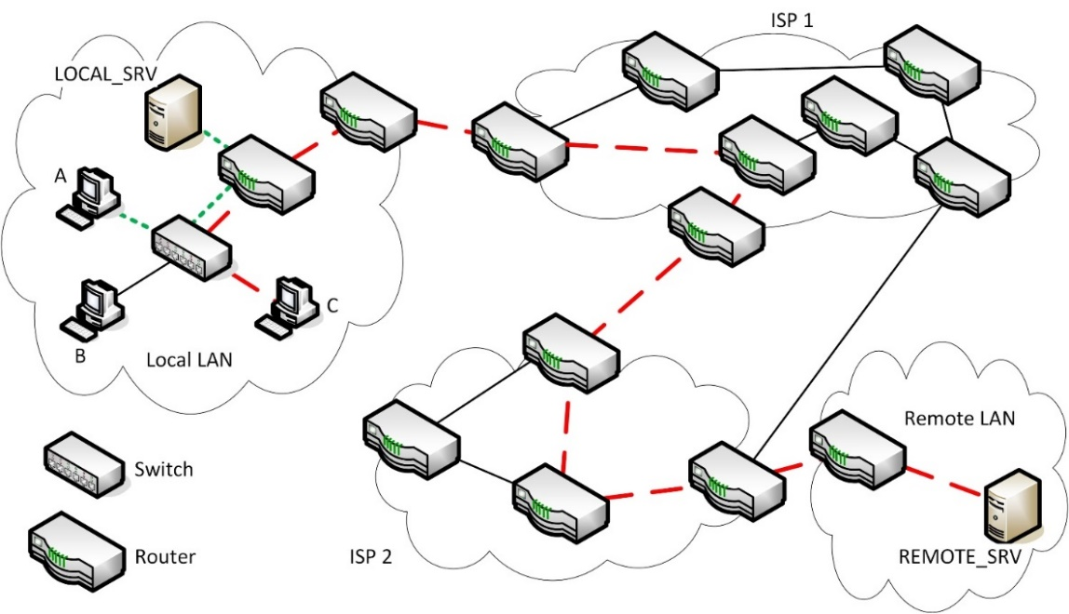
Packet Delivery
Directly connected routes versus next hop router
Default route
Time To Live (TTL)

Slide 9
Static and Default Routes
Static routes - configured manually in routing table
Difficult to manage changes
Default route
  Identifies next hop for unknown destinations
  0.0.0.0/0
  ::/0

Slide 10
Learned Routes
Hierarchical
  Organize routers in domains
  Backbone/border routers communicate between domains
  Internal routers can only communicate within a domain or out of a domain via a backbone router
  Supports route summarization
Distance-vector
  Propagate entire routing table
  Slower convergence
Flat
  All routers are peers of one another
  Each network ID requires a separate routing table entry
Link-state
  Propagate updates to routing table only
  Faster convergence and better support for larger networks
  Require more advanced hardware

Slide 11
Routing Metrics
Convergence
Path length (distance/hop count)
Reliability
Latency (delay)
Bandwidth
Load (link utilization)
MTU (Maximum Transmission Unit)
Price/costs

Slide 12
Dynamic Routing Protocols

Slide 13
Routing Information Protocol (RIP)
Distance-vector
Interior Gateway Protocol
Simple/limited
RIPv2 supports classless addressing
RIPng supports IPv6
Runs over UDP on port 520 (521 for RIPng)

Slide 14
Enhanced Interior Gateway Routing Protocol (EIGRP)
Interior Gateway Protocol
Advanced distance-vector
More metrics than RIP
Supports classless addressing
Versions for IPv4 and IPv6
Doesn’t use TCP or UDP but runs over IP directly (protocol #88)

Slide 15
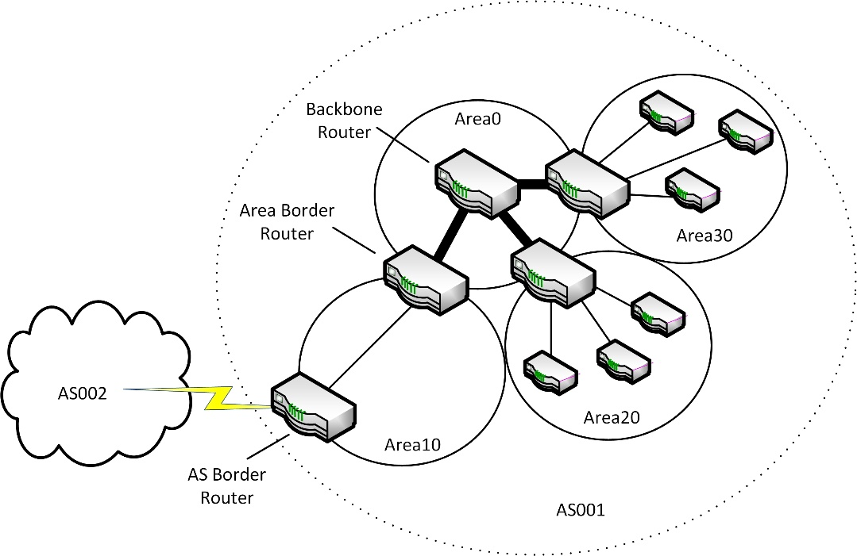
Open Shortest Path First (OSPF)
Link-state
Interior Gateway Protocol
Suited to complex private networks
Group related networks by area
Supports classless addressing
Doesn’t use TCP or UDP but runs over IP directly (protocol #89)

Slide 16
Border Gateway Protocol (BGP)
Classed as hybrid or path vector
Usually deployed as an Exterior Gateway Protocol
Supports routing on the Internet
  Autonomous Systems (AS) hide internal network complexity from Internet routers
  Autonomous System Number (ASN)
  BGP routers exchange AS path data between Autonomous Systems
Supports classless addressing
Runs over TCP on port 179

Slide 17
AD and Route Redistribution
Administrative Distance (AD)
  Metric used when multiple routing protocols are used
  Lower value routing protocols are preferred
Route redistribution
  Router learns routes passed from one routing protocol to another
  Consolidate different metrics

Slide 18
IPv4 and IPv6 Internet Routing
IPv4 Internet routing
  CIDR/supernetting introduced in the 90s
  /8 CIDR blocks allocated to Regional Internet Registries (RIR)
  RIRs allocate blocks to ISPs
  ISPs divide up their allocations between customer organizations and end users
IPv6 Internet routing
  Designed as a hierarchy from the start
  Global unicast address space
  Top-level allocations to RIRs then to ISPs
  Customers get allocations from /48 (big organization) to /64 (home user)

Slide 19
High Availability Routing
Provide redundancy for hosts – keep default gateway online!
Hot Standby Router Protocol (HSRP)
  Multiple router appliances serve as default gateway
  Configured with actual and virtual IP addresses
  Hosts given virtual IP address as default gateway parameter
Virtual Router Redundancy Protocol (VRRP)
  Open standard protocol providing similar functionality to HSRP

Slide 20
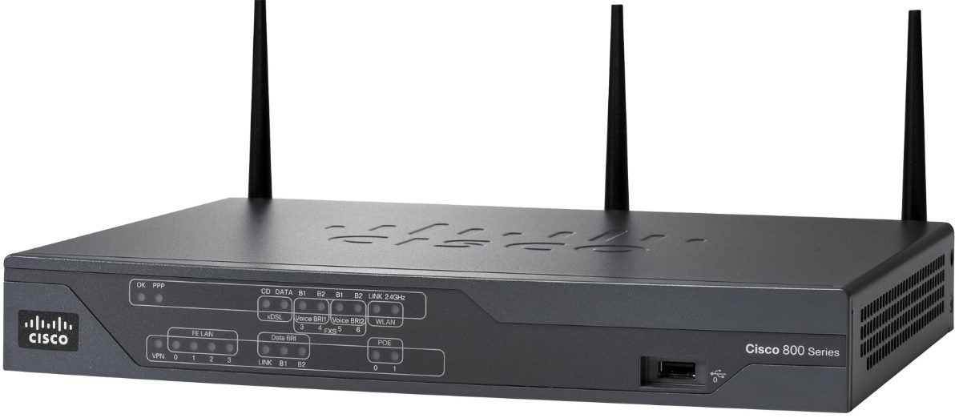
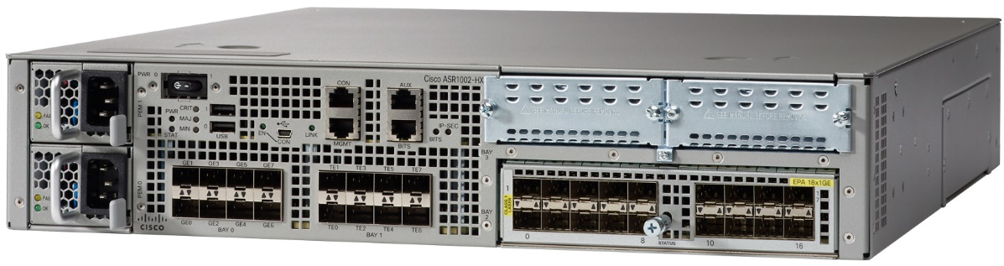
Installing and Configuring Routers
Software/Network OS (NOS) router (multi-homed server)
SOHO router – multifunction with DSL and Wi-Fi
Enterprise router appliance
  High reliability and scalable performance
  Plug-in cards provide adaptability
Images © and Courtesy of Cisco Systems, Inc. Unauthorized use not permitted

Slide 21
Router Placement

Slide 22
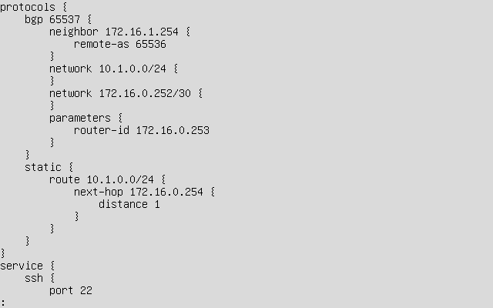
Router Configuration
Appliance
  SSH or Telnet
  Console port
  Network interface
  Loopback interface
NOS router configuration tools

Slide 23
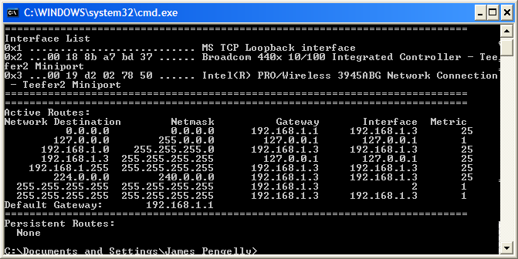
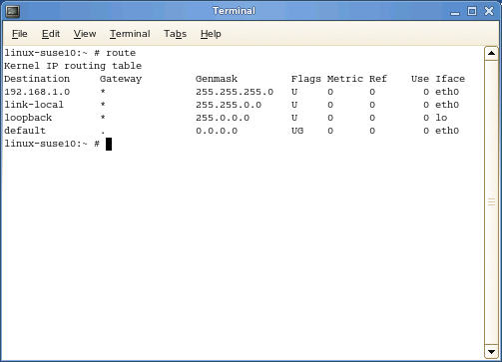
route

Slide 24
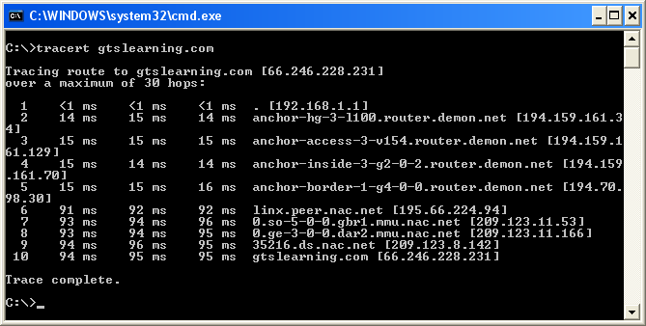
tracert and pathping
tracert/tracert -6
pathping

Slide 25
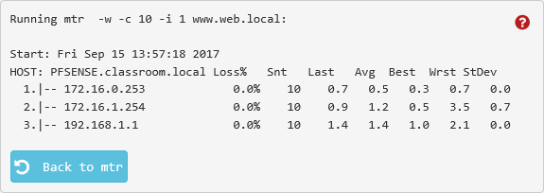
traceroute and mtr
traceroute6/traceroute -6
mtr
Looking Glass site

Slide 26
Designing a Branch Office Network

Slide 27
Routers allow the interconnection of networks or the division of a single network into subnets.
Routers perform path selection and switching between networks, storing information about networks in a routing table.
Path selection can be configured statically but is more likely to be determined by a dynamic routing protocol, working with defined routing metrics.
Dynamic routing protocols can be classed as distance-vector (RIP, EIGRP, BGP) or link-state (OSPF).
A single Autonomous System uses an Interior Gateway Protocol. Extra-AS routing uses an Exterior Gateway Protocol (BGP).
Routers can be implemented by software running on Windows/Linux servers or as dedicated appliances.
The route command allows for static configuration of Windows/Linux routing while tracert/traceroute, pathping, and mtr use ICMP to track a packet as it traverses a network.
Notes:
What is a directly connected route? A host or subnet connected to one of the router's interfaces.
An entry in a routing table will list the destination network address and netmask plus a gateway and metrics. What other piece of information is required? Interface - the local port used to route to the destination.
If a routing protocol carries a subnet mask field for route updates, what feature of IP routing does the routing protocol support? Classless addressing (subnetting and supernetting).
True or false? A router would normally have more than one network interface. True. Routers with a single interface (a "router on a stick") might be used to route between VLANs though.
What does it mean if a routing protocol converges to a steady state quickly? Changes to the network topology are propagated between routers quickly. This makes the network quicker and more reliable.
Which general class of dynamic routing protocol provides the best convergence performance? Link-state.
What routing metric might you prioritize for a VoIP application? Latency (minimizing delay) is important.
What is an ASN and how does it assist route aggregation? An Autonomous System Number (ASN) identifies a group of network prefixes under the administrative control of a single entity (such as an ISP). The AS can be advertised to other AS through a single prefix (route aggregation), hiding the complexity of the internal network from other autonomous systems.
When might an Administrative Distance metric be factored into routing decisions? When a router obtains routes from multiple different routing protocols the AD metric is an index of routing protocol reliability.
What is the purpose of HSRP and VRRP? Hot Standby Router Protocol (HSRP) and Virtual Router Redundancy Protocol (VRRP) allow multiple physical router appliances to act as the same logical router, providing redundancy, load balancing, and failover.
How would you view the routing table on a Linux PC? Just enter "route" without any other parameters.
If you receive a "Request timed out" error message when using ping, what would you attempt next? Use tracert to try to identify the routing problem.
What tool(s) could you use to measure link statistics over time? pathping or mtr.
What is a looking glass site? A server allowing third parties to inspect the routing infrastructure of an autonomous system, assisting troubleshooting.

Slide 28
Lab 7 / Configuring Routing
Notes:
Note that there are three sets of labs available to use with this course:
Classroom labs that you set up and run yourself (refer to the separate "Labs" book and setup guide on the instructor resource support site).
Learn On Demand (LOD) hosted classroom labs accessed via a browser but following the same general sequence and steps as the classroom lab book.
Self-study Online Labs from Practice Labs accessed by students online - these labs are intended for use by students studying independently and are different from the classroom and hosted classroom labs. If you are using Practice Labs online labs in the classroom, you must specify this at the time of purchase so that the appropriate bandwidth is provisioned in advance. Please ensure that the student PCs meet the requirements for accessing the Self-study Online Labs series. You can obtain a setup guide at gtsgo.to/nf1rc
The sequence of classroom and hosted classroom labs is shown on this slide and in the margins of your instructor edition and in the course timetable. You should guide the students to complete each lab.
If you are not using the classroom or LOD hosted classroom labs you should delete this slide.

