Slide 1
CompTIA Network+ Certification
2.4 DHCP and APIPA

Slide 2
Understand methods for autoconfiguring IP addressing information (DHCP and APIPA)
Configure a DHCP server and DHCP relay
Notes:
The number in the bottom right corner of the slides refers back to the page where this topic starts in the course book.

Slide 3
IPv4 Address Autoconfiguration
Static versus dynamic IP address configuration
  Problems with static IP allocation
  Time-consuming
  Risk of incorrect configurations/duplicate IP addresses
RARP (Reverse Address Resolution Protocol)
  Obtain an IP address from a server configured with static list of MAC:IP mappings
BOOTP
  Also download a configuration file using TFTP (Trivial File Transfer Protocol)
DHCP (Dynamic Host Configuration Protocol)
  Assign configurations to hosts dynamically

Slide 4
DHCP Client Initialization
Discover
Offer
Request
Ack

Slide 5
APIPA
Automatic Private IP Addressing (APIPA)
A DHCP client that cannot contact a server autoconfigures
Uses address range 169.254.x.y
APIPA is Microsoft terminology – standards refer to link-local addressing
Link-local addressing also implemented by Bonjour on Mac OS X and Avahi on Linux

Slide 6
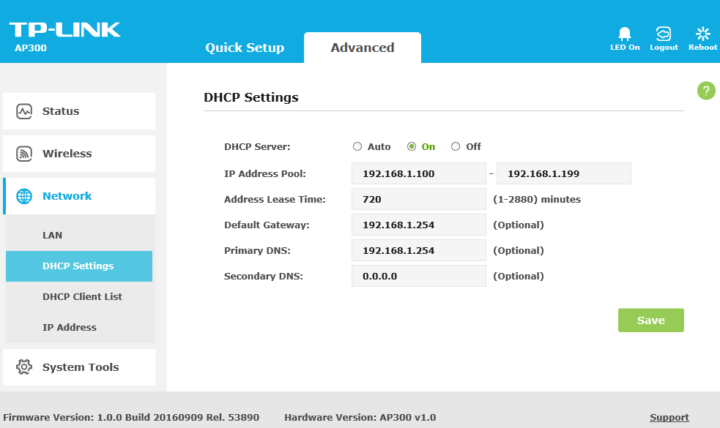
Configuring DHCP
Appliance versus NOS implementation
A range (or pool) of IP addresses and subnet masks to allocate
A lease period plus renewal (T1) and rebinding (T2) timers
Other optional information to allocate, such as default gateway and DNS server address(es)

Slide 7
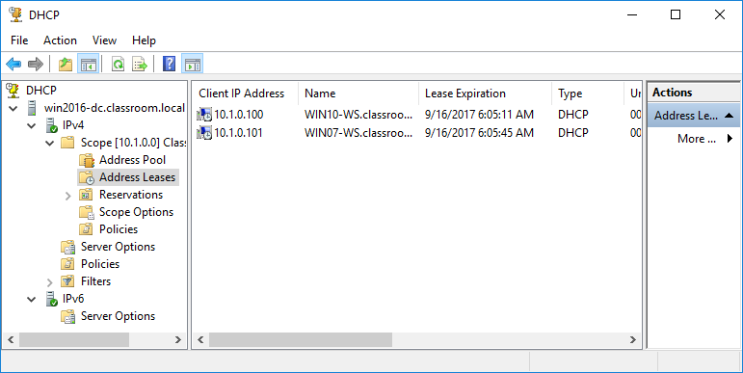
DHCP Address Pool
Range of IP addresses available to lease to clients on a particular subnet (or scope)
Defined by start and end IP addresses and netmask
1:1 mapping of pools to subnets
Redundant DHCP services should use non-overlapping address pools
Used with permission from Microsoft

Slide 8
DHCP Lease Time/TTL
Lease time determines how long client keeps address
  Long lease reduces DHCP traffic but may risk address pool exhaustion
  Environments with high host “turnover” will configure short leases
T1 timer (attempt renewal with same server after 50% of lease Time to Live expired)
T2 timer (attempt rebind with any server after 87.5% of lease expired)

Slide 9
DHCP Options
Options are customizable but typical parameters include
  The default gateway (IP address of the router)
  The IP address(es) of DNS servers
  The DNS suffix (domain name) to be used by the client
  Other useful server options, such as time synchronization (NTP), file transfer (TFTP), or VoIP proxy

Slide 10
DHCP Reservations and Exclusions
Static assignments and exclusions
  Use IP addresses outside address pool
  Exclude specific IP addresses from pool range
MAC/IP reservations
  Always allocate a device (identified by MAC address) the same IP
  Automatic allocation – lease an IP address (any IP address) to the same client permanently

Slide 11
DHCP Relay and IP Helper
DHCP broadcast traffic not normally forwarded by routers
Would mean DHCP server for each subnet/VLAN
DHCP relay agent/RFC 1542 compliant router
  Forwards BOOTP/DHCP traffic broadcasts to specified interface for a DHCP server
  Forwards responses from server back to appropriate client subnet
ip-helper
  Cisco command supporting operation of DHCP relay
  Can forward various types of broadcast traffic (not just DHCP)

Slide 12
DHCPv6 (1)
IPv6 defines router/prefix discovery and Stateless Address Autoconfiguration (SLAAC)
DHCPv6 often just used to provide additional options
DHCPv6 clients use multicast ff:02::1:2 to locate server
DHCPv6 uses ports 546 (client) and 547 (server)

Slide 13
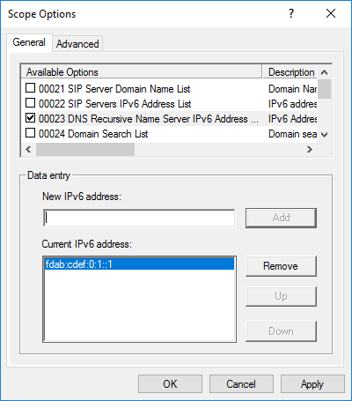
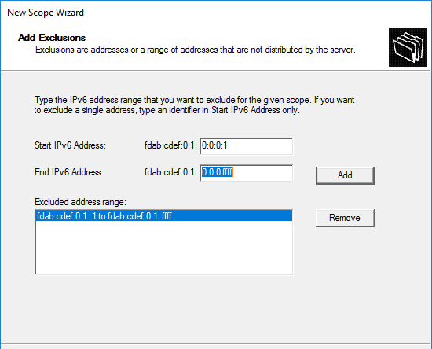
DHCPv6 Modes
Stateless mode
Stateful mode
Prefix Delegation (PD)
Used with permission from Microsoft

Slide 14
DHCP is a method for a client to automatically request IP configuration information from a server.
A DHCP service can be configured to run on a Windows/Linux server or can be provided by most types of switches and routers.
In Windows, if a client cannot contact a DHCP server, it uses an APIPA (link-local) address that allows for communication on the local network.
DHCPv6 is principally used to provide optional information, such as DNS server addresses. Router advertisements can be used to direct a client to use a stateless or stateful autoconfiguration.
Notes:
What is the advantage of having a DHCP server in a TCP/IP network? It simplifies the configuration of TCP/IP on the client computers and reduces the chance of errors.
What port should be open on the client for it to negotiate with a DHCP server? UDP port 68.
True or false? If a client accepts a DHCPOFFER, the DHCPREQUEST packet is broadcast on the network. True.
If a network adapter is using the address 169.254.1.10 on a host connected to the LAN, what would you suspect? That a DHCP server is offline (the system is configured to obtain an address automatically but cannot contact a DHCP server and is using APIPA).
On the DHCP server, what is a range of IP addresses that are available to be leased or assigned to clients called? Scope.
When configuring multiple DHCP servers for redundancy, what should you take care to do? Configure the servers with non-overlapping scopes.
True or false? DHCP options can be configured on a per-scope basis. True.
What is an RFC 1542 compliant router? One that can forward DHCP traffic to and from remote networks (using IP helper for instance).
What address is used to contact a DHCPv6 server? IPv6 does not support broadcast so clients use the multicast address ff:02::1:2 to discover a DHCP server.
In a stateless environment, what sort of information does DHCPv6 provide? In a stateless environment, the host autoconfigures an address using a network prefix provided by the router (typically). DHCPv6 is then used to provide the IPv6 addresses used to access network services, such as DNS or SIP gateways.

Slide 15
Lab 6 / Configuring Address Autoconfiguration
Notes:
Note that there are three sets of labs available to use with this course:
Classroom labs that you set up and run yourself (refer to the separate "Labs" book and setup guide on the instructor resource support site).
Learn On Demand (LOD) hosted classroom labs accessed via a browser but following the same general sequence and steps as the classroom lab book.
Self-study Online Labs from Practice Labs accessed by students online - these labs are intended for use by students studying independently and are different from the classroom and hosted classroom labs. If you are using Practice Labs online labs in the classroom, you must specify this at the time of purchase so that the appropriate bandwidth is provisioned in advance. Please ensure that the student PCs meet the requirements for accessing the Self-study Online Labs series. You can obtain a setup guide at gtsgo.to/nf1rc
The sequence of classroom and hosted classroom labs is shown on this slide and in the margins of your instructor edition and in the course timetable. You should guide the students to complete each lab.
If you are not using the classroom or LOD hosted classroom labs you should delete this slide.

